Slide 1
A steep hill
The Struggle for School Desegregation in Rome, Georgia

Slide 2
Rome’s climb
The 1877 Georgia State Constitution required taxpayer-funded schools to educate black and white children in separate facilities. Segregated education remained state policy even after the Supreme Court’s 1954 decision in Brown v. Board of Education declared such practices unconstitutional.

Slide 3
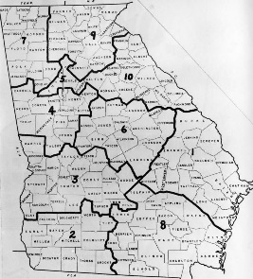
Massive resistance
The Georgia legislature engaged in massive resistance to desegregation by passing regulations like the 1956 act that required the governor to close down integrated schools. A 1960 investigation by the state-appointed Sibley Commission determined that 60% of Georgians supported dismantling the state’s public school system to maintain segregation. Most Floyd County residents, however, wanted to keep the schools open.

Slide 4
1964 Civil rights act
The Rome NAACP petitioned the school board to integrate the city’s schools following passage of the 1964 Civil Rights Act. The gradual desegregation of Rome’s public schools began in 1965. Yet in 1967, the U.S. Department of Health, Education, and Welfare declared that Rome’s integration efforts still left 75% of students attending racially-identifiable schools.
Mary T. Banks Elementary School, Rome, GA, 1950

Slide 5
Rome Integration expanded
Although the Rome School System increased its integration efforts by closing the predominately African American-attended Main High School in 1969, it became one of 83 school districts in Georgia sued that year by the Department of Justice for failure to desegregate quickly. The court order monitoring Rome’s integration efforts was finally lifted in 2008.
On May 8, 2007, Main High School, the historic school for African Americans in Rome, was rededicated as the Kelsey-Aycock-Burrell Center.

Slide 6
For further information
Civil Rights in Rome, Georgia - https://sites.berry.edu/civilrights/

