Slide 1
Chapter 1
Principles of Biochemistry

Slide 2
1.1 What Is Biochemistry?
Biochemistry aims to explain biological processes at the molecular and cellular levels.

Slide 3
Biochemistry: An Applied Science
Biochemistry uses advanced experimental methods to develop in vitro conditions for exploiting cellular processes and enzymatic reactions.

Slide 4
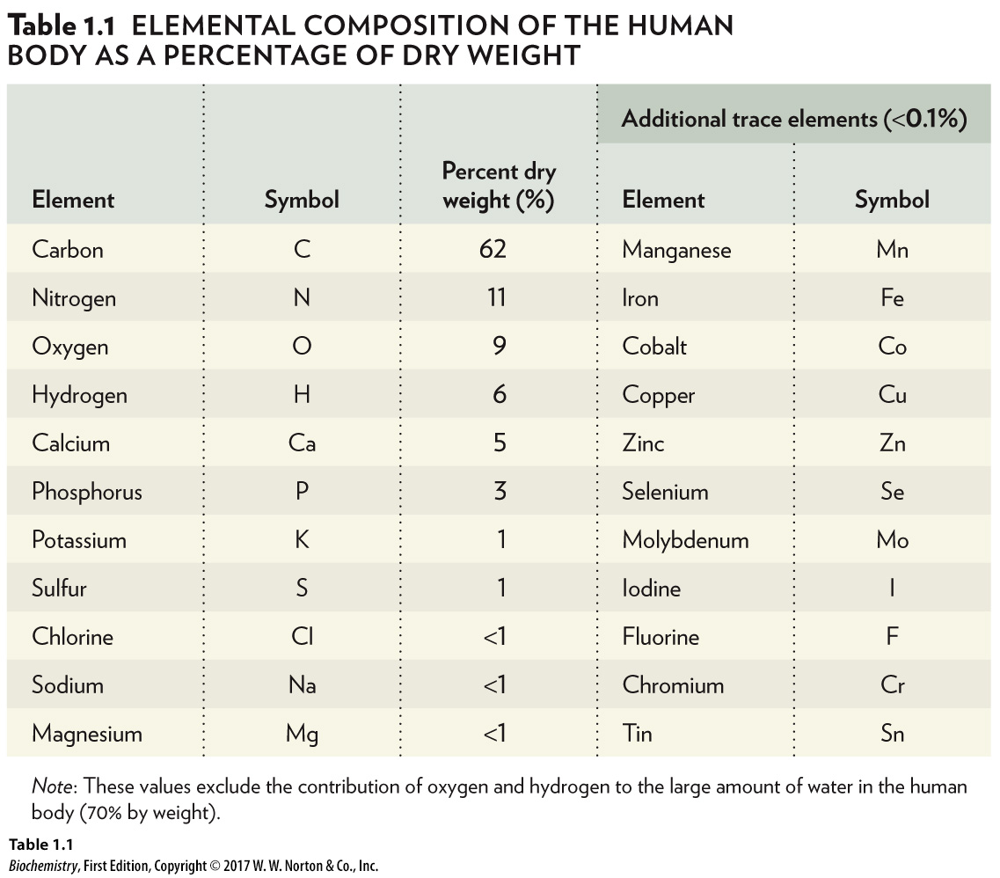
1.2 The Chemical Basis of Life: A Hierarchical Perspective
The foundation of this hierarchy includes chemical elements and functional groups.
Chemical elements:
Element | Symbol | Percent dry weight (%)
Carbon | Upper C | 62
Nitrogen | Upper N | 11
Oxygen | Upper O | 9
Hydrogen | Upper H | 6
Calcium | Upper C-a | 5
Phosphorus | Upper P | 3
Potassium | Upper K | 1
Sulfur | Upper S | 1
Chlorine | Upper C-l | Less than 1
Sodium | Upper N-a | Less than 1
Magnesium | Upper M-g | Less than 1
Manganese | Upper M-n | Less than 0.1
Iron | Upper F-e | Less than 0.1
Cobalt | Upper C-o | Less than 0.1
Copper | Upper C-u | Less than 0.1
Zinc | Upper Z-n | Less than 0.1
Selenium | Upper S-e | Less than 0.1
Molybdenum | Upper M-o | Less than 0.1
Iodine | Upper I | Less than 0.1
Fluorine | Upper F | Less than 0.1
Chromium | Upper C-r | Less than 0.1
Tin | Upper S-n | Less than 0.1

Slide 5
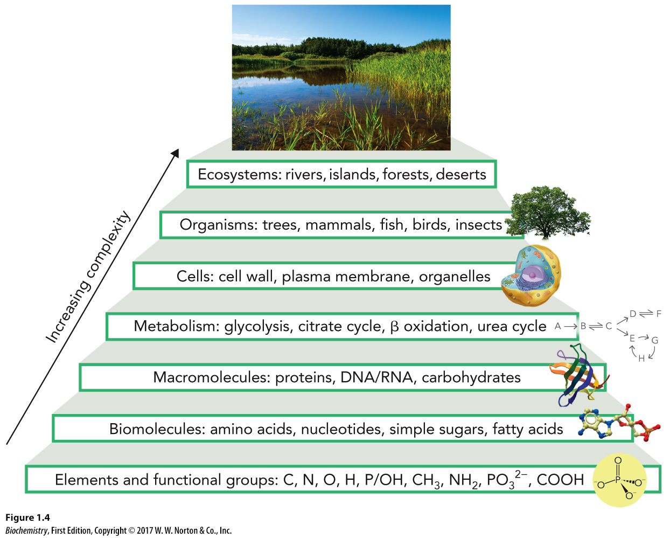
Organizational Hierarchy of Biochemistry

Slide 6
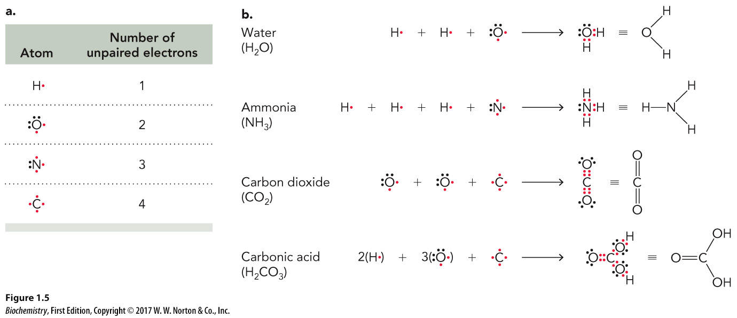
Chemical Bonding Observed in Biochemistry
The most common carbon bonds are C-C, C=C, C-H, C=O, C-N, C-S, and C-O.
Atom | Number of unpaired electrons
The hydrogen symbol with a single red dot on the right side of the atom. | 1
The oxygen symbol with two paired electrons at the top, two paired electrons on the left, one unpaired electron on the left and one unpaired electron on the bottom. | 2
The nitrogen symbol with two paired electrons at the left, one unpaired electrons on the top, one unpaired electron on the left and one unpaired electron on the bottom. | 3
The carbon symbol with one unpaired electron on the top, one unpaired electron on the left, one unpaired electron on the bottom and one unpaired electron on the right. | 4

Slide 7
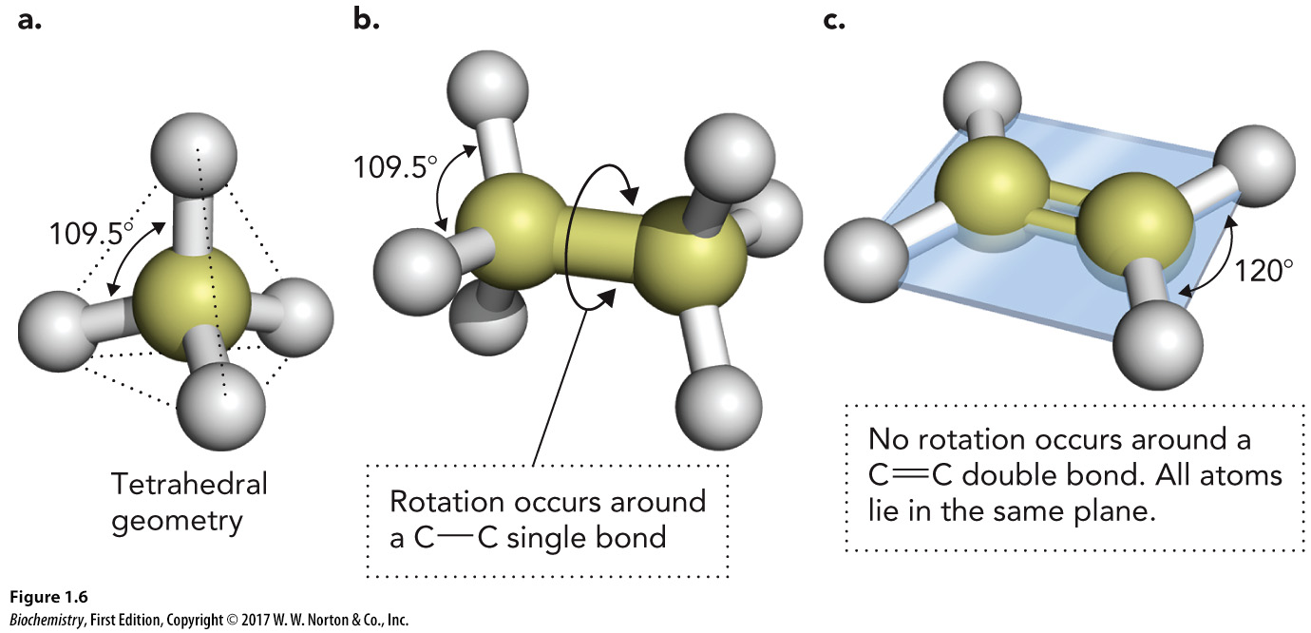
Molecular Geometry Revisited
A carbon atom can bind up to four single bonds to form a tetrahedron
The rotation around a single bond is very easy due to its sigma bond, while a carbon-carbon double bond includes a pi bond and rotation is not possible without breaking this pi bond.

Slide 8
Trace Elements
In addition to the elements observed in Table 1.1, trace elements are used as cofactors in proteins and are required for life.
These elements are required in smaller (“trace”) amounts.
These elements include:

Slide 9
Essential Ions
Play a key role in cell signaling and neurophysiology
Include:

Slide 10
Functional Groups
Play an important role in structure and function of biomolecules

Slide 11
Biomolecules, Part 1
Four major types:

Slide 12
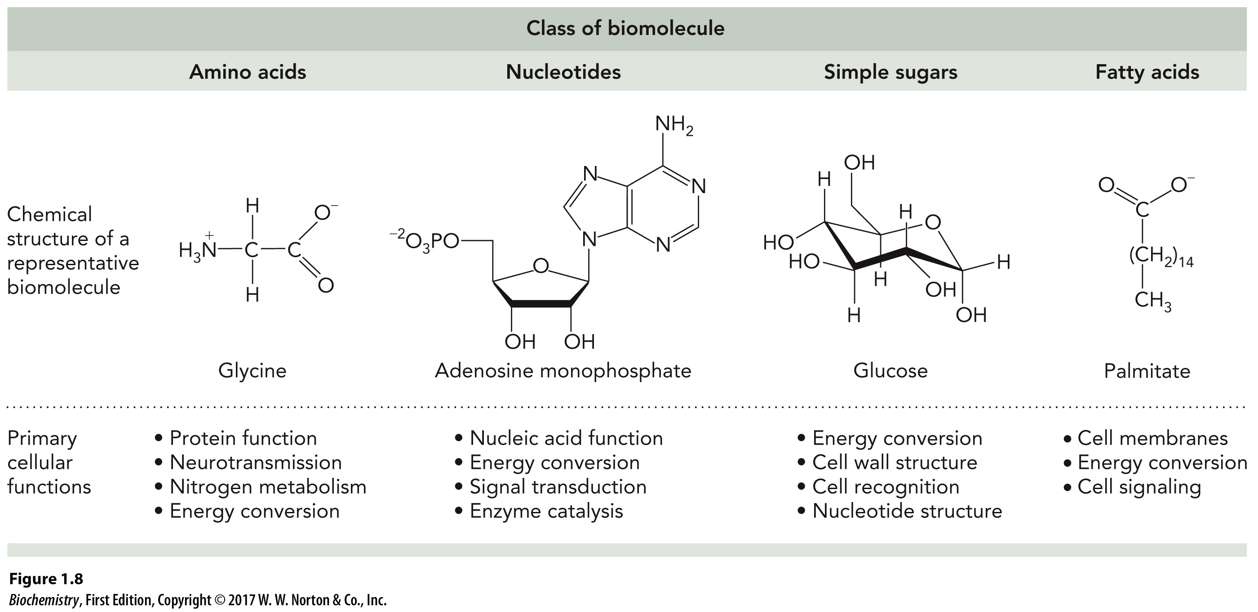
Biomolecules, Part 2
Primary cellular function
Amino acid
Protein function
Neurotransmission
Nitrogen metabolism
Energy conversion
Nucleotides
Nucleic acid function
Energy conversion
Signal transduction
Enzyme catalysis
Simple sugar
Energy conversion
Cell wall structure
Cell recognition
Nucleotide structure
Fatty acid
Cell membranes
Energy conversion
Cell signaling

Slide 13
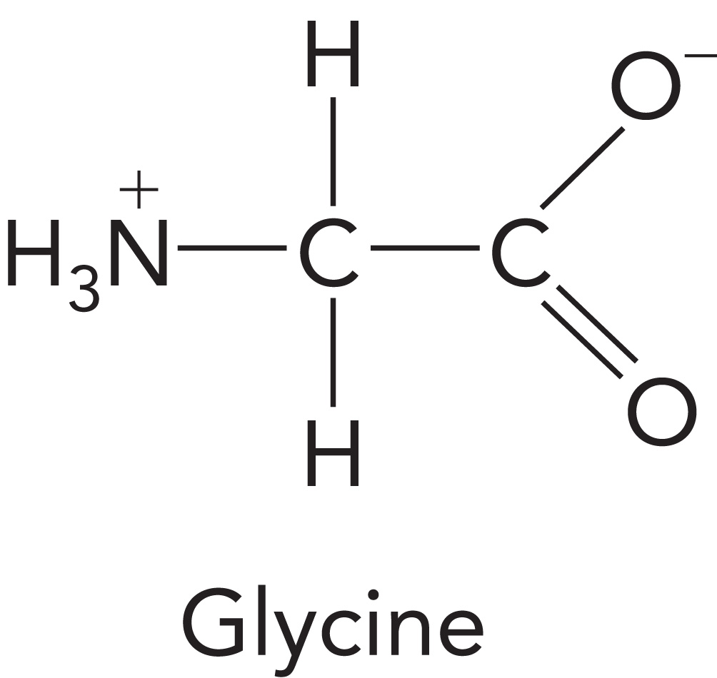
Amino Acids

Slide 14
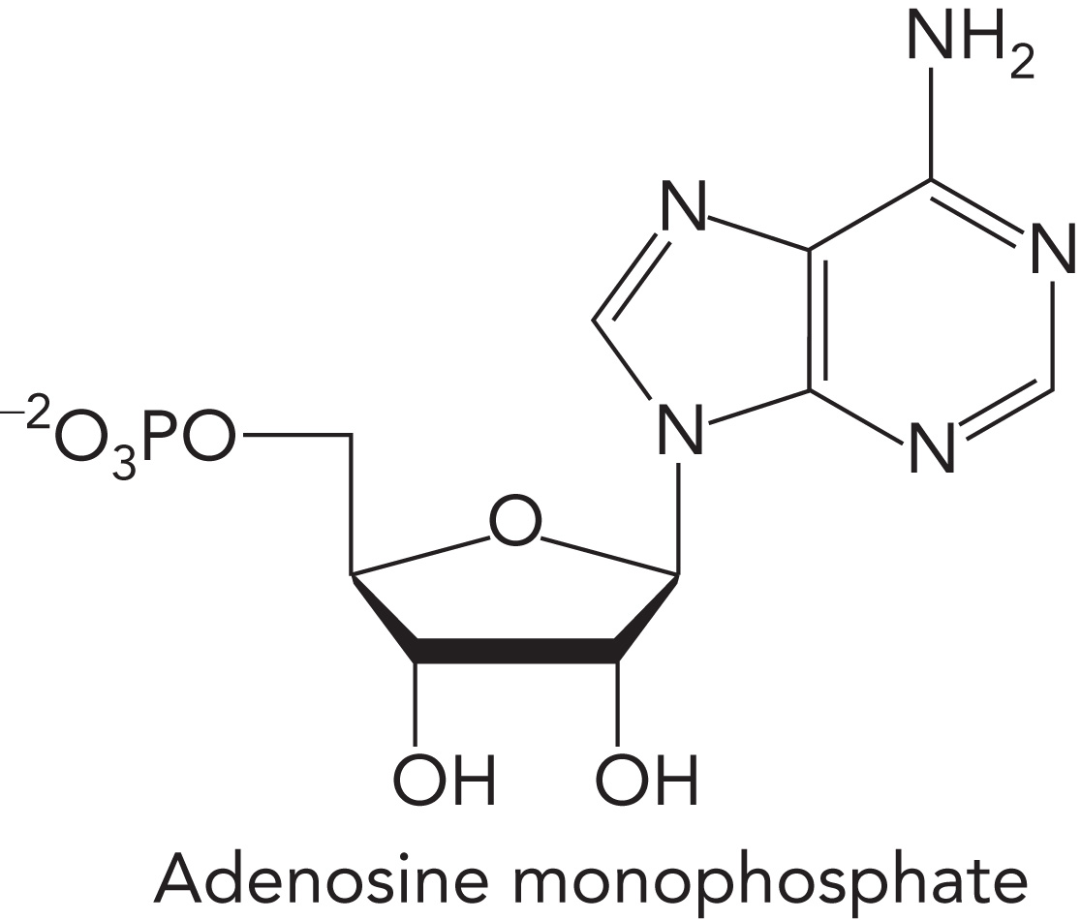
Nucleotides

Slide 15
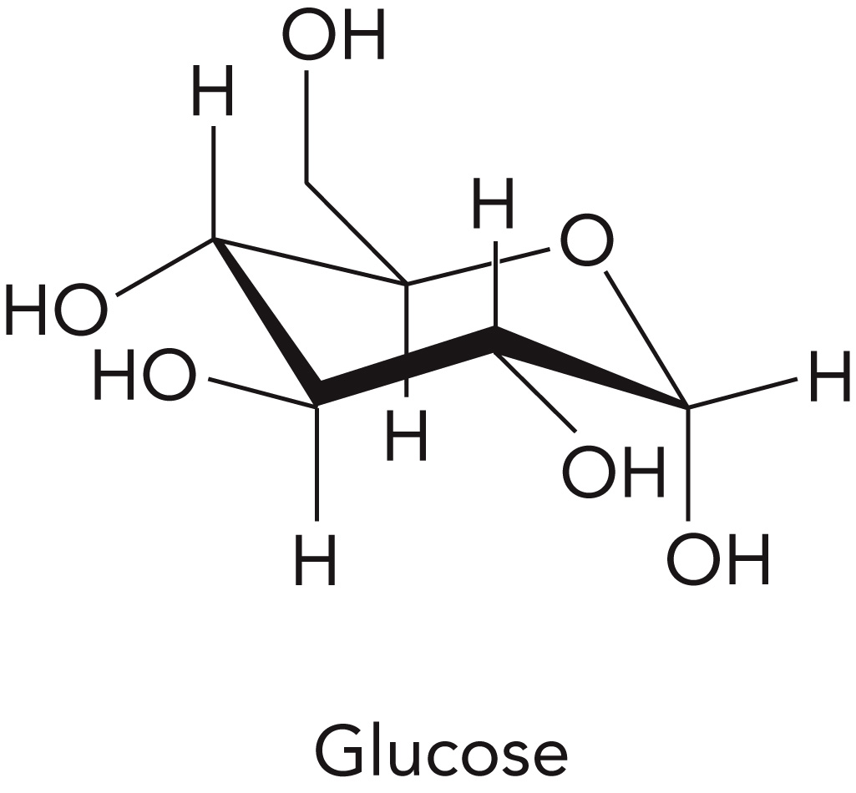
Simple Sugars

Slide 16
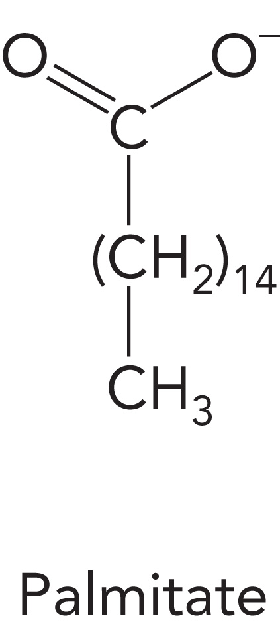
Fatty Acids

Slide 17
Saturated vs. Polyunsaturated Fatty Acids

Slide 18
Macromolecules
Higher end structural form of biomolecules
Include:

Slide 19
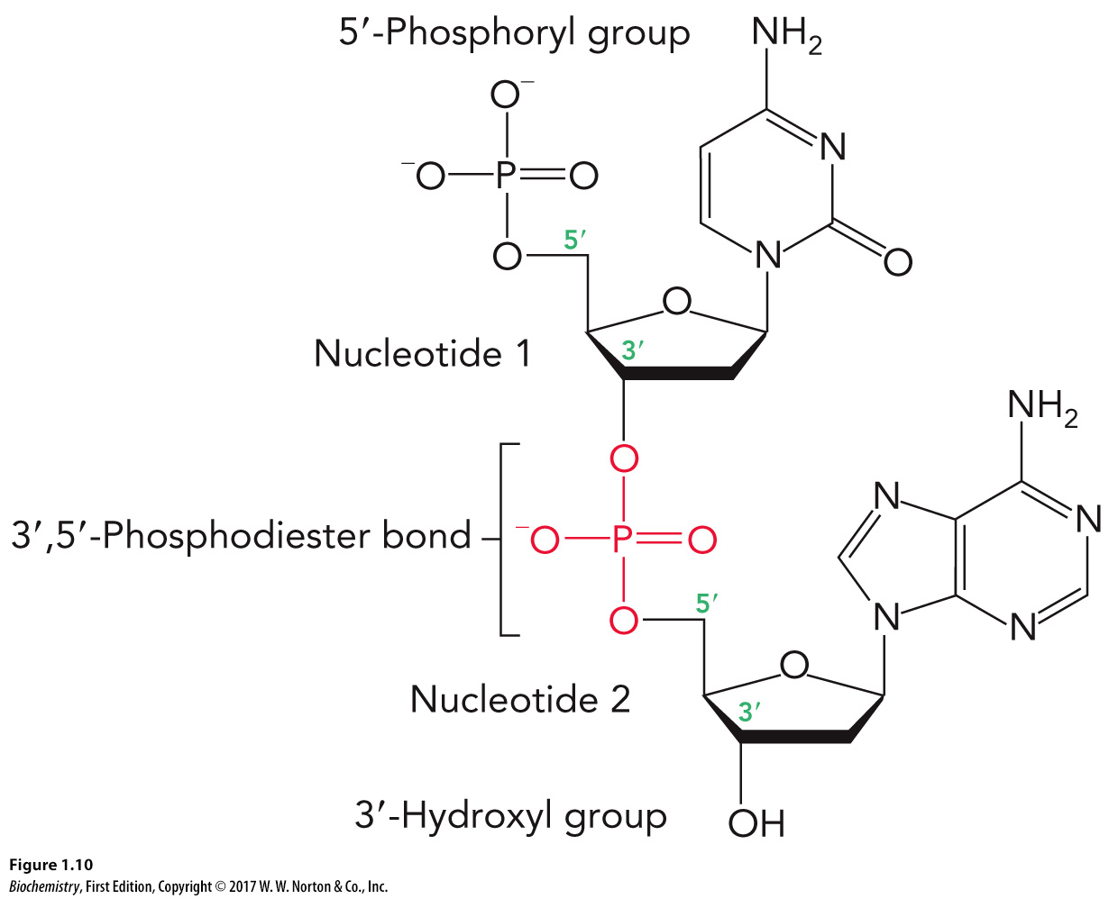
Polymers in Macromolecules: Nucleic Acids

Slide 20
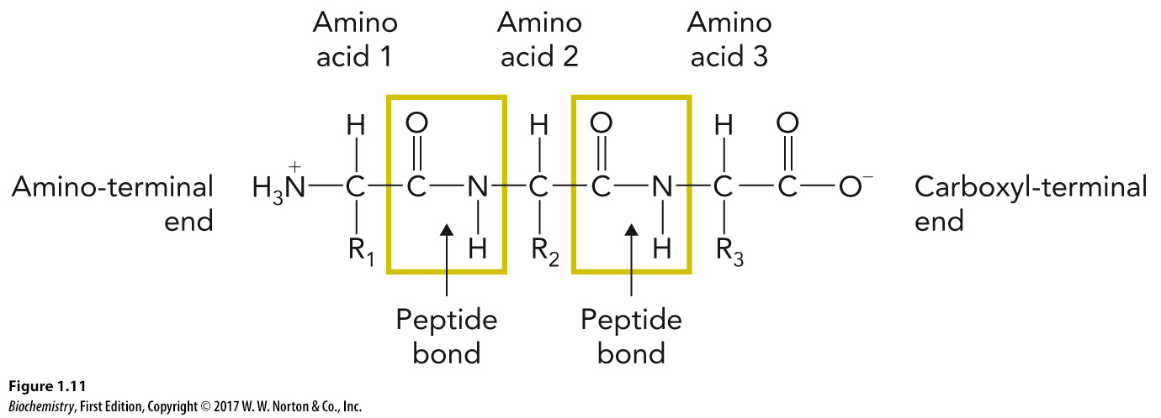
Polymers in Macromolecules: Proteins
Covalently linked amino acids
Also known as polypeptides
R = different amino acid side chains

Slide 21
Polymers in Macromolecules: Polysaccharides

Slide 22
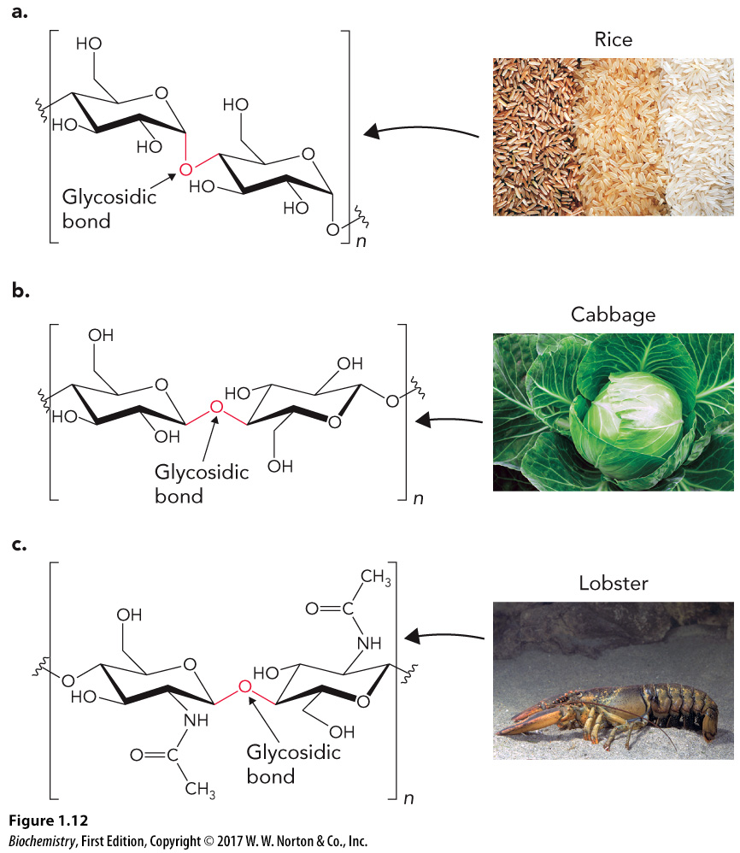
Various Examples of Polysaccharides

Slide 23
Metabolic Pathways
Enable cells to coordinate and control complex biochemical processes in response to available energy

Slide 24
Metabolic Pathway Terminology
Metabolites
Metabolic flux

Slide 25
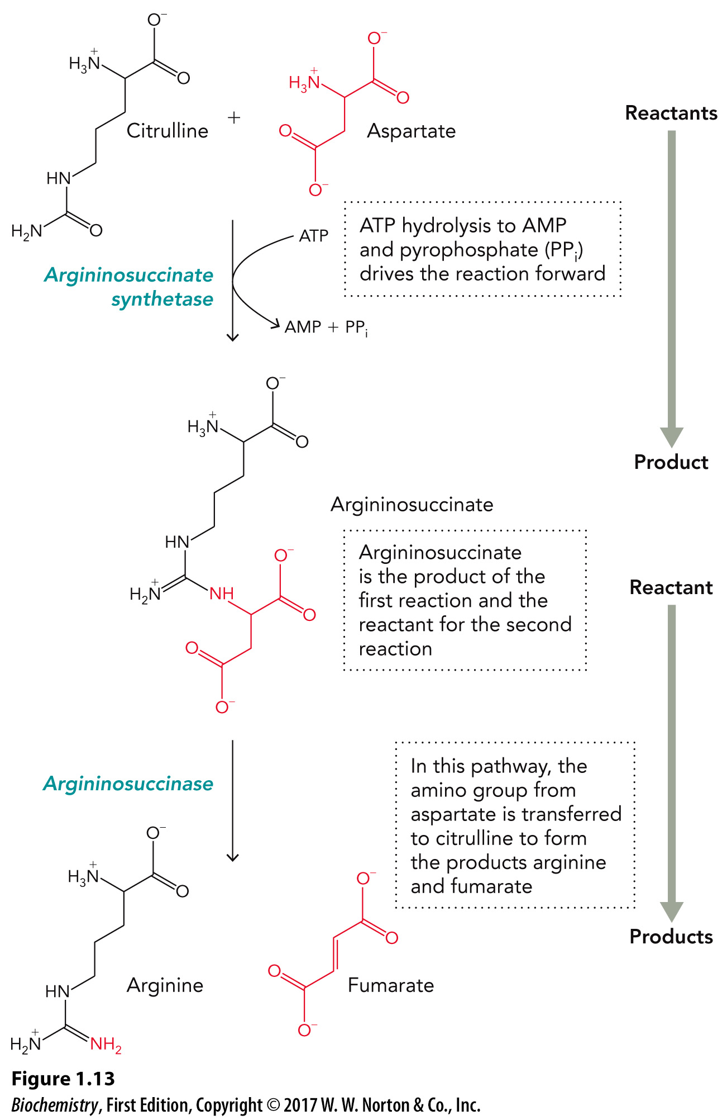
Metabolic Pathway Example: The Urea Cycle

Slide 26
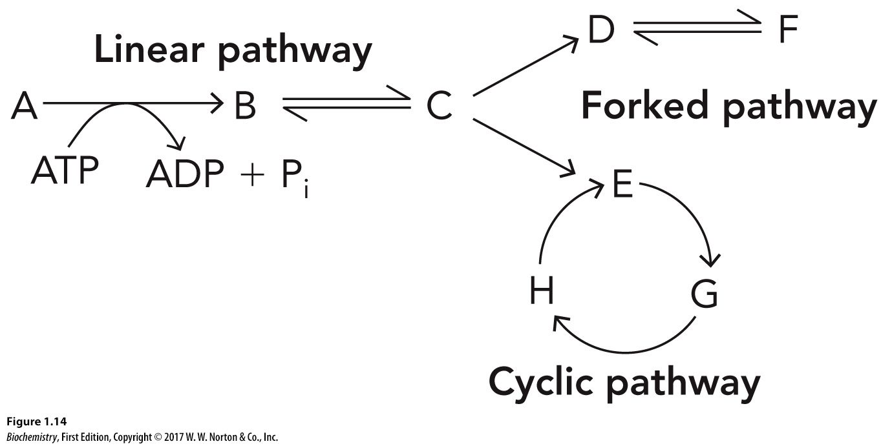
Metabolic Pathway Formats

Slide 27
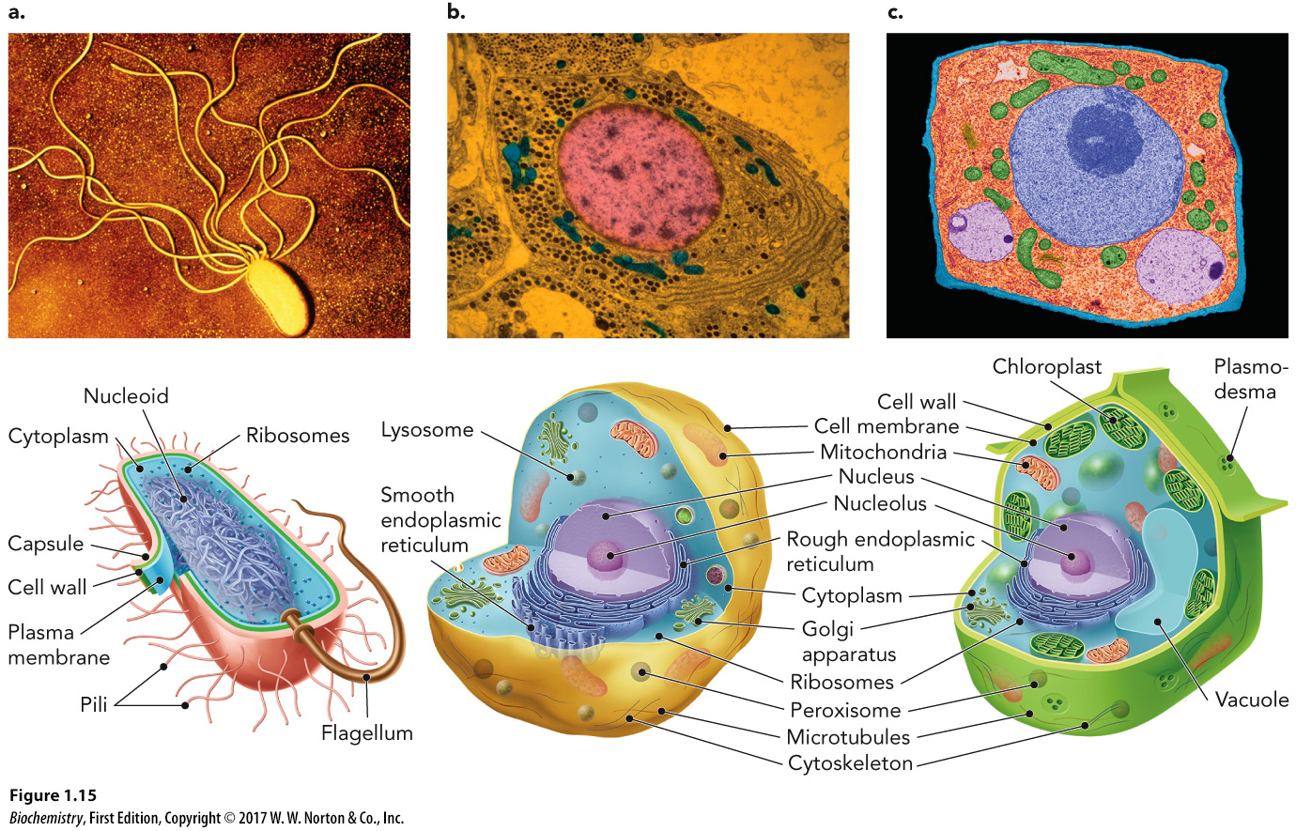
Cellular Structures

Slide 28
Key Cellular Structure Functions, Part 1
Genome
Nucleolus
Ribosomes

Slide 29
Key Cellular Structure Functions, Part 2
Mitochondria
Peroxisomes and lysosomes
Endoplasmic reticulum
Golgi apparatus

Slide 30
Cell Specialization
A higher level of organizational complexity
Allows multicellular organisms to exploit their environment through signal transduction

