Slide 1
Chapter 2
Physical Biochemistry

Slide 2
2.1 Energy Conversion in Biological Systems
Sunlight is the source of energy on Earth.
The laws of thermodynamics apply to biological processes.

Slide 3
Bioenergetics
Is defined as energy conversion in biological system

Slide 4
The Importance of Chemical Energy
Chemical energy is used by organisms to perform work.

Slide 5
Types of Work
Energy conversion in living systems is required for three types of work:

Slide 6
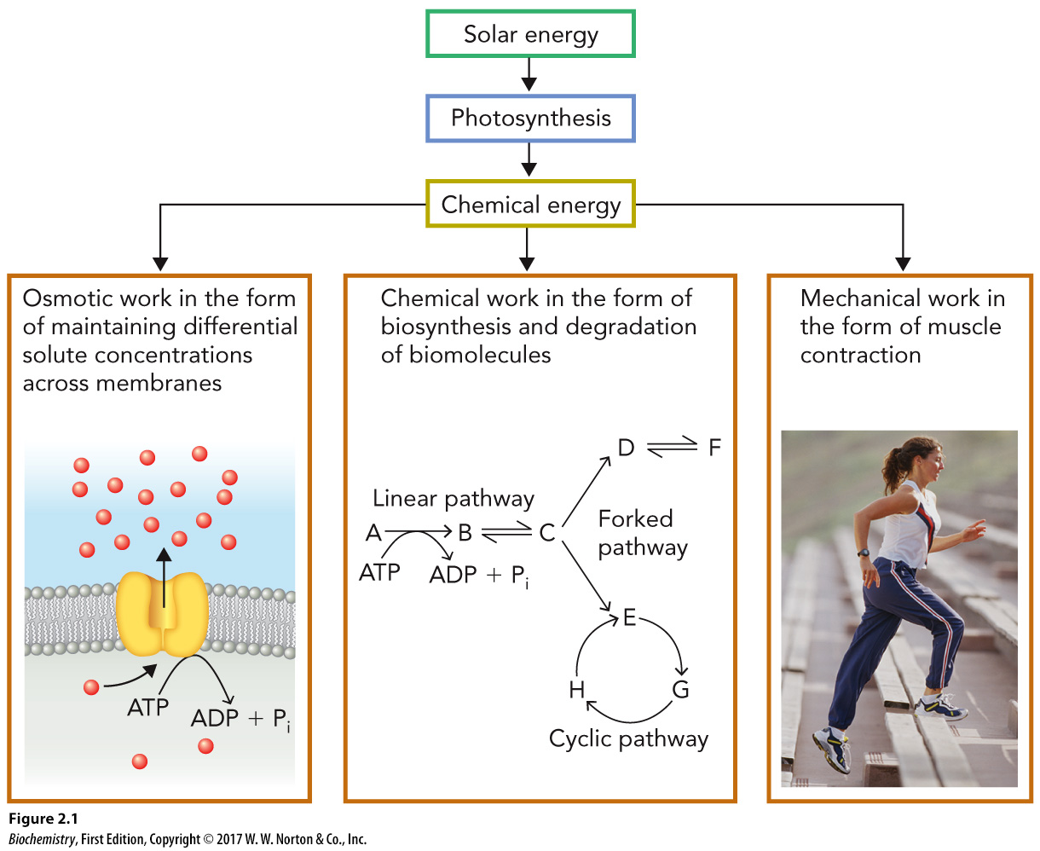
Description of the Different Types of Energy

Slide 7
Homeostasis vs. Equilibrium
Homeostasis
Equilibrium

Slide 8
Redox Reactions
A series of linked oxidation–reduction reactions

Slide 9
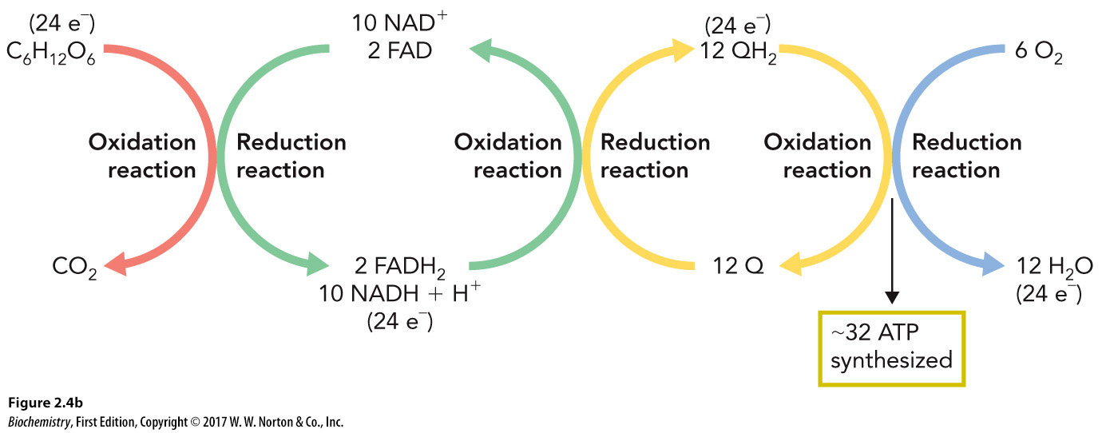
Reduction vs. Oxidation
Reduction
Oxidation

Slide 10
Thermodynamic Terms
System
Collection of matter in a defined space
Surroundings
All the space not included in the system

Slide 11
Various Types of Systems
Open
Closed
Isolated

Slide 12
Laws of Thermodynamics, Part 1
First law

Slide 13
Laws of Thermodynamics, Part 2
Second law

Slide 14
Varying Descriptions of Enthalpy
Exothermic
Endothermic

Slide 15
Entropy
A measure of disorder

Slide 16
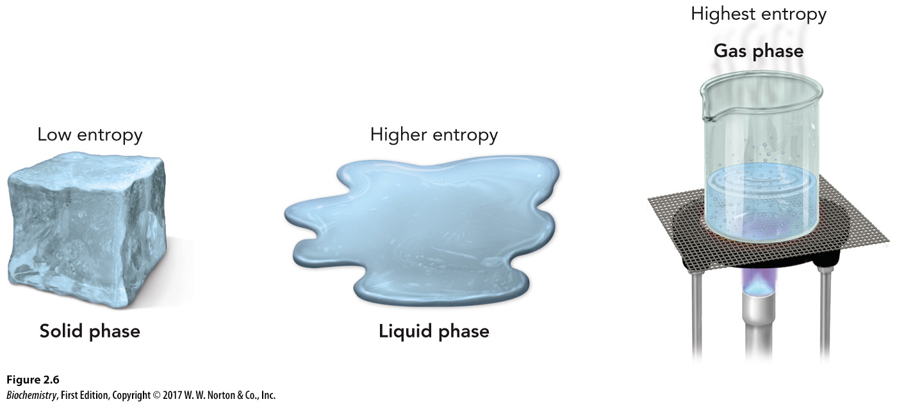
An Example of Entropy

Slide 17
Gibbs Free Energy (G)
The difference between enthalpy (H) and the entropy (S) of a system at a given temperature
G = H – TS

Slide 18
Exergonic vs. Endergonic Reactions
Exergonic
Endergonic

Slide 19
Standard Free Energy Change (ΔG°)
Can be used to compare chemical reactions under a defined set of conditions
ΔG˚ = ΔH˚ – TΔS˚

Slide 20
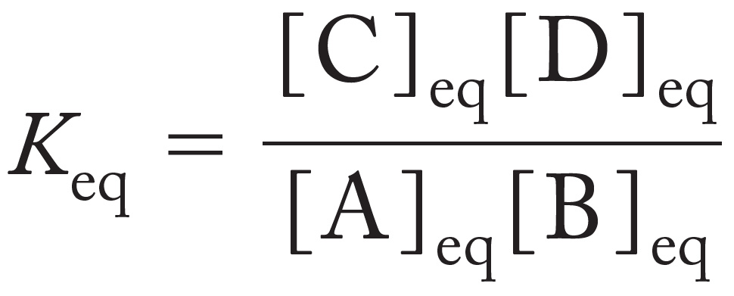
Relationship Between ΔG° and K_{eq}
The standard Gibbs free energy is directly related to the equilibrium constant, K_{eq}.
ΔG˚ = –RTlnK_{eq}
For the reaction,

Slide 21
Biochemical Standard Conditions (ΔG°′)
The conditions at standard free energy change (ΔG°) remain, but also these other conditions occur:

Slide 22
Coupled Reactions
If a reaction is endergonic, it can be coupled to an exergonic reaction to become overall favorable.

Slide 23
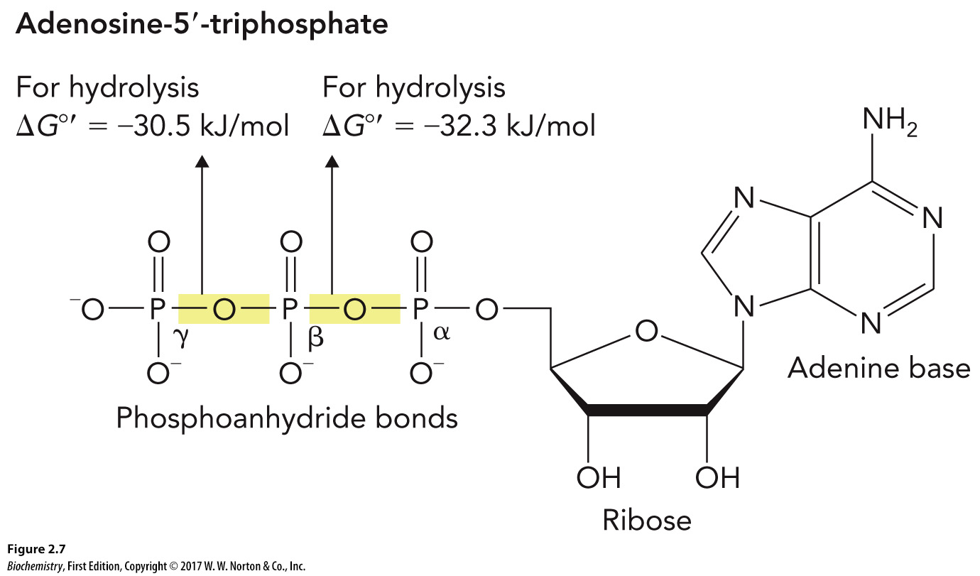
Energy Charge (EC)
The relationship between [ATP], [ADP], and [AMP] at any given time in the cell

Slide 24
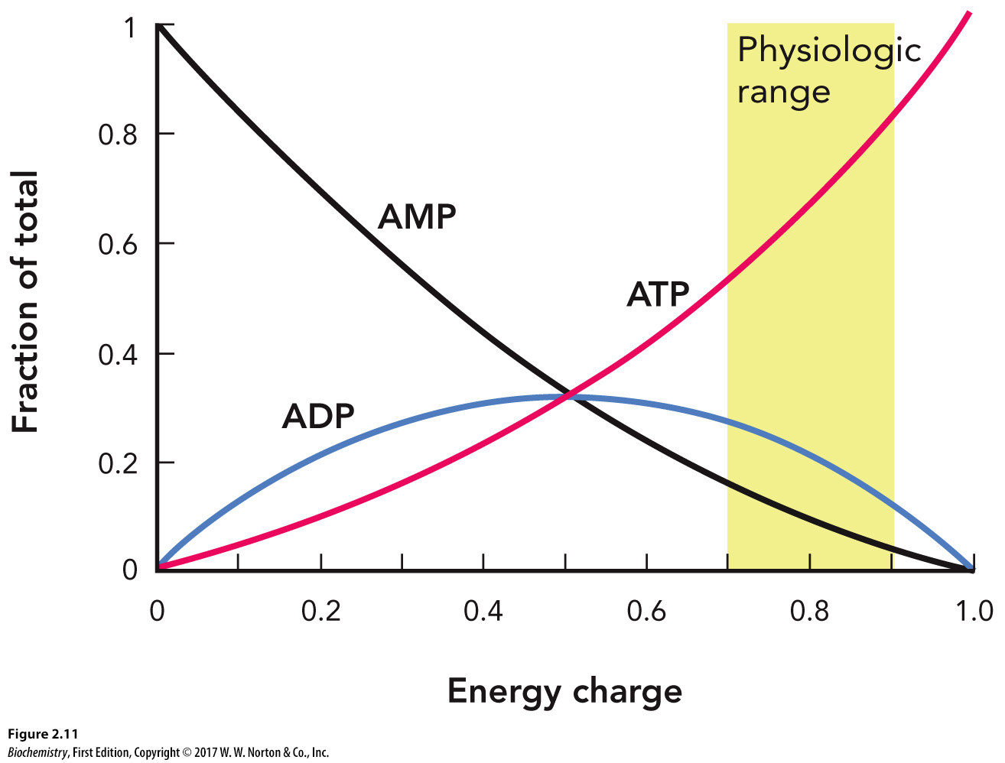
Energy Charge as a Function of [ATP], [ADP], and [AMP]

Slide 25
Catabolic Pathways
Convert energy-rich compounds into energy-depleted compounds

Slide 26
Anabolic Pathway
Reactions that produce biomolecules from smaller molecules

Slide 27
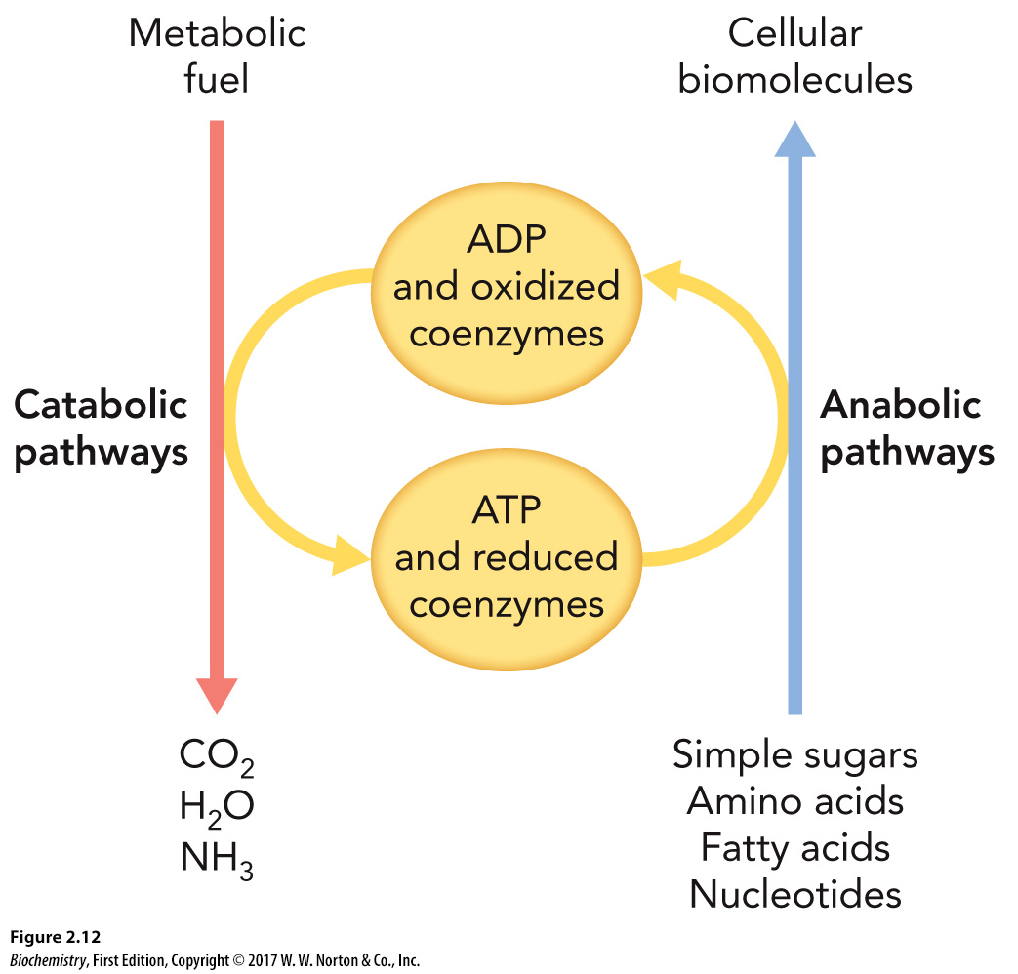
Catabolic and Anabolic Balanced Flux

Slide 28
2.2 Water Is Critical for Life Processes
Hydrogen bonding is responsible for the unique properties of water.

Slide 29
Water

Slide 30
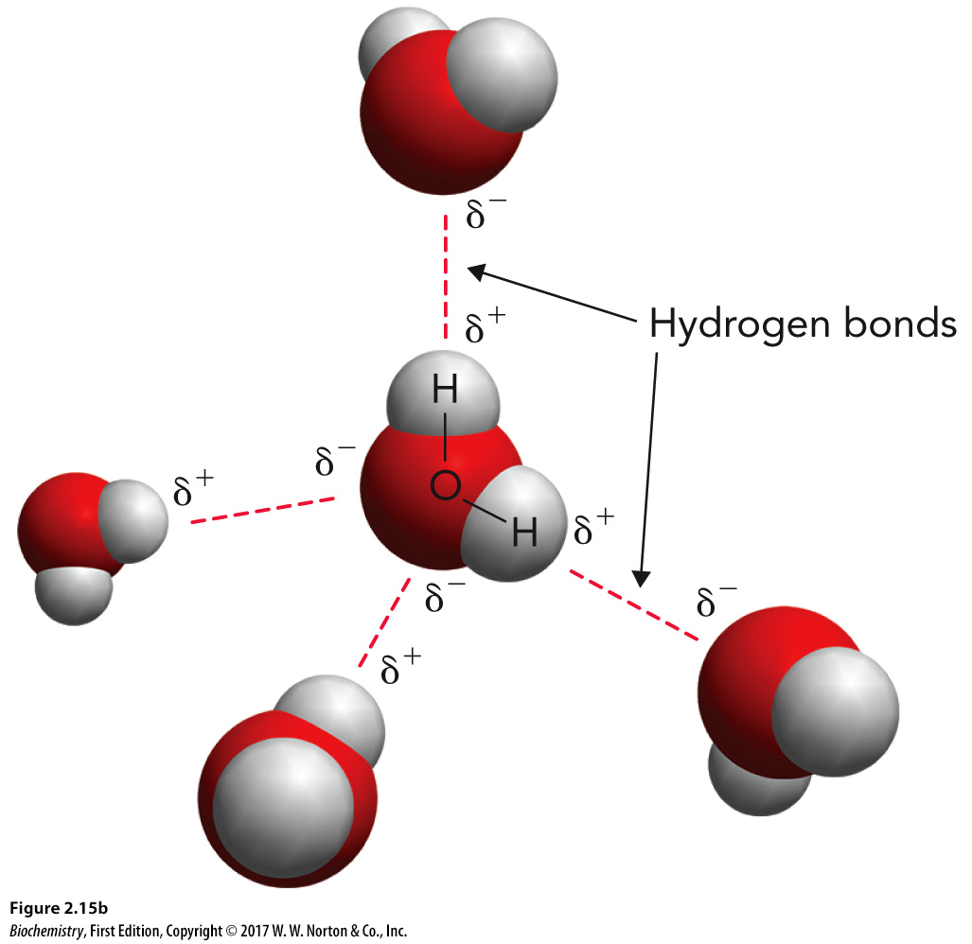
Polarity of Water

Slide 31
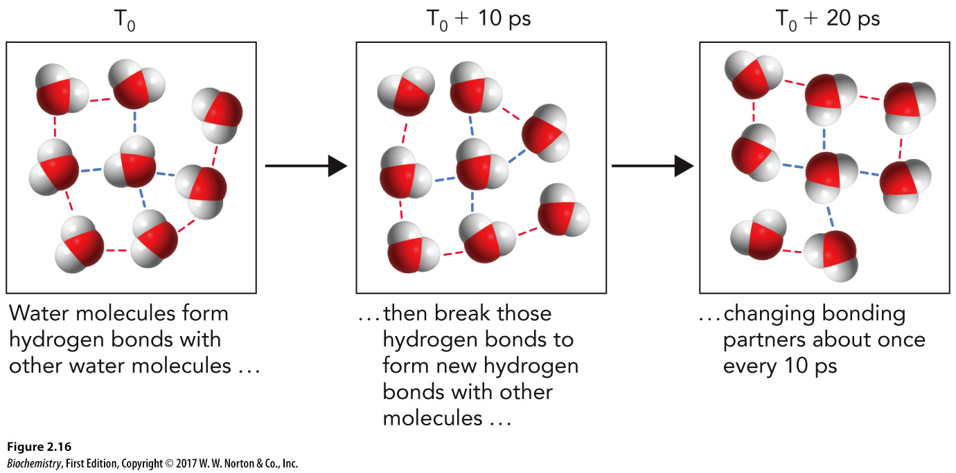
Hydrogen Bonding Capability of Water
Although this bonding is short-lived, each water molecule can form four hydrogen bonds.

Slide 32
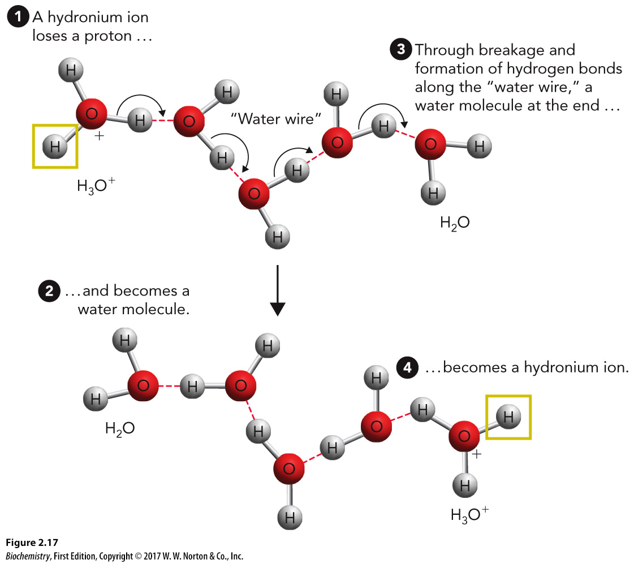
Electron Geometry of Water

Slide 33
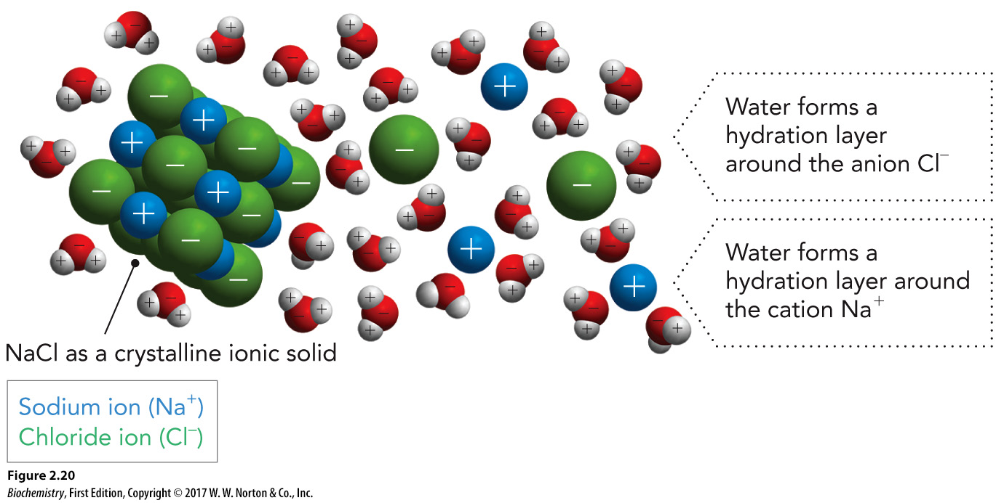
Water’s Role in Biomolecule Solubility

Slide 34
Weak Noncovalent Interactions in Biomolecules, Part 1
Hydrogen bonds
Ionic interactions

Slide 35
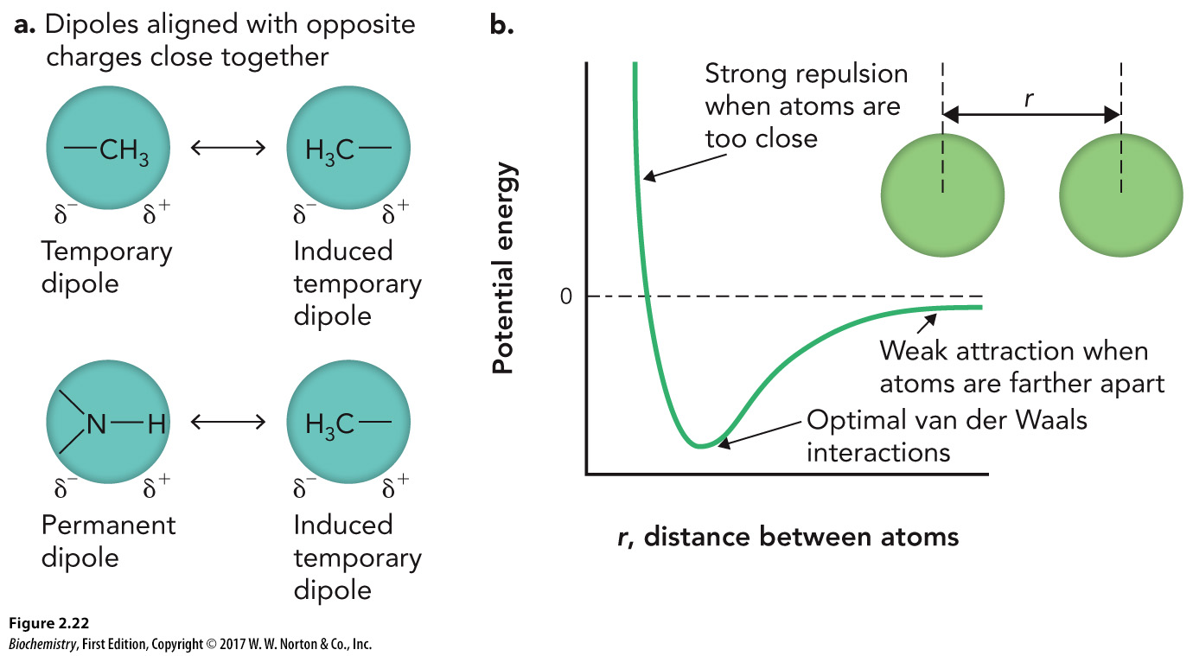
Weak Noncovalent Interactions in Biomolecules, Part 2
Van der Waals interactions

Slide 36
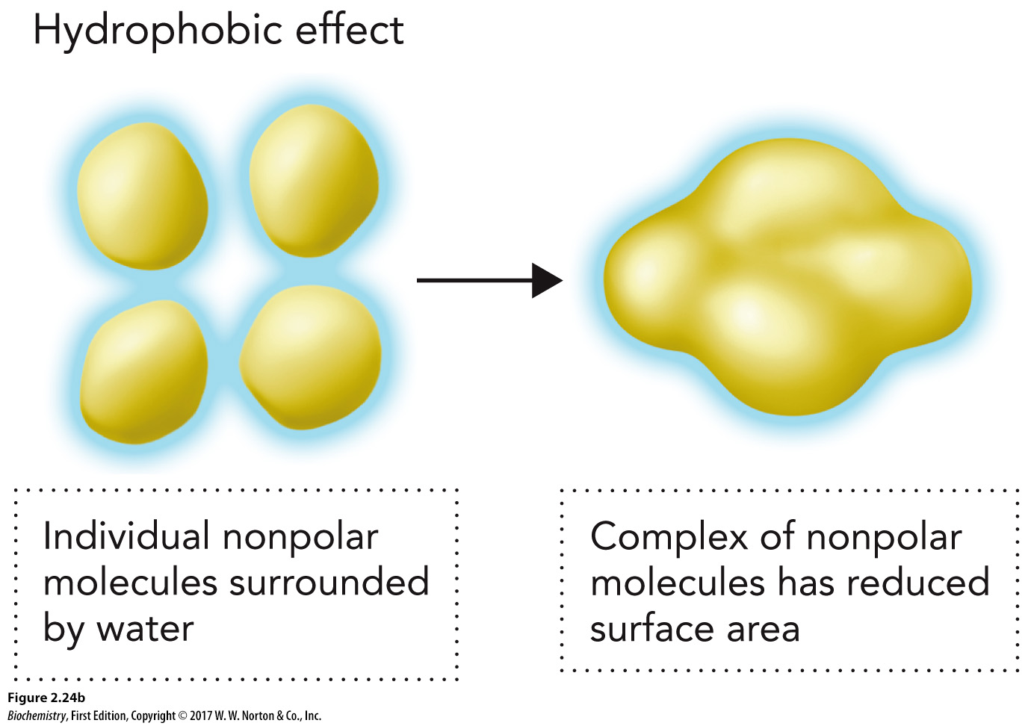
Weak Noncovalent Interactions in Biomolecules, Part 3
Hydrophobic effects

Slide 37
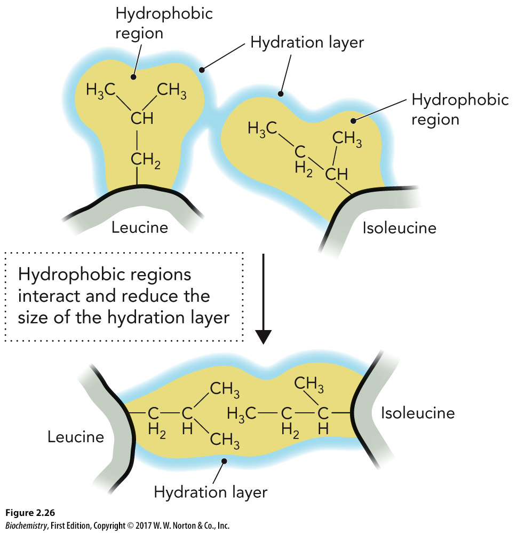
Hydrophobic Effects

Slide 38
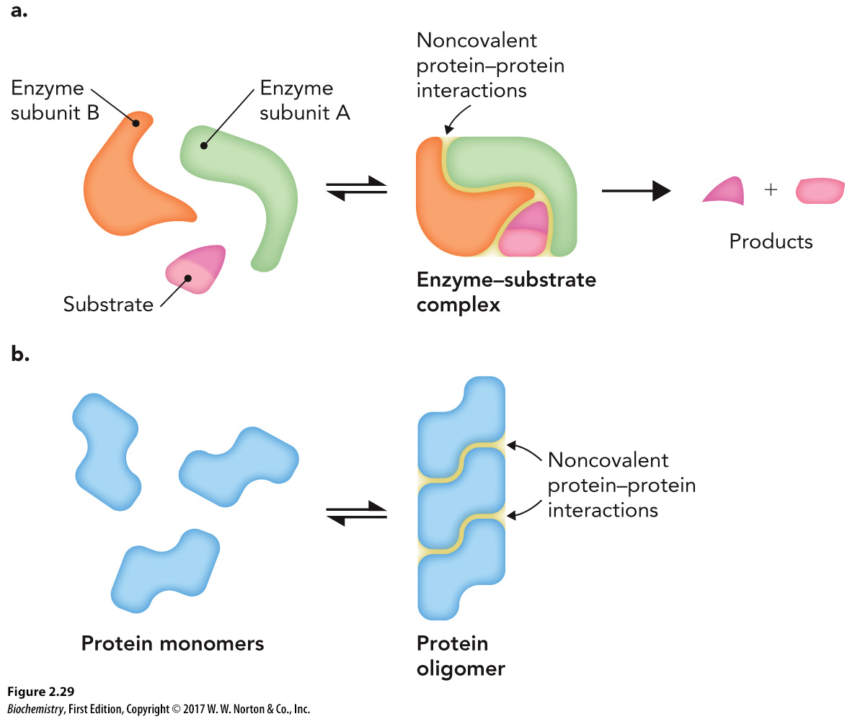
Noncovalent Weak Interaction

Slide 39
Ionization of Water

Slide 40
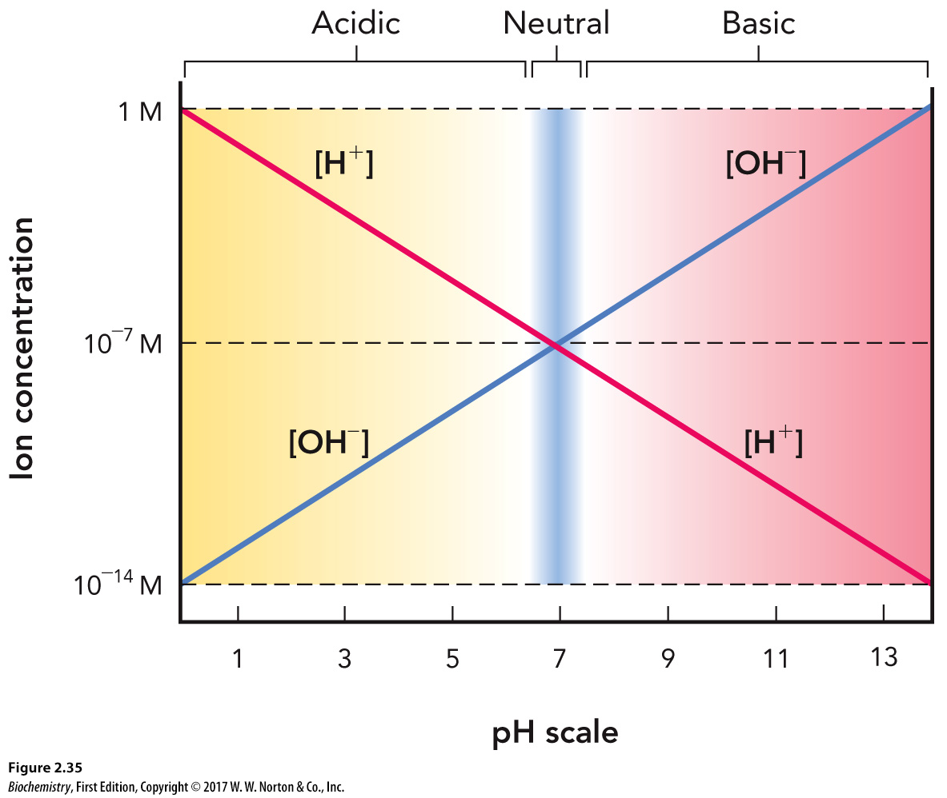
The pH Scale
pH refers to the [H⁺] and is a measure of acidity.
Buffers are aqueous solutions that resist small changes in pH.

Slide 41
Henderson-Hasselbalch Equation
This equation shows the relationship between the pH and the pK_{a}.

Slide 42
