Slide 1
Chapter 4
Protein Structure

Slide 2
4.1 Proteins Are Polymers of Amino Acids
Amino acids are covalently linked together through amide (peptide) bonds to form proteins (polypeptides).
Peptides
Short polypeptides
Usually less than 40 amino acids in length
Also called oligopeptides

Slide 3
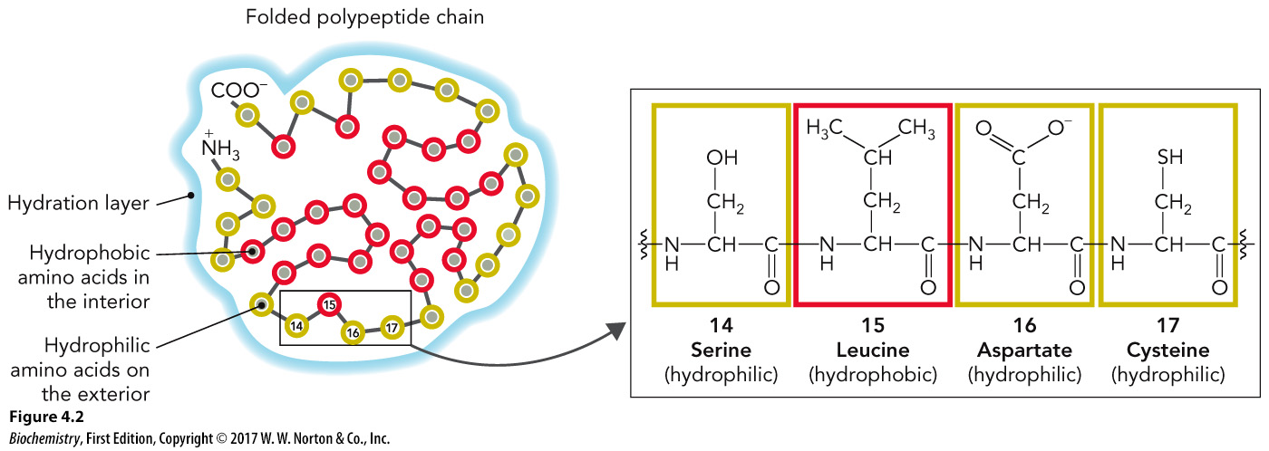
Hydrophobic Effect, Part 1

Slide 4
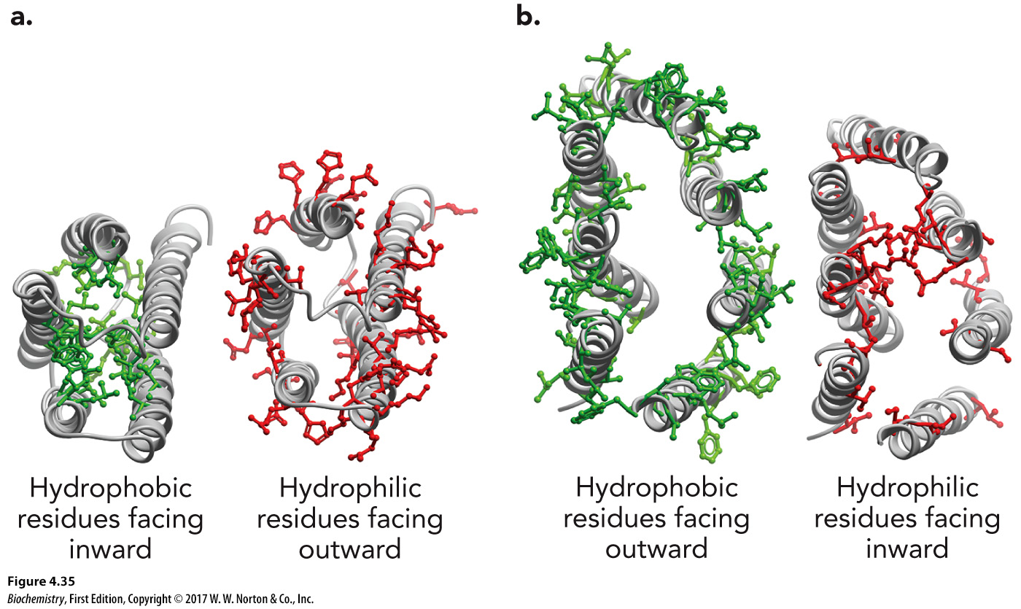
Hydrophobic Effect, Part 2

Slide 5
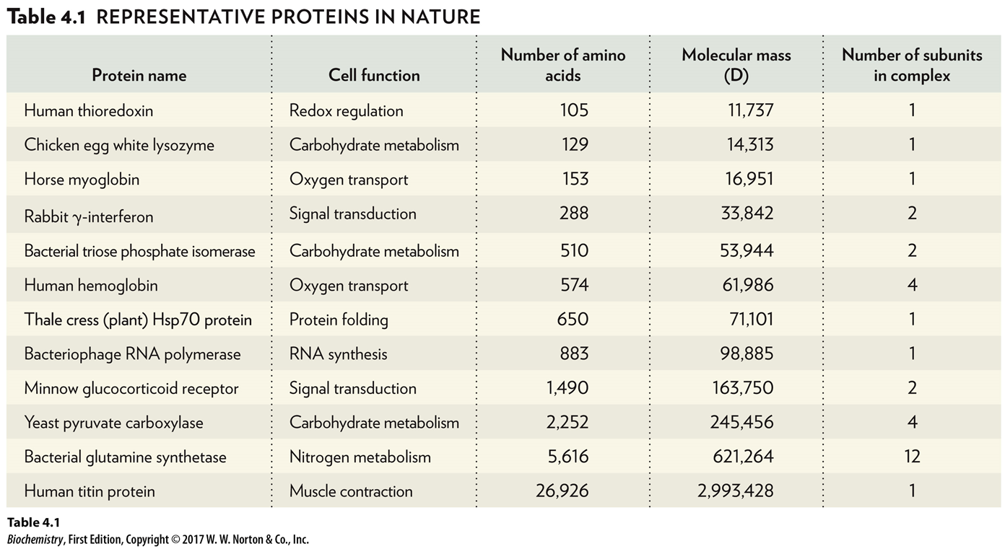
Representative Proteins in Nature
Protein name | Cell function | Number of amino acids | Molecular mass (D) | Number of subunits in complex
Human thioredoxin | Redox regulation | 105 | 11,737 | 1
Chicken egg white lysozyme | Carbohydrate metabolism | 129 | 14,313 | 1
Horse myoglobin | Oxygen transport | 153 | 16,951 | 1
Rabbit γ-interferon | Signal transduction | 288 | 33,842 | 2
Bacterial triose phosphate isomerase | Carbohydrate metabolism | 510 | 53,944 | 2
Human hemoglobin | Oxygen transport | 574 | 61,986 | 4
Thale cress (plant) Hsp70 protein | Protein folding | 650 | 71,101 | 1
Bacteriophage RNA polymerase | RNA synthesis | 883 | 98,885 | 1
Minnow glucocorticoid receptor | Signal transduction | 1,490 | 163,750 | 2
Yeast pyruvate carboxylase | Carbohydrate metabolism | 2,252 | 245,456 | 4
Bacterial glutamine synthetase | Nitrogen metabolism | 5,616 | 621,264 | 12
Human titin protein | Muscle contraction | 26,926 | 2,993,428 | 1

Slide 6
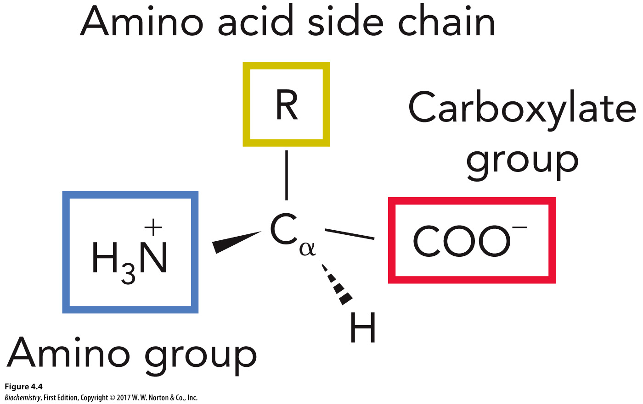
Amino Acid Structure

Slide 7
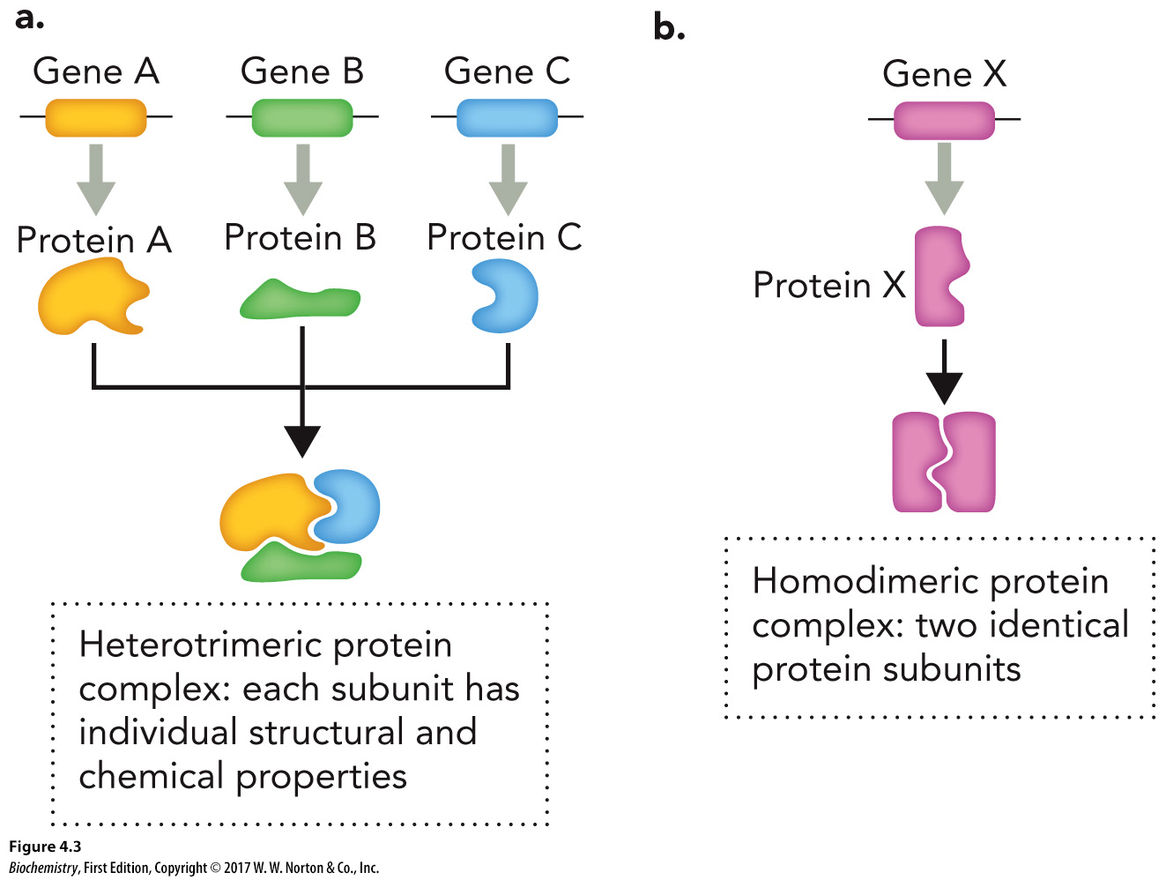
Structure and Function

Slide 8
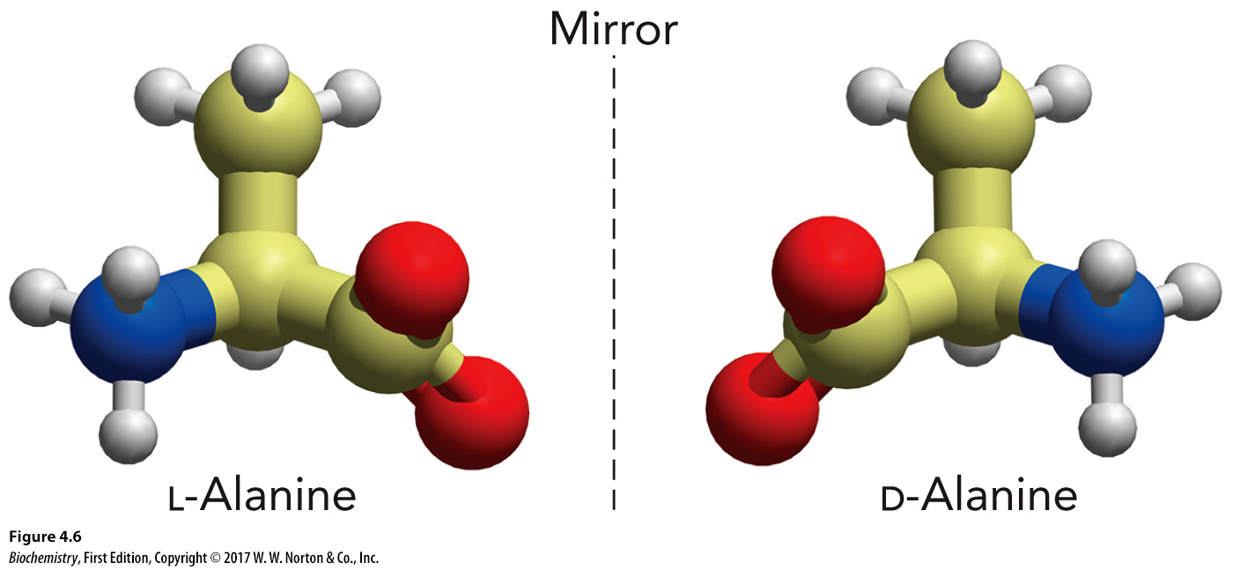
Amino Acids Are Chiral

Slide 9
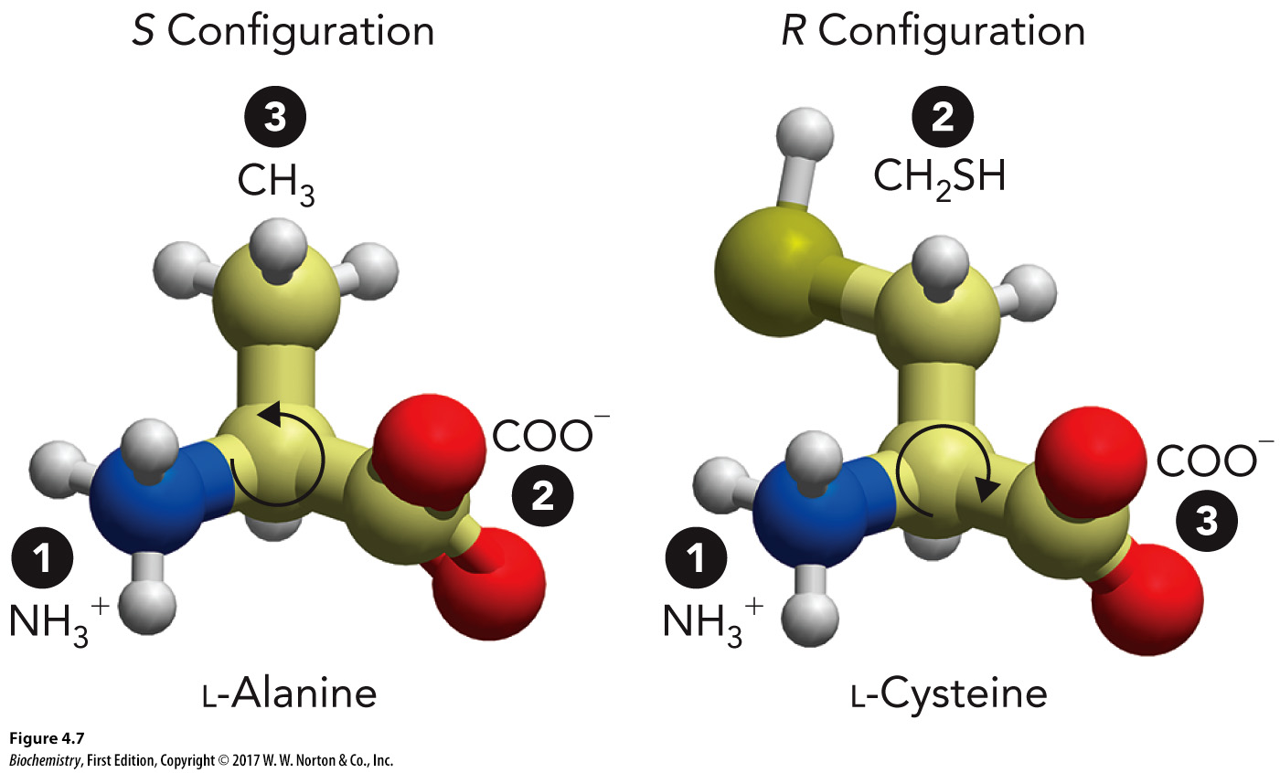
Amino Acid Isomers and Configuration

Slide 10
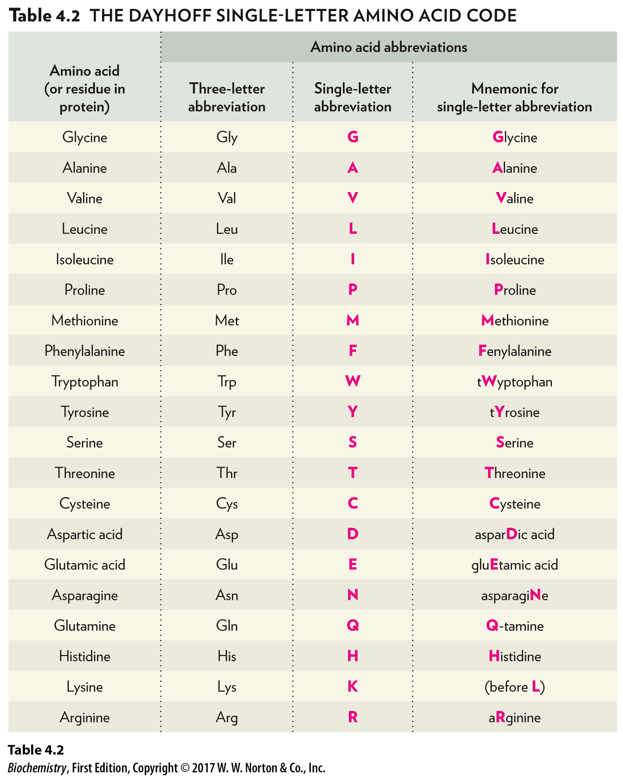
Amino Acid Abbreviations, Part 1
Amino acid (or residue in protein) | Three-letter abbreviation | Single-letter abbreviation | Mnemonic for single-letter abbreviation
Glycine | Gly | G | Glycine
Alanine | Ala | A | Alanine
Valine | Val | V | Valine
Leucine | Leu | L | Leucine
Isoleucine | Ile | I | Isoleucine
Proline | Pro | P | Proline
Methionine | Met | M | Methionine
Phenylalanine | Phe | F | Fenylalanine
Tryptophan | Trp | W | tWyptophan
Tyrosine | Tyr | Y | tYrosine
Serine | Ser | S | Serine
Threonine | Thr | T | Threonine
Cysteine | Cys | C | Cysteine
Aspartic acid | Asp | D | asparDic acid
Glutamic acid | Glu | E | gluEtamic acid
Asparagine | Asn | N | asparagiNe
Glutamine | Gln | Q | Q-tamine
Histidine | His | H | Histidine
Lysine | Lys | K | (before L)
Arginine | Arg | R | aRginine

Slide 11
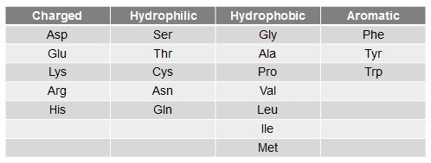
Amino Acid Classifications, Part 2
Charged | Hydrophilic | Hydrophobic | Aromatic
Asp, Glu, Lys, Arg, His | Ser, Thr, Cys, Asn, Gln | Gly, Ala, Pro, Val, Leu, Ile, Met | Phe, Tyr, Trp

Slide 12
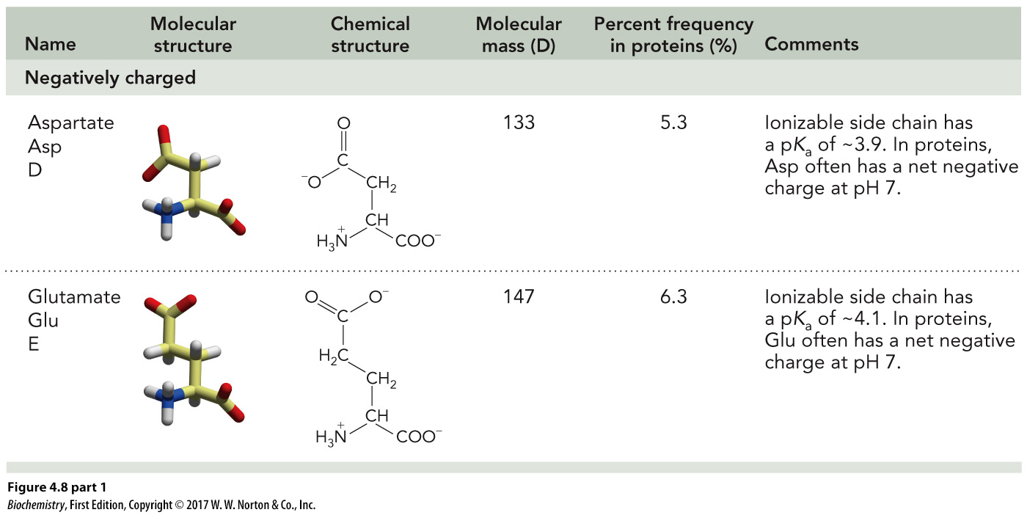
Charged Amino Acid Structures, Part 1
Name | Molecular structure | Chemical structure | Molecular mass (D) | Percent frequency in proteins (percent) | Comments
Negatively charged Aspartate Asp D | The molecular structure of aspartate shown in a three dimensional model. | The chemical structure of Aspartate has a molecular formula of Negative 1 Upper C 4 Upper H 6 Upper N Upper O 4. | 133 | 5.3 | lonizable side chain has a pK_{a} of approximately 3.9. In proteins, Asp often has a net negative charge at pH 7.
Negatively charged Glutamate Glu E | The molecular structure of glutamate shown in a three dimensional model. | The chemical structure of glutamate has a molecular formula of Negative 1 Upper C 5 Upper H 8 Upper N Upper O 4. | 147 | 6.3 | lonizable side chain has a pK_{a} of approximately 4.1. In proteins, Glu often has a net negative charge at pH 7.

Slide 13
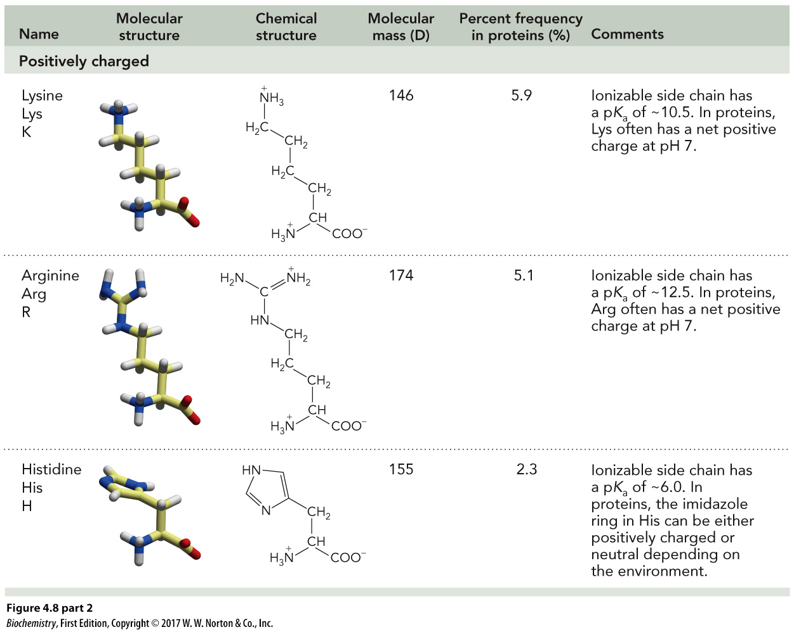
Charged Amino Acid Structures, Part 2
Name | Molecular structure | Chemical structure | Molecular mass (D) | Percent frequency in proteins (percent) | Comments
Positively charged Lysine Lys K | The molecular structure of lysine shown in a three dimensional model. | The chemical structure of lysine has a molecular formula of Positive 1 Upper C 6 Upper H 15 Upper N 2 Upper O 2. | 146 | 5.9 | lonizable side chain has a pK_{a} of approximately 10.5. In proteins, Lys often has a net positive charge at pH 7.
Positively charged Arginine Arg R | The molecular structure of arginine shown in a three dimensional model. | The chemical structure of arginine has a molecular formula of Positive 1 Upper C 6 Upper H 15 Upper N 4 Upper O 2. | 174 | 5.1 | lonizable side chain has a pK_{a} of approximately 12.5. In proteins, Arg often has a net positive charge at pH 7.
Positively charged Histidine His H | The molecular structure of histidine shown in a three dimensional model. | The chemical structure of histidine has a molecular formula of Positive 1 Upper C 6 Upper H 9 Upper N 3 Upper O 2. | 155 | 2.3 | lonizable side chain has a pK_{a} of approximately 6.0. In proteins, the imidazole ring in His can be either positively charged or neutral depending on the environment.

Slide 14
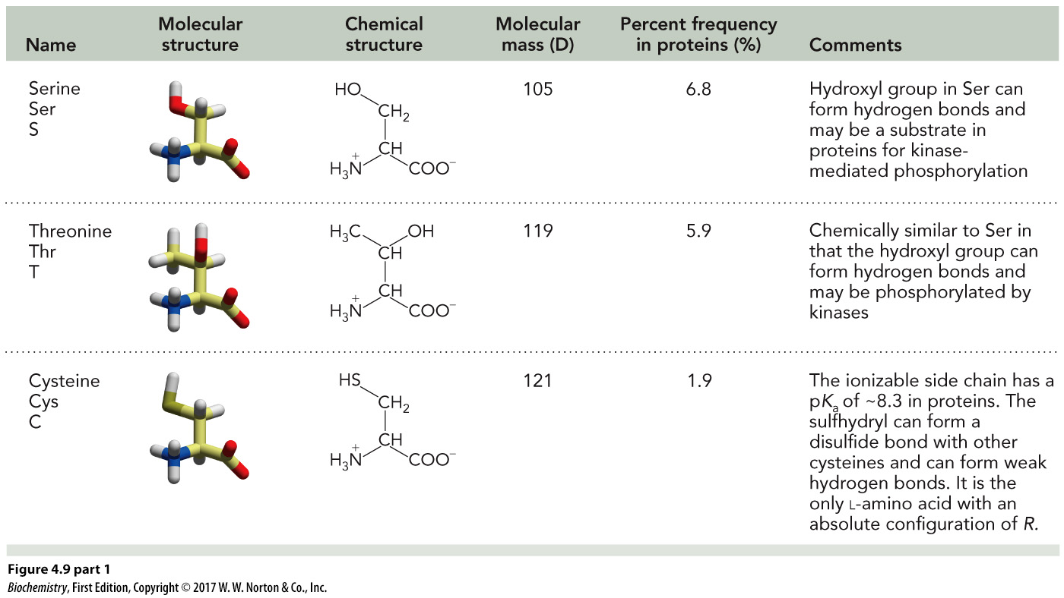
Hydrophilic Amino Acids, Part 1
Name | Molecular structure | Chemical structure | Molecular mass (D) | Percent frequency in proteins (percent) | Comments
Serine Ser S | The molecular structure of serine shown in a three dimensional model. | The chemical structure of serine has a molecular formula of Upper C 3 Upper H 7 Upper N Upper O 3. | 105 | 6.8 | Hydroxyl group in Ser can form hydrogen bonds and may be a substrate in proteins for kinase-mediated phosphorylation
Threonine Thr T | The molecular structure of threonine shown in a three dimensional model. | The chemical structure of threonine has a molecular formula of Upper C 4 Upper H 9 Upper N Upper O 3. | 119 | 5.9 | Chemically similar to Ser in that the hydroxyl group can form hydrogen bonds and may be phosphorylated by kinases
Cysteine Cys C | The molecular structure of cysteine shown in a three dimensional model. | The chemical structure of cysteine has a molecular formula of Upper C 3 Upper H 7 Upper N Upper O 2 Upper S. | 121 | 1.9 | The ionizable side chain has a pK_{a} of approximately 8.3 in proteins. The sulfhydryl can form a disulfide bond with other cysteines and can form weak hydrogen bonds. It is the only L-amino acid with an absolute configuration of R.

Slide 15
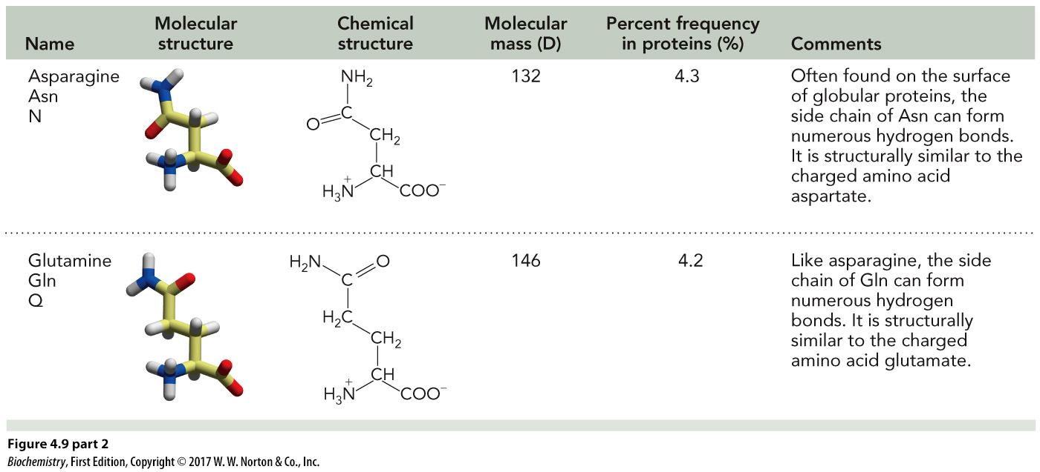
Hydrophilic Amino Acids, Part 2
Name | Molecular structure | Chemical structure | Molecular mass (D) | Percent frequency in proteins (percent) | Comments
Asparagine Asn N | The molecular structure of asparagine shown in a three dimensional model. | The chemical structure of asparagine has a molecular formula of Upper C 4 Upper H 8 Upper N 2 Upper O 3. | 132 | 4.3 | Often found on the surface of globular proteins, the side chain of Asn can form numerous hydrogen bonds. It is structurally similar to the charged amino acid aspartate.
Glutamine Gln Q | The molecular structure of glutamine shown in a three dimensional model. | The chemical structure of glutamine has a molecular formula of Upper C 5 Upper H 10 Upper N 2 Upper O 3. | 146 | 4.2 | Like asparagine, the side chain of Gln can form numerous hydrogen bonds. It is structurally similar to the charged amino acid glutamate.

Slide 16
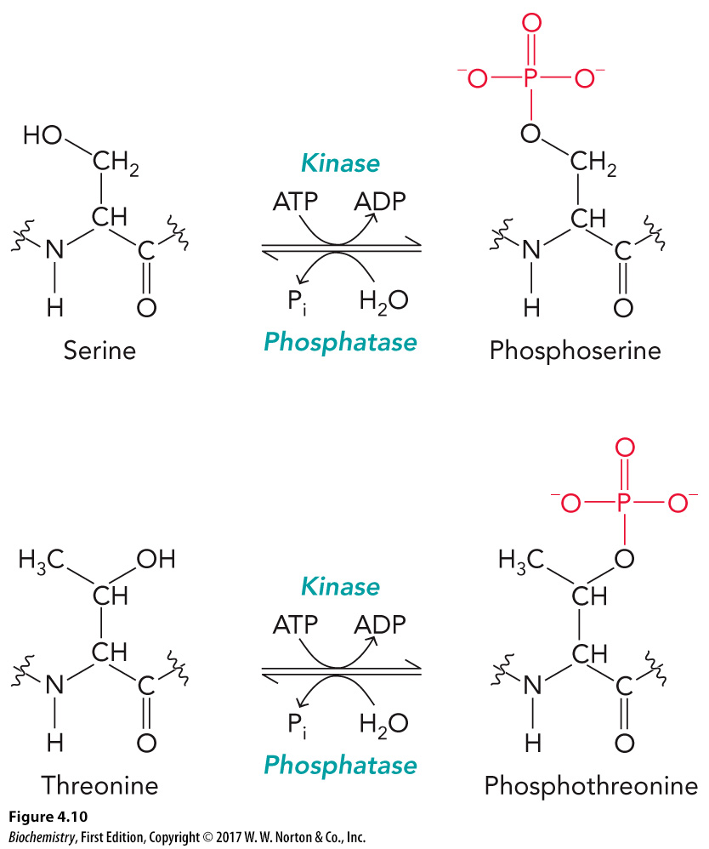
Common Covalent Modifications with Hydrophilic Amino Acids
.

Slide 17
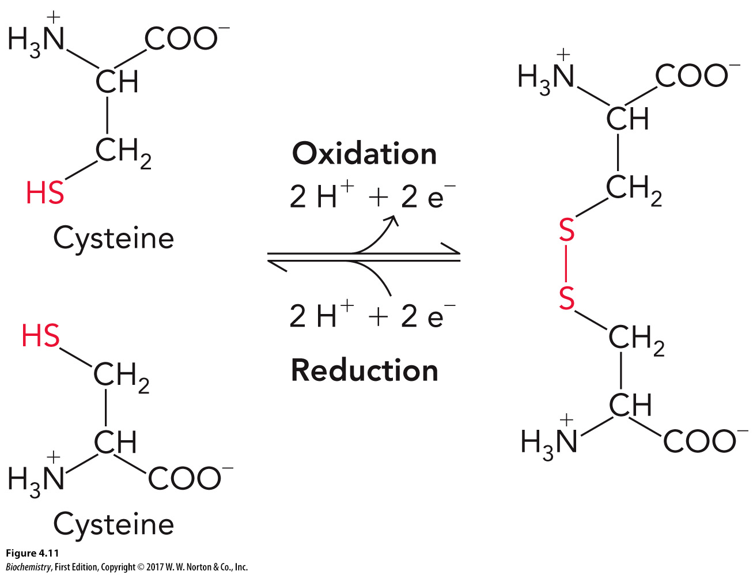
Cysteine Is a Weak Acid

Slide 18
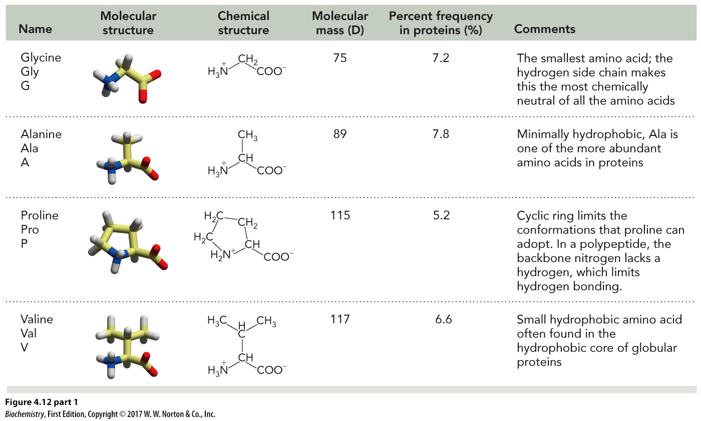
Hydrophobic Amino Acids, Part 1
Name | Molecular structure | Chemical structure | Molecular mass (D) | Percent frequency in proteins (percent) | Comments
Glycine Gly G | The molecular structure of glycine shown in a three dimensional model. | The chemical structure of glycine has a molecular formula of Upper C 2 Upper H 5 Upper N Upper O 2. | 75 | 7.2 | The smallest amino acid; the hydrogen side chain makes this the most chemically neutral of all the amino acids
Alanine Ala A | The molecular structure of alanine shown in a three dimensional model. | The chemical structure of alanine has a molecular formula of Upper C 3 Upper H 7 Upper N Upper O 2. | 89 | 7.8 | Minimally hydrophobic, Ala is one of the more abundant amino acids in proteins
Proline Pro P | The molecular structure of proline shown in a three dimensional model. | The chemical structure of proline has a molecular formula of Upper C 5 Upper H 9 Upper N Upper O 2. | 115 | 5.2 | Cyclic ring limits the conformations that proline can adopt. In a polypeptide, the backbone nitrogen lacks a hydrogen, which limits hydrogen bonding.
Valine Val V | The molecular structure of valine shown in a three dimensional model. | The chemical structure of valine has a molecular formula of Upper C 5 Upper H 11 Upper N Upper O 2. | 117 | 6.6 | Small hydrophobic amino acid often found in the hydrophobic core of globular proteins

Slide 19
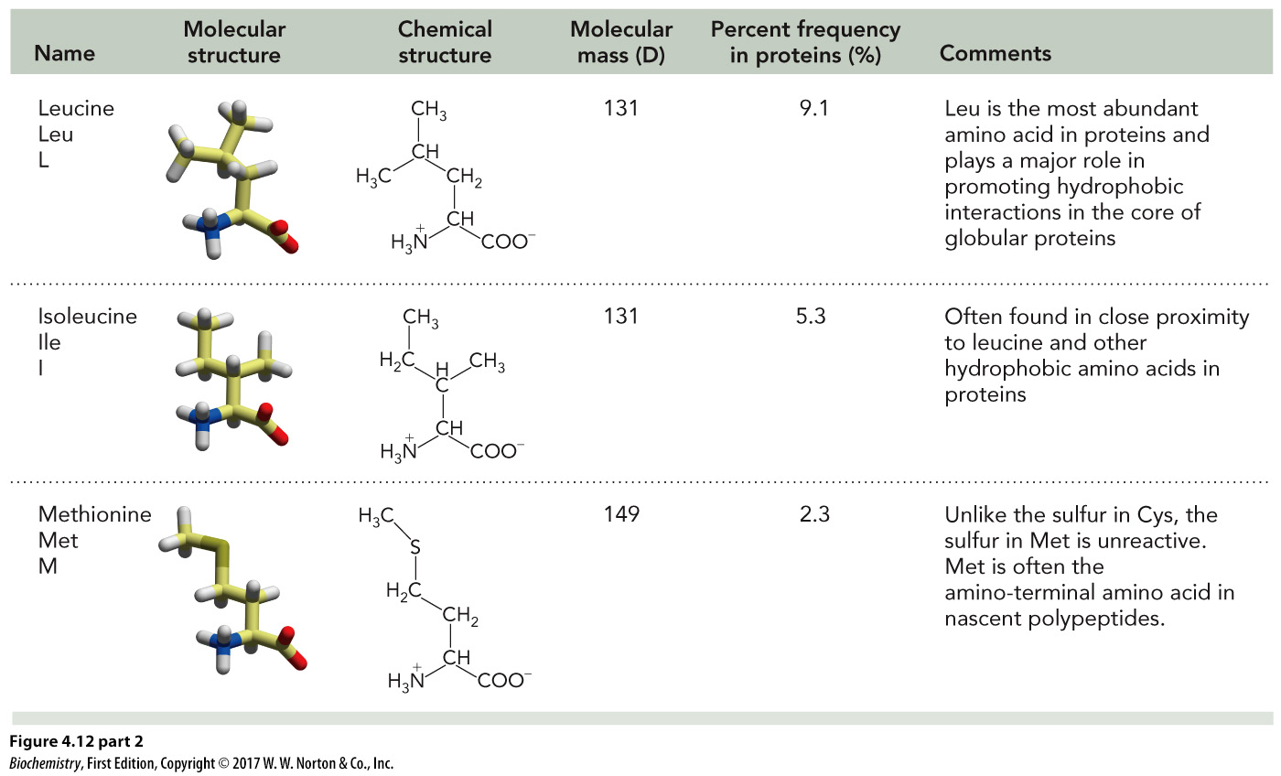
Hydrophobic Amino Acids, Part 2
Name | Molecular structure | Chemical structure | Molecular mass (D) | Percent frequency in proteins (percent) | Comments
Leucine Leu L | The molecular structure of leucine is shown in a three dimensional model. | The chemical structure of leucine has a molecular formula of Upper C 6 Upper H 13 Upper N Upper O 2. | 131 | 9.1 | Leu is the most abundant amino acid in proteins and plays a major role in promoting hydrophobic interactions in the core of globular proteins
Isoleucine lie 1 | The molecular structure of isoleucine is shown in a three dimensional model. | The chemical structure of leucine has a molecular formula of Upper C 6 Upper H 13 Upper N Upper O 2. | 131 | 5.3 | Often found in close proximity to leucine and other hydrophobic amino acids in proteins
Methionine Met M | The molecular structure of methionine is shown in a three dimensional model. | The chemical structure of leucine has a molecular formula of Upper C 5 Upper H 11 Upper N Upper O 2 Upper S | 149 | 2.3 | Unlike the sulfur in Cys, the sulfur in Met is unreactive. Met is often the amino-terminal amino acid in nascent polypeptides.

Slide 20
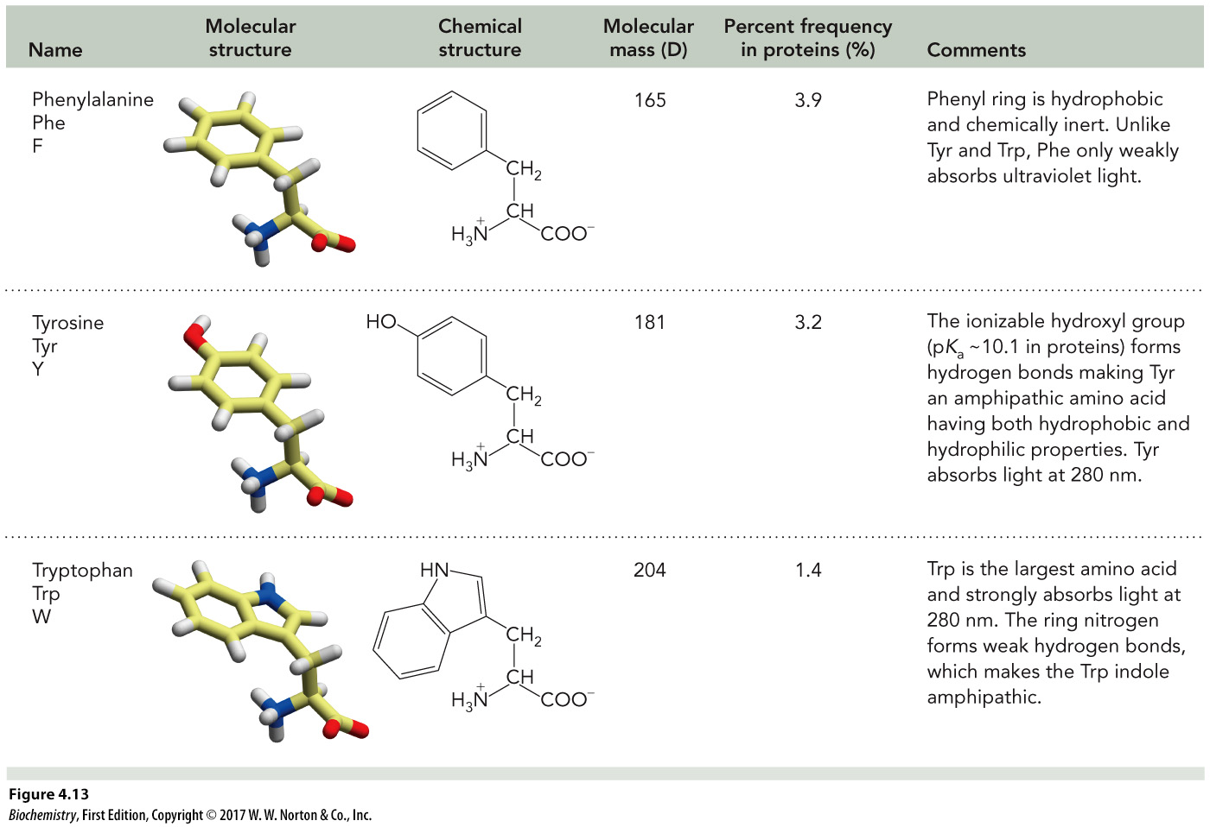
Aromatic Amino Acids
Name | Molecular structure | Chemical structure | Molecular mass (D) | Percent frequency in proteins (percent) | Comments
Phenylalanine Phe F | The molecular structure of phenylalanine is shown in a three dimensional model. | The chemical structure of phenylalanine has a molecular formula of Upper C 9 Upper H 11 Upper N Upper O 2. | 165 | 3.9 | Phenyl ring is hydrophobic and chemically inert. Unlike Tyr and Trp, Phe only weakly absorbs ultraviolet light.
Tyrosine Tyr Y | The molecular structure of tyrosine is shown in a three dimensional model. | The chemical structure of phenylalanine has a molecular formula of Upper C 9 Upper H 11 Upper N Upper O 3. | 181 | 3.2 | The ionizable hydroxyl group (pK_{a} -10.1 in proteins) forms hydrogen bonds making Tyr an amphipathic amino acid having both hydrophobic and hydrophilic properties. Tyr absorbs light at 280 nm.
Tryptophan Trp W | The molecular structure of tryptophan is shown in a three dimensional model. | The chemical structure of phenylalanine has a molecular formula of Upper C 11 Upper H 12 Upper N 2 Upper O 2. | 204 | 1.4 | Trp is the largest amino acid and strongly absorbs light at 280 nm. The ring nitrogen forms weak hydrogen bonds, which makes the Trp indole amphipathic.

Slide 21
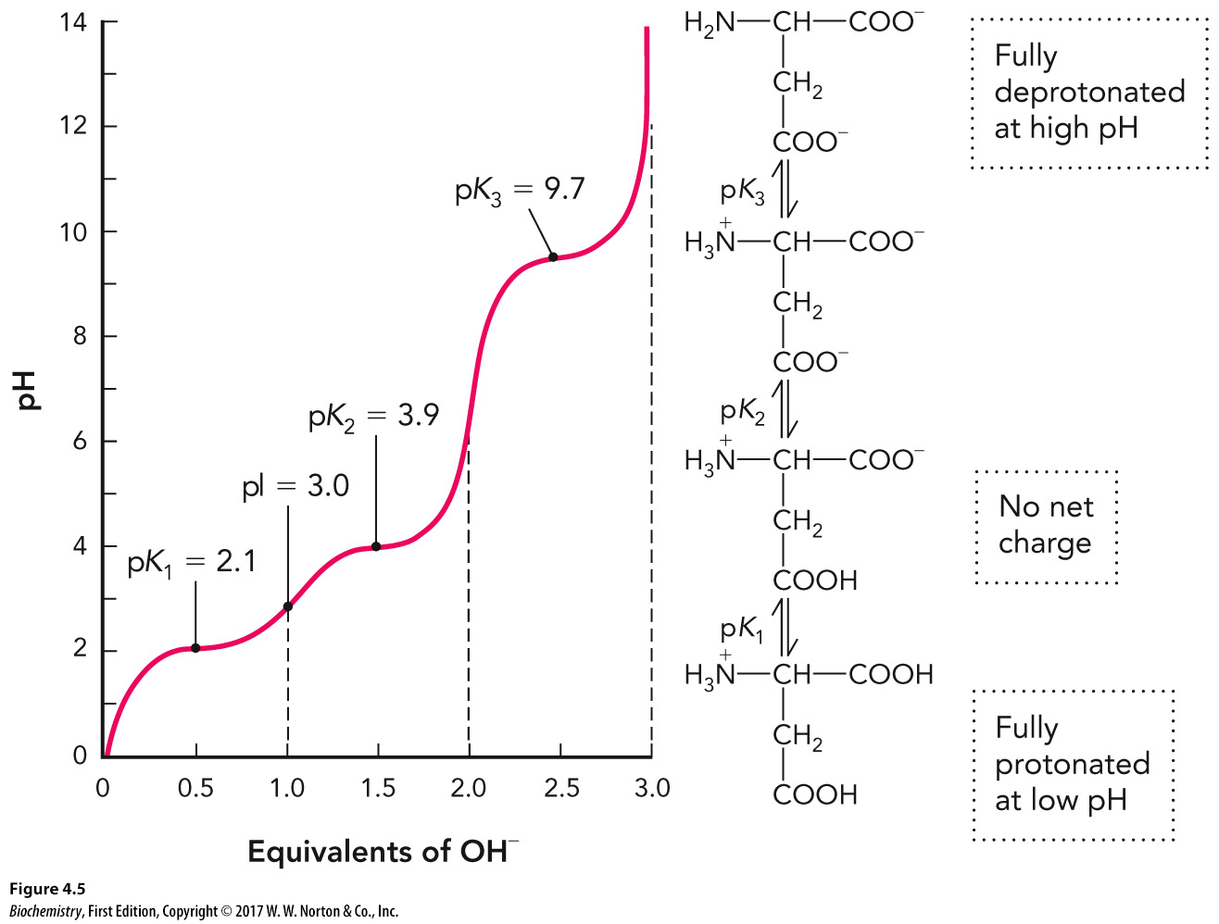
Isoelectric Point (pI)

Slide 22
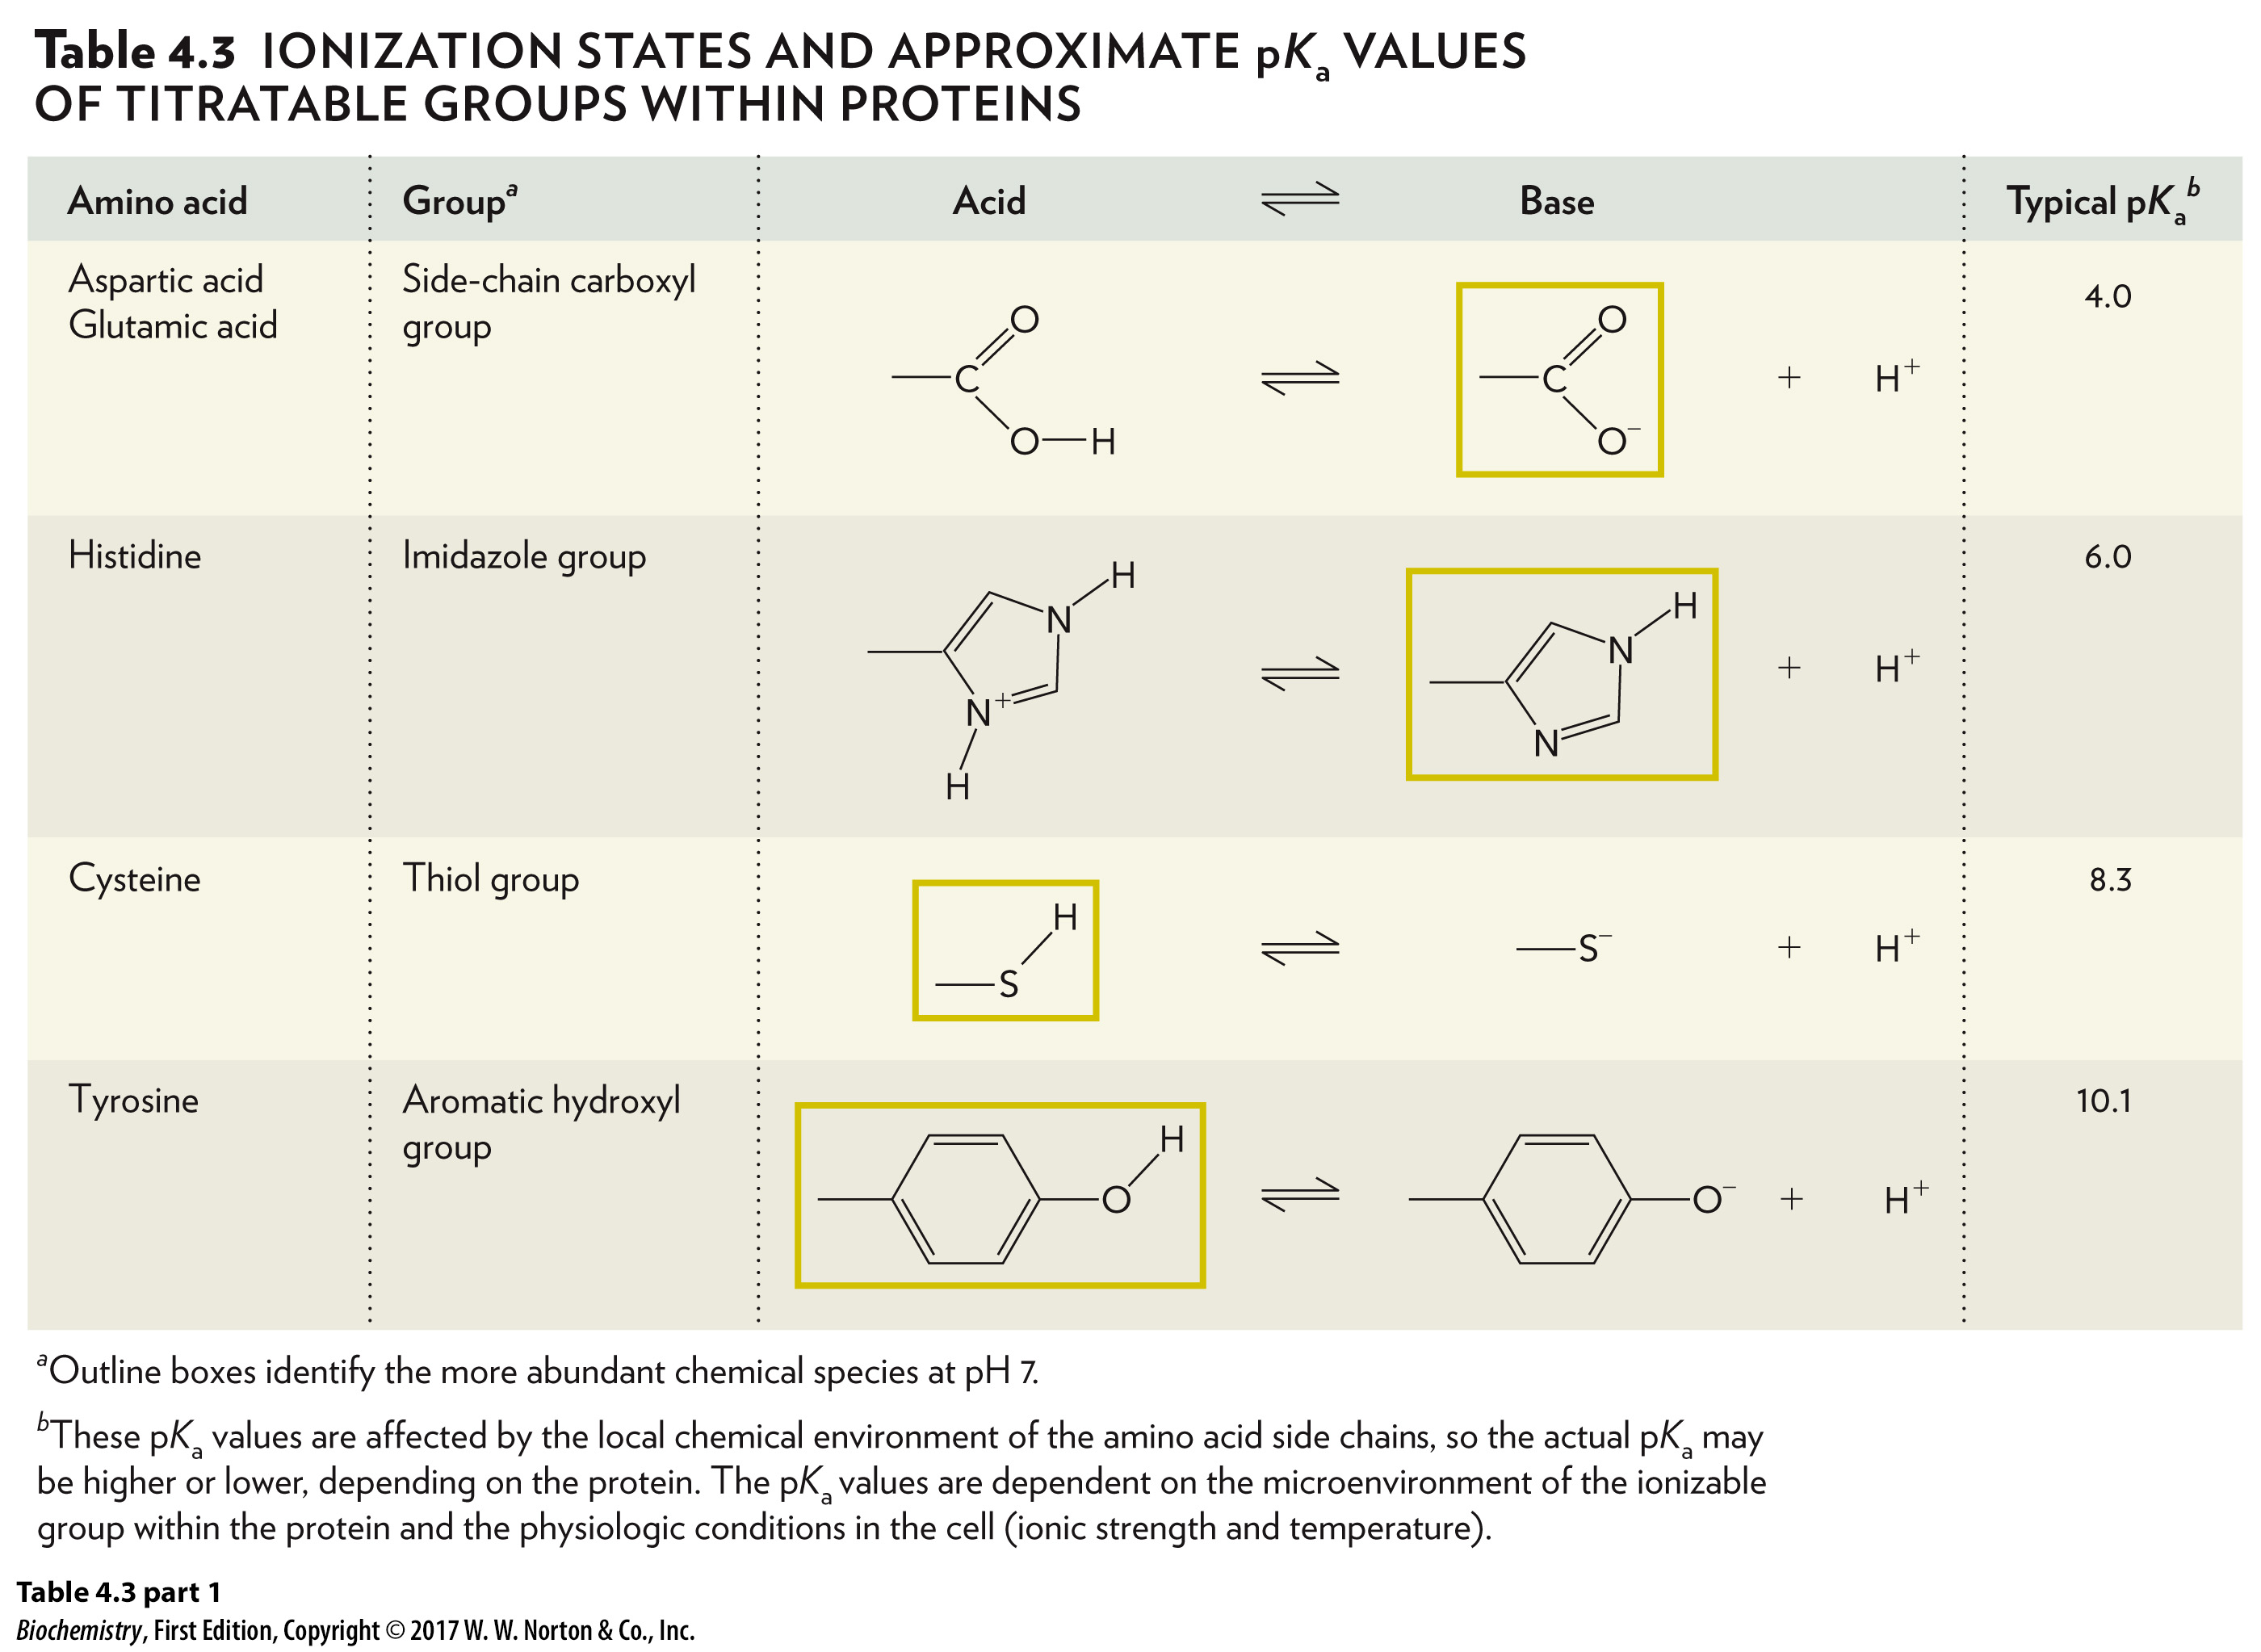
Amino Acid Side Chains with Ionizable Hydrogens, Part 1
Amino acid | Group | Acid is in equilibrium with Base | Typical p upper K subscript a
Aspartic acid, Glutamic acid | Side-chain carboxyl group | The acid is Upper C double bonded to Upper O, single bonded to Upper C, and single bonded to Upper O, which is single bonded to Upper H. This acid is in equilibrium with the base plus positive 1 Upper H. The base is Upper C double bonded to Upper O, single bonded to negative 1 Upper O ion, and single bonded to Upper C. The base is the more abundant chemical species at pH 7. | 4.0
Histidine | Imidazole group | The acid has a ring shape. In the ring, Upper N is single bonded to Upper C that is double bonded to positive 1 Upper N ion that is single bonded to Upper C (single bonded to another Upper C outside of the ring) that is double bonded to Upper C that is single bonded to the original Upper N. Each Upper N is single bonded to an Upper H not in the ring. This acid is in equilibrium with the base plus positive 1 Upper H ion. The base is a ring with Upper N (single bonded to Upper H outside of the ring) that is single bonded to Upper C that is double bonded to Upper N that is single bonded to Upper C (single bonded to another Upper C outside of the ring) that is double bonded to Upper C that is single bonded to the original Upper N. The base is the more abundant chemical species at pH 7. | 6.0
Cysteine | Thiol group | The acid is Upper S single bonded to Upper H and single bonded to Upper C. The acid is in equilibrium with the base plus positive 1 Upper H ion. The base is negative 1 Upper S ion single bonded to Upper C. The acid is the more abundant chemical species at pH 7. | 8.3
Tyrosine | Aromatic hydroxyl group | The acid is a benzene ring single bonded to Upper C and double bonded to Upper O, which is single bonded to Upper H. The acid is in equilibrium with the base plus positive 1 Upper H ion. The base is a benzene ring single bonded to Upper C and single bonded to negative 1 Upper O ion. The acid is the more abundant chemical species at pH 7. | 10.1

Slide 23
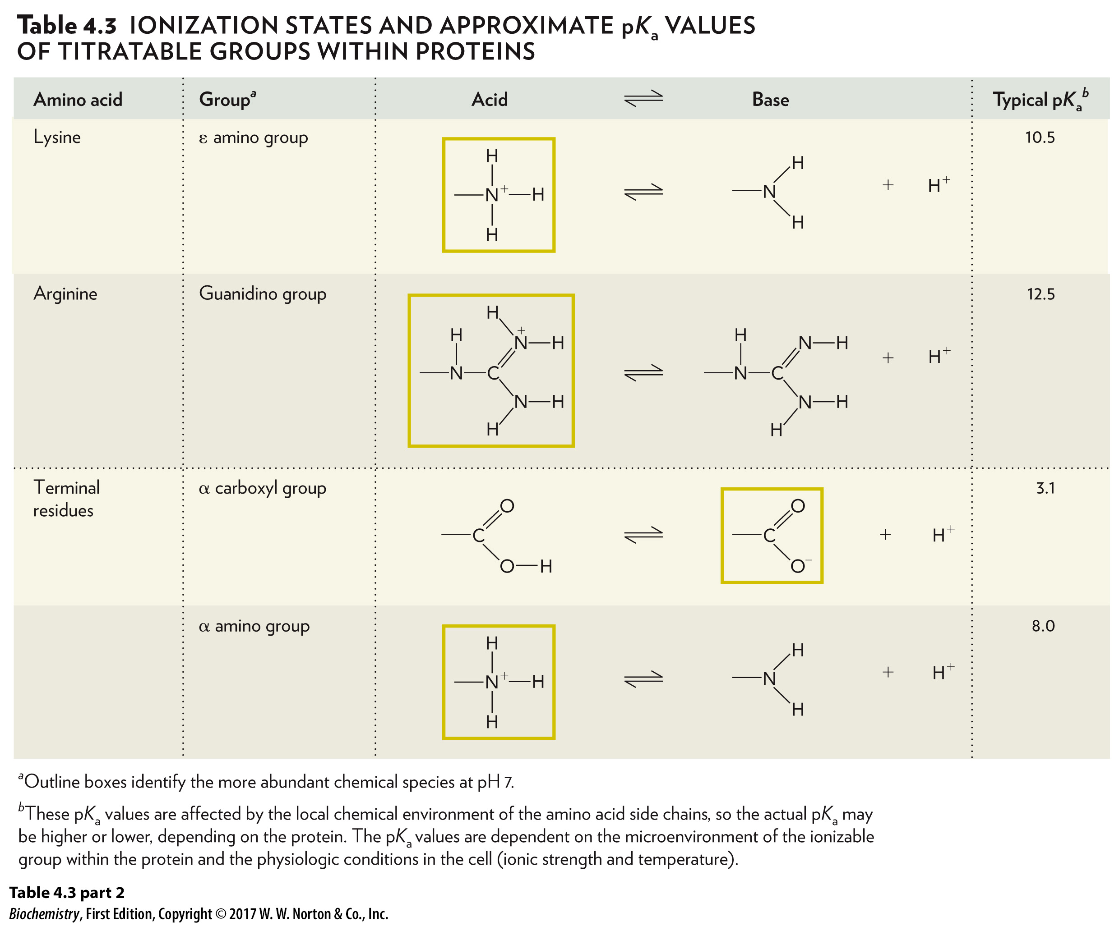
Amino Acid Side Chains with Ionizable Hydrogens, Part 2
Amino acid | Group | Acid is in equilibrium with Base | Typical p upper K subscript a
Lysine | Epsilon amino group | The acid is a positive 1 Upper N ion single bonded to Upper H, single bonded to a second Upper H, single bonded to a third Upper H, and single bonded to Upper C. The acid is in equilibrium with the base plus a positive 1 Upper H ion. The base is Upper H single bonded to Upper H, single bonded to a second Upper H, and single bonded to Upper C. The acid is the more abundant chemical species at pH 7. | 10.5
Arginine | Guanidino group | The acid is Upper N single bonded to Upper C, Upper H, and a second Upper C. This central Upper C is double bonded to positive 1 Upper N ion and single bonded to Upper N. The positive 1 Upper N ion is single bonded to Upper H and Upper H. The Upper N is also single bonded to Upper H and Upper H. This acid is in equilibrium with the base and positive 1 Upper H ion. The base is Upper N single bonded to Upper C, Upper H, and a second Upper C. This central Upper C is double bonded to Upper N that is single bonded to Upper H, and the central Upper C is also single bonded to another Upper N, which is single bonded to Upper H and Upper H. The acid is the more abundant chemical species at pH 7. | 12.5
Terminal residues | Alpha carboxyl group | The acid is Upper C single bonded to Upper C, double bonded to Upper O, and single bonded to Upper O that is single bonded to Upper H. The acid is in equilibrium with the base plus positive 1 Upper H ion. The base is Upper C single bonded to Upper C, double bonded to Upper O, and single bonded to negative one Upper O ion. The base is the more abundant chemical species at pH 7. | 3.1
Terminal residues | Alpha amino group | The acid is positive 1 Upper N ion single bonded to Upper C, Upper H, Upper H, and Upper H. The acid is in equilibrium with the base plus positive 1 Upper H ion. The base is Upper N single bonded to Upper C, Upper H, and Upper H. The acid is the more abundant chemical species at pH 7. | 8.0

Slide 24
Formation of Peptide Bonds

Slide 25
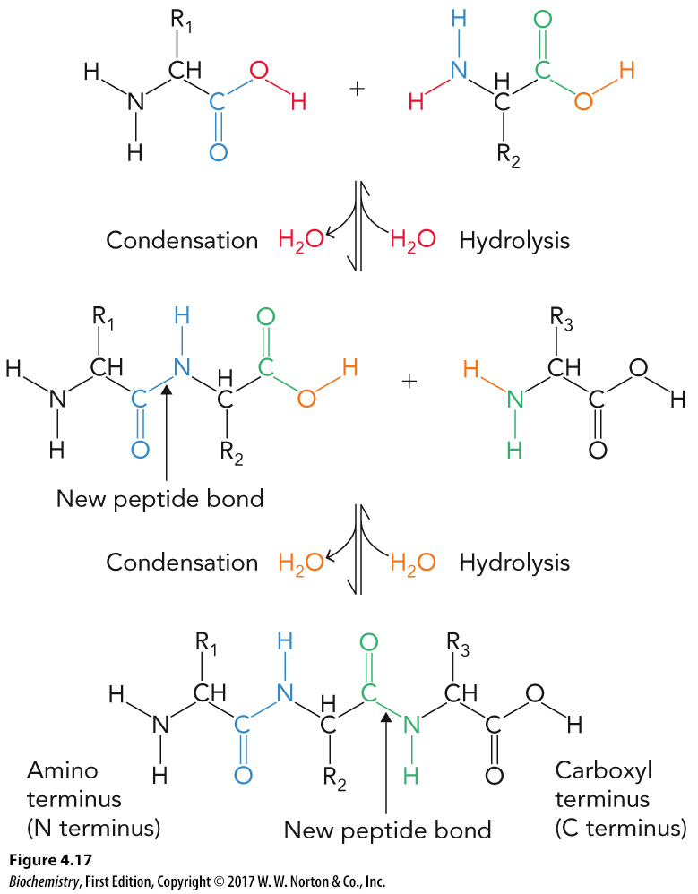
Peptide Formation and Degradation

Slide 26
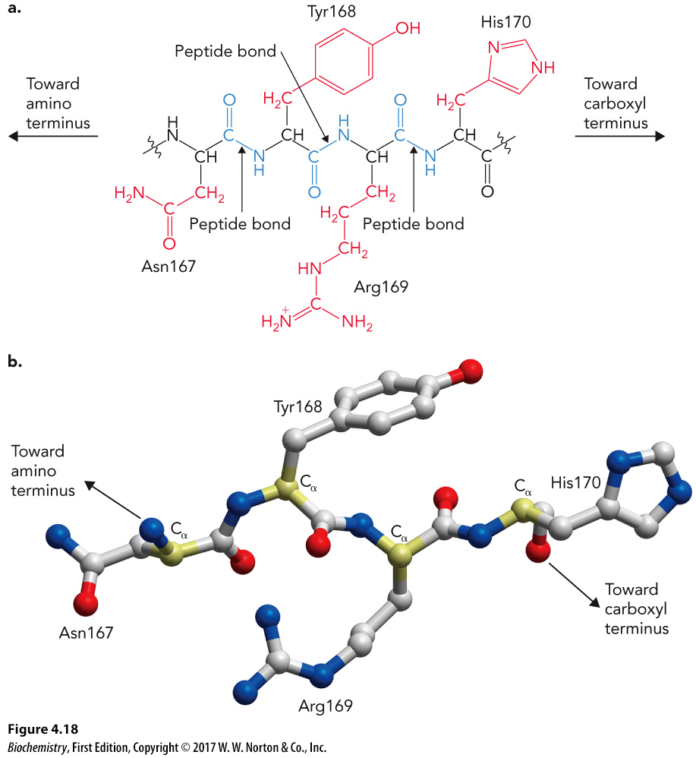
Tripeptide Example

Slide 27
4.2 Hierarchical Organization of Protein Structure

Slide 28
Levels of Protein Structure
Primary (1°)
Secondary (2°)
Tertiary (3°)
Quaternary (4°)

Slide 29
Primary Structure
Linear amino acid sequence
Determines how the polypeptide backbone folds into a stable 3D structure

Slide 30
Secondary Structure
Arrangement of local regions of the polypeptide backbone
Secondary structures form
β strands
α helices
β turns
Protein folds (collections of secondary structures) are observed in protein structure and are common in multiple protein families.

Slide 31
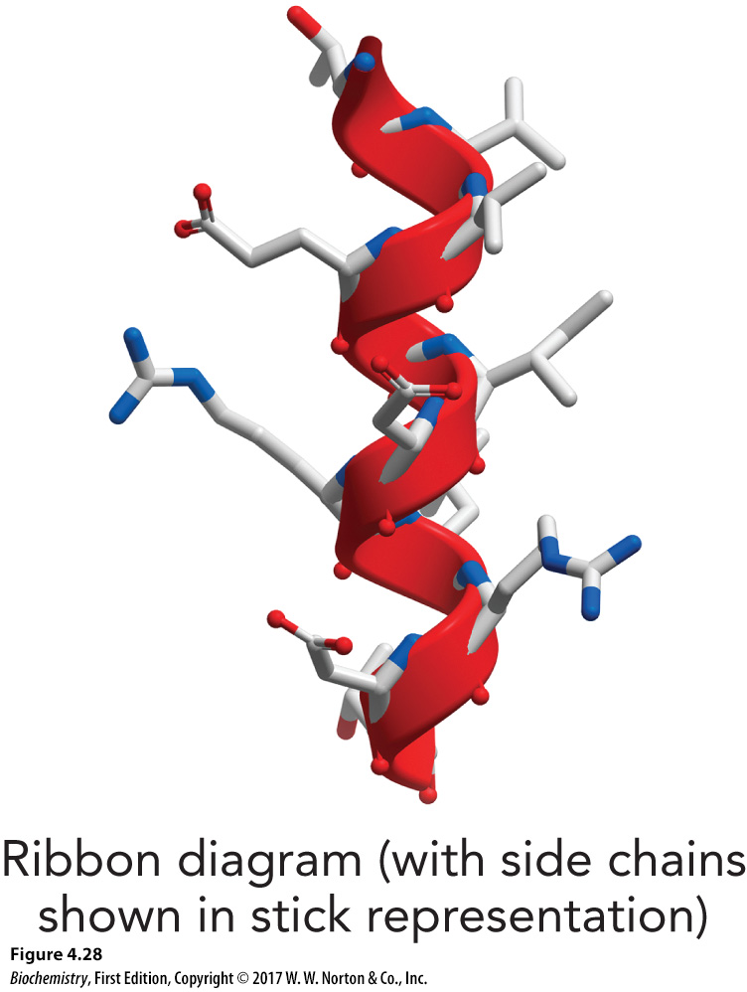
Alpha Helix

Slide 32
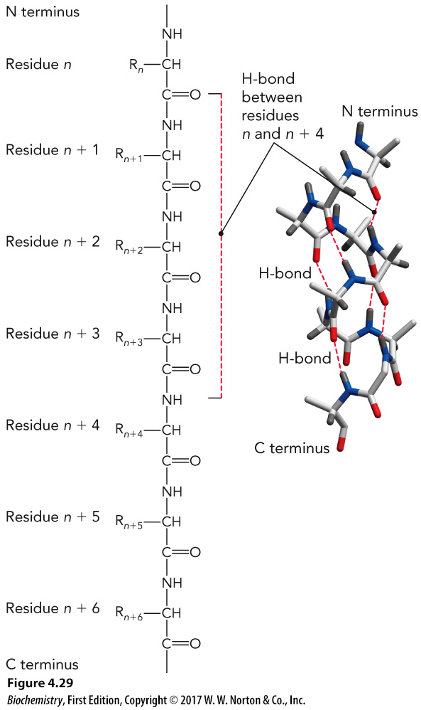
Hydrogen Bonding and Alpha Helices

Slide 33
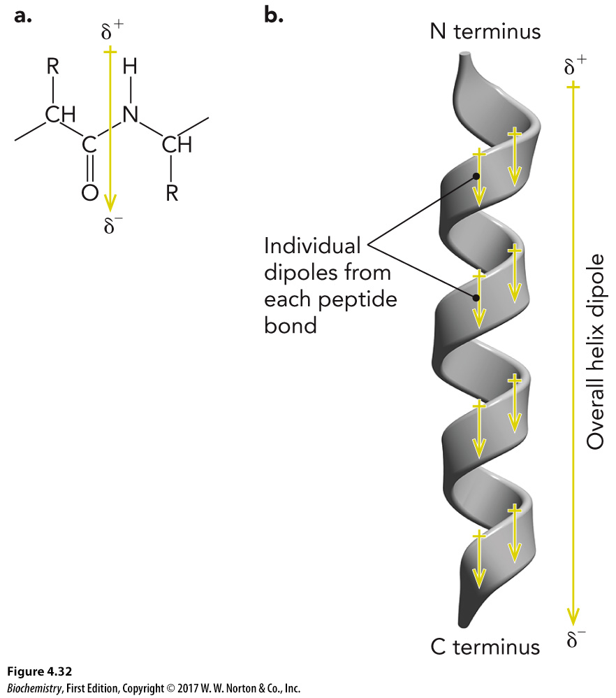
Amino Acids and Dipoles

Slide 34
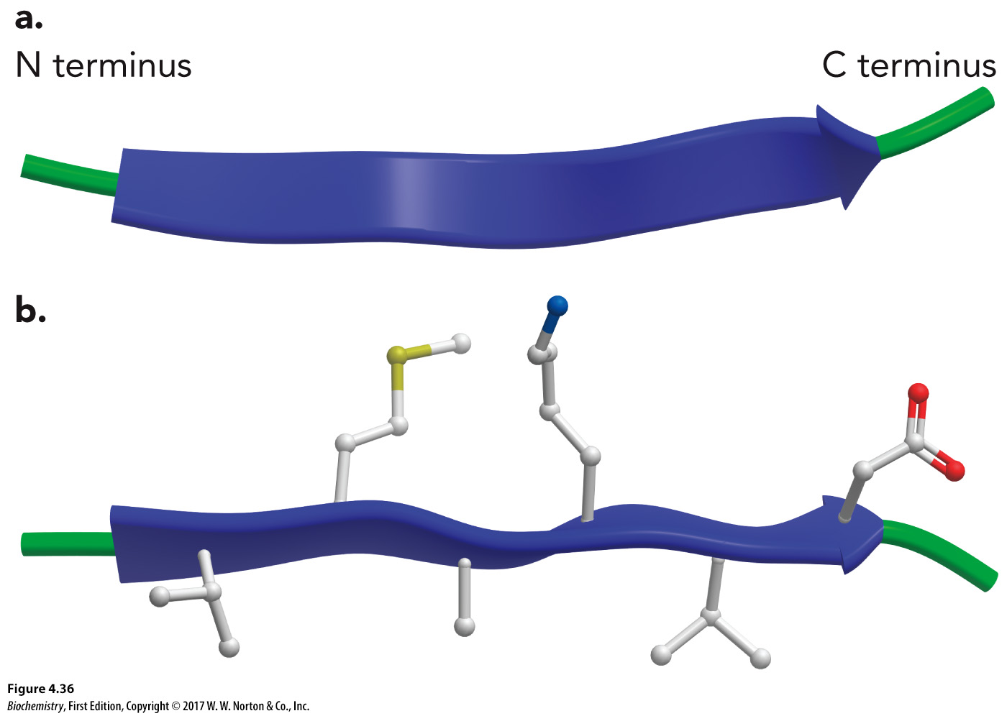
Beta Strands
Form beta (pleated) sheets
Held together by hydrogen bonding

Slide 35
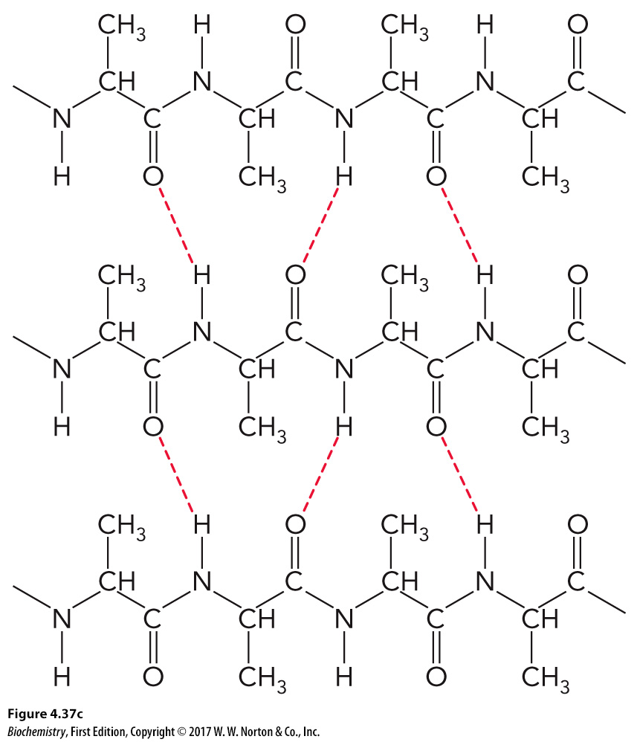
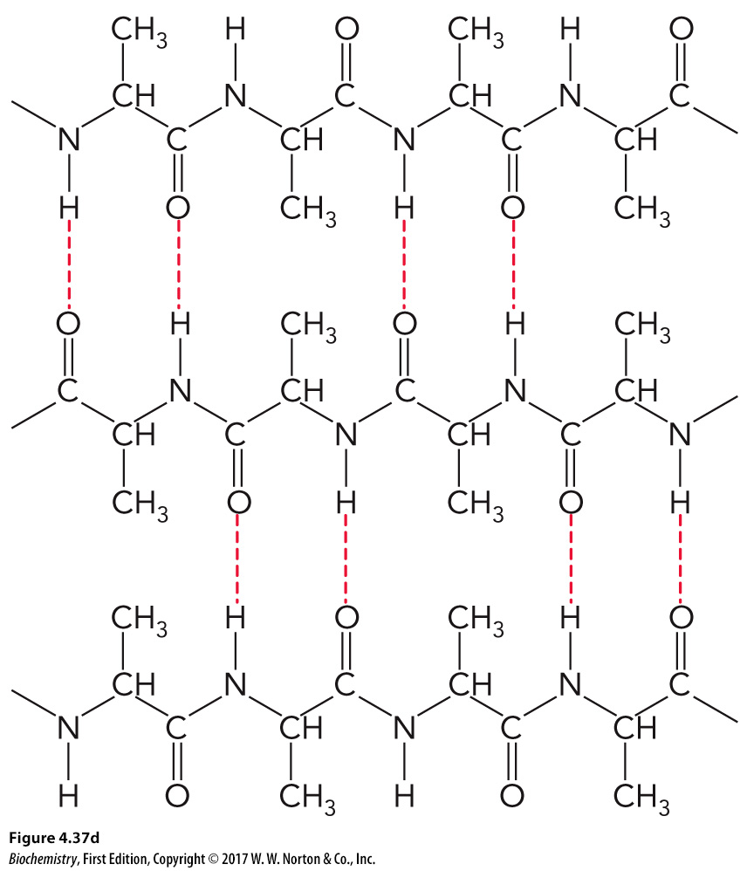
Conformation of B Sheets
Parallel
Antiparallel

Slide 36
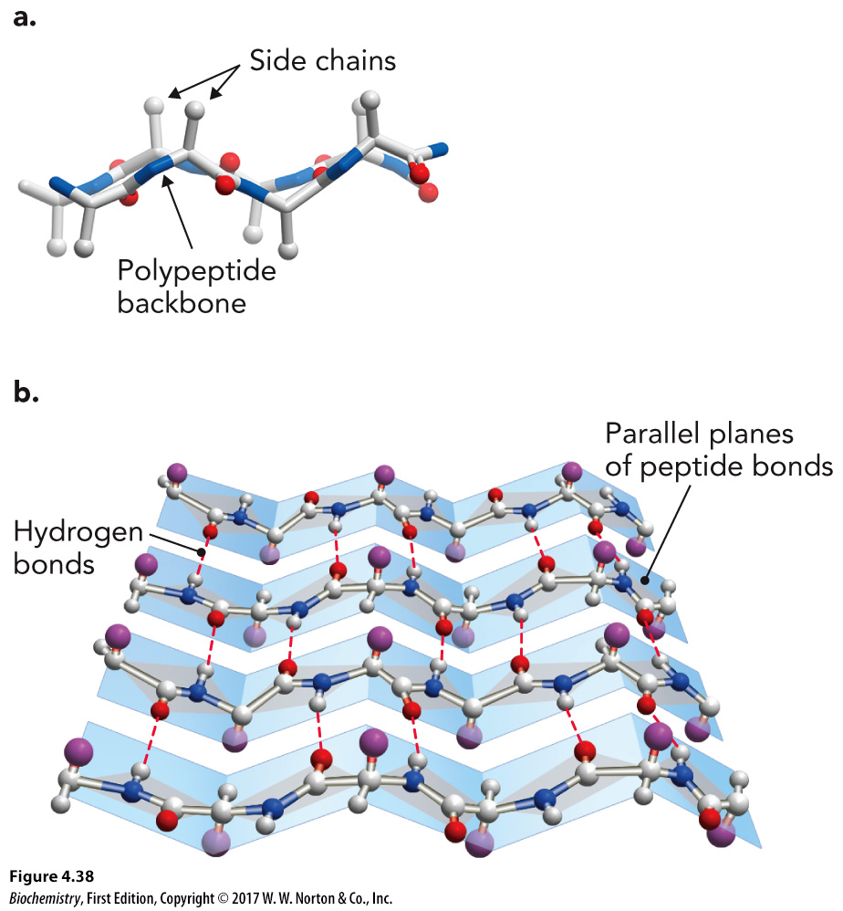
Beta Pleated Sheets

Slide 37
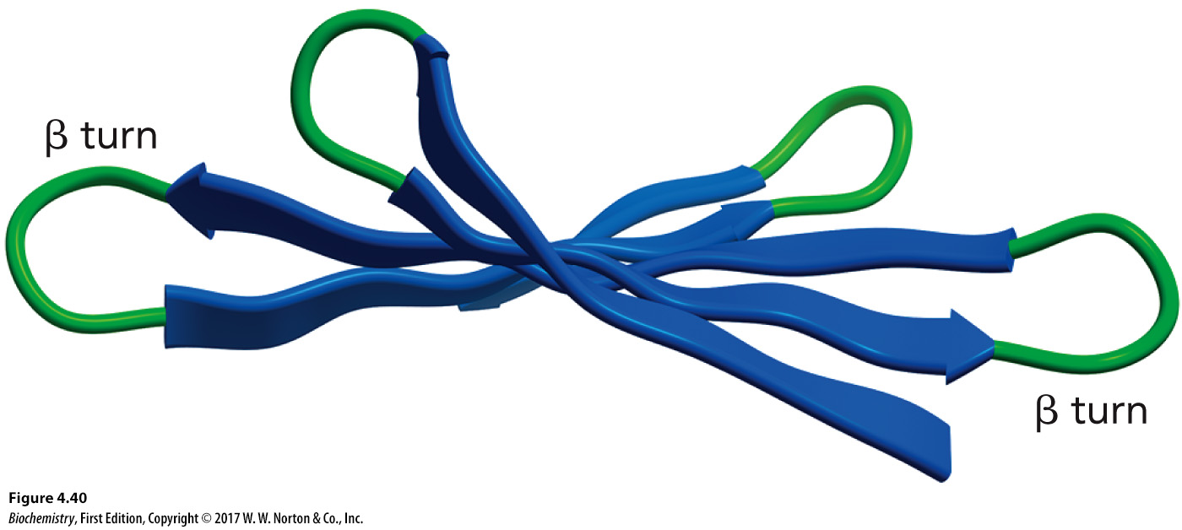
Beta Turns, Part 1
Connect two B strands in an antiparallel B sheet

Slide 38
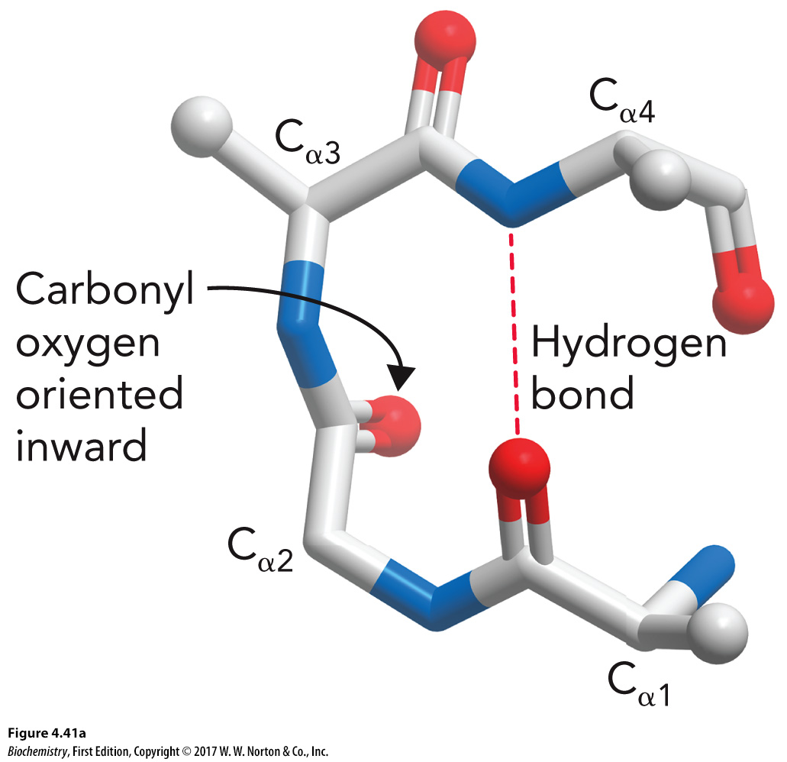
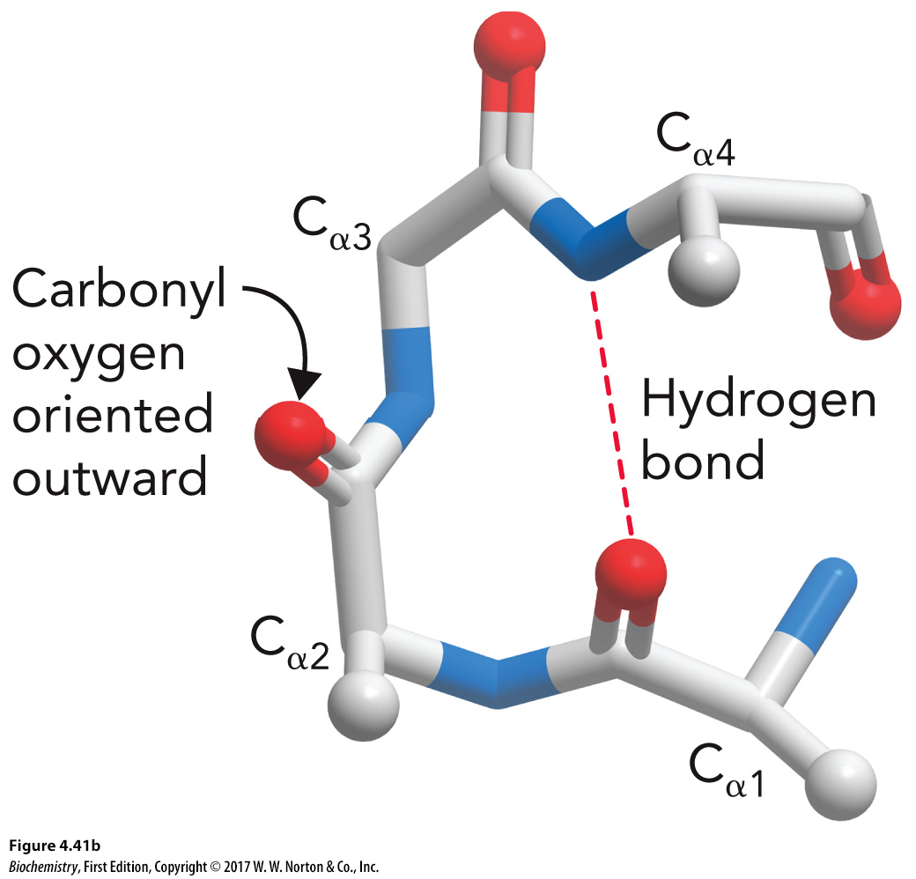
Beta Turns, Part 2
Type I
Turn with the carbonyl oxygen inward
Type II
Turn with the carbonyl oxygen facing outward

Slide 39
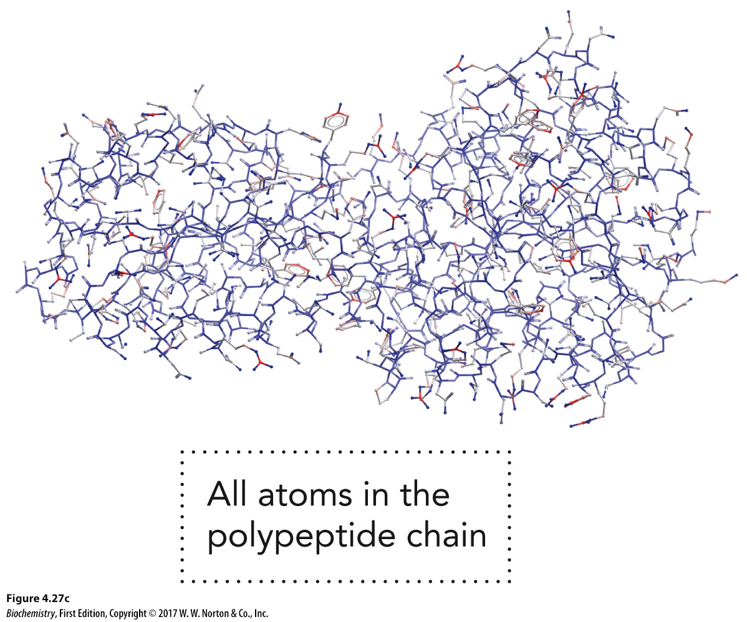
Tertiary Structure
3D structure of a protein that includes all the secondary structures in their folding pattern

Slide 40
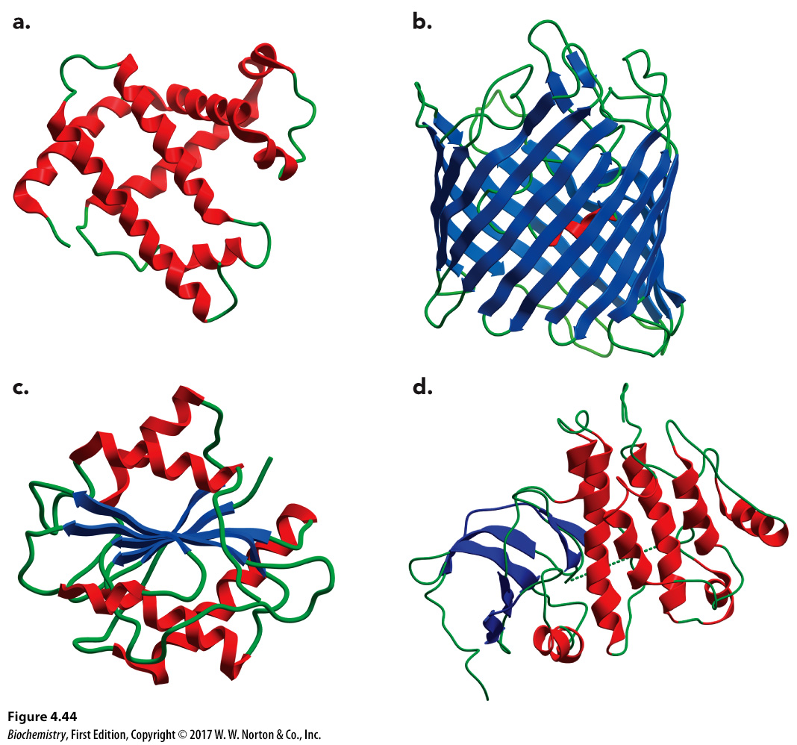
Four Major Classes of Structures

Slide 41
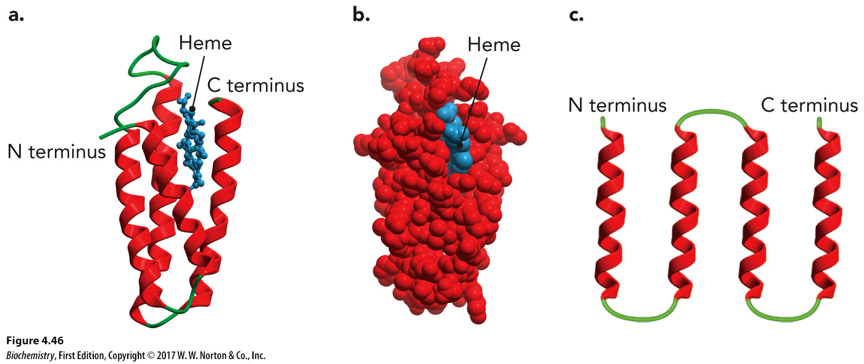
Four Helix Bundle
Common protein fold
Example: Heme domain of cytochrome b

Slide 42
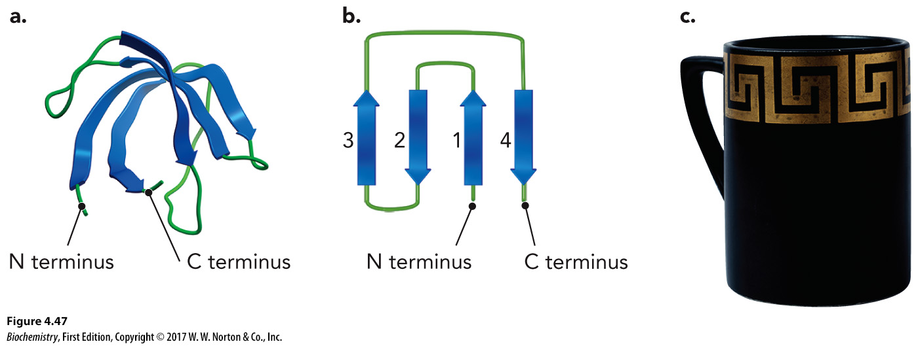
Greek Key Fold
Common protein fold
Consists of four or more beta strands linked together to form a beta sheet

Slide 43
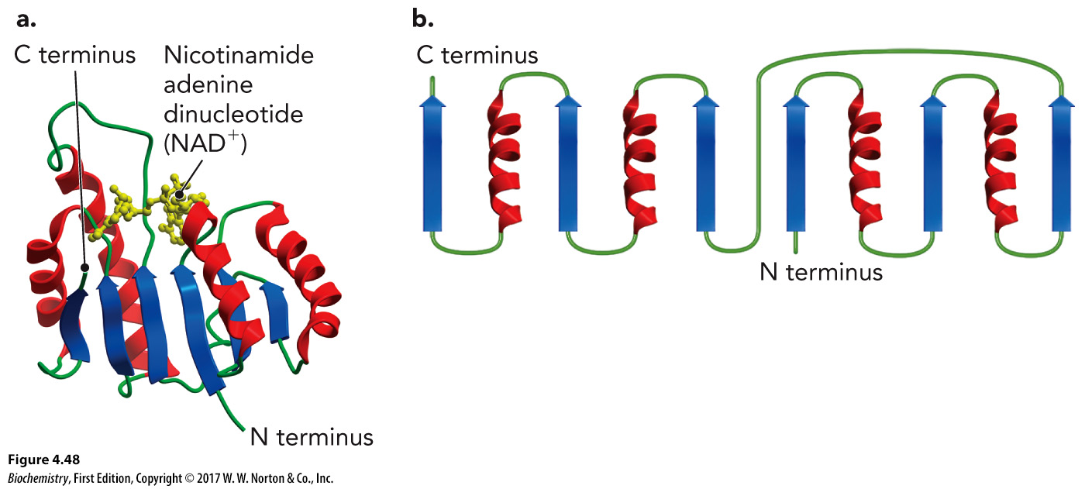
Rossmann Fold
Complex protein fold in which there are alternating alpha helices and beta strands
Found in proteins that bind nucleotides

Slide 44
TIM Barrel Fold
Protein fold that has alternating alpha helix and beta strand (α/β barrel)
Found in a large number of metabolic enzymes

Slide 45
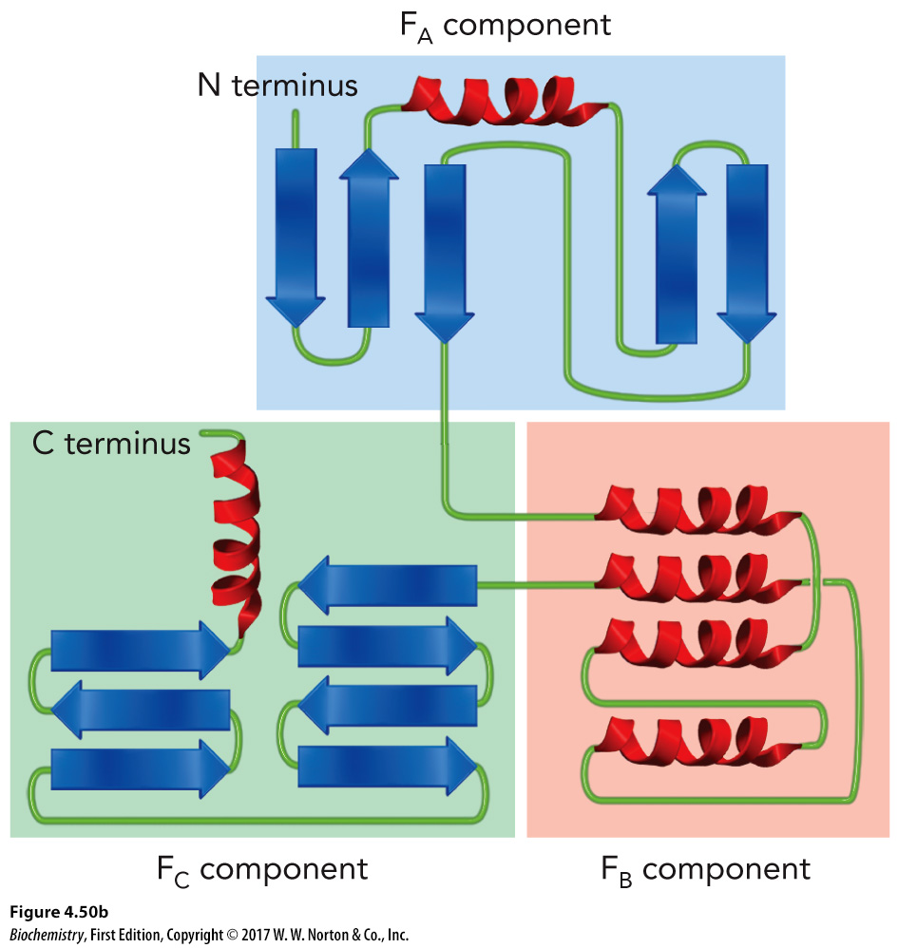
FERM Domain
Large protein fold
Consists of three distinct structural components:
F_{A}
Mostly beta sheets
F_{B}
Only alpha helices
F_{C}
Mostly beta sheets

Slide 46
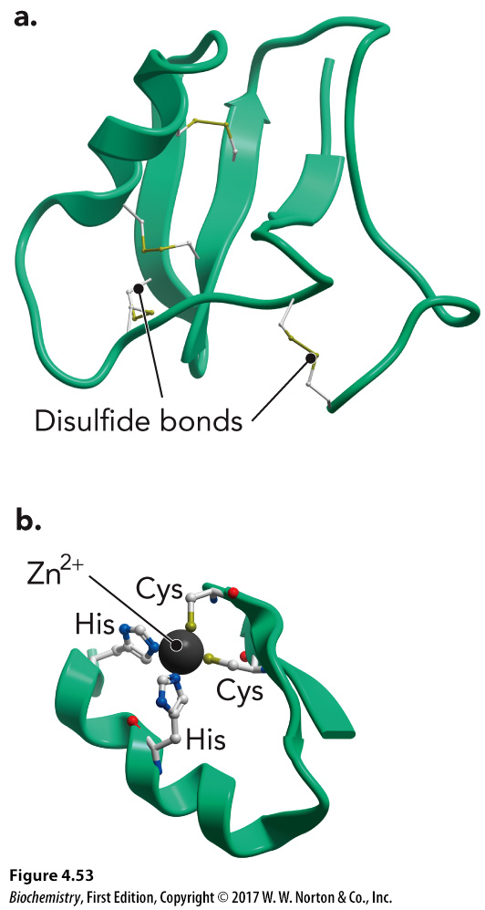
Disulfide Bonds
Observed in tertiary structure
Formed when two nearby cysteine residues are oxidized
Found in toxins and growth factors

Slide 47
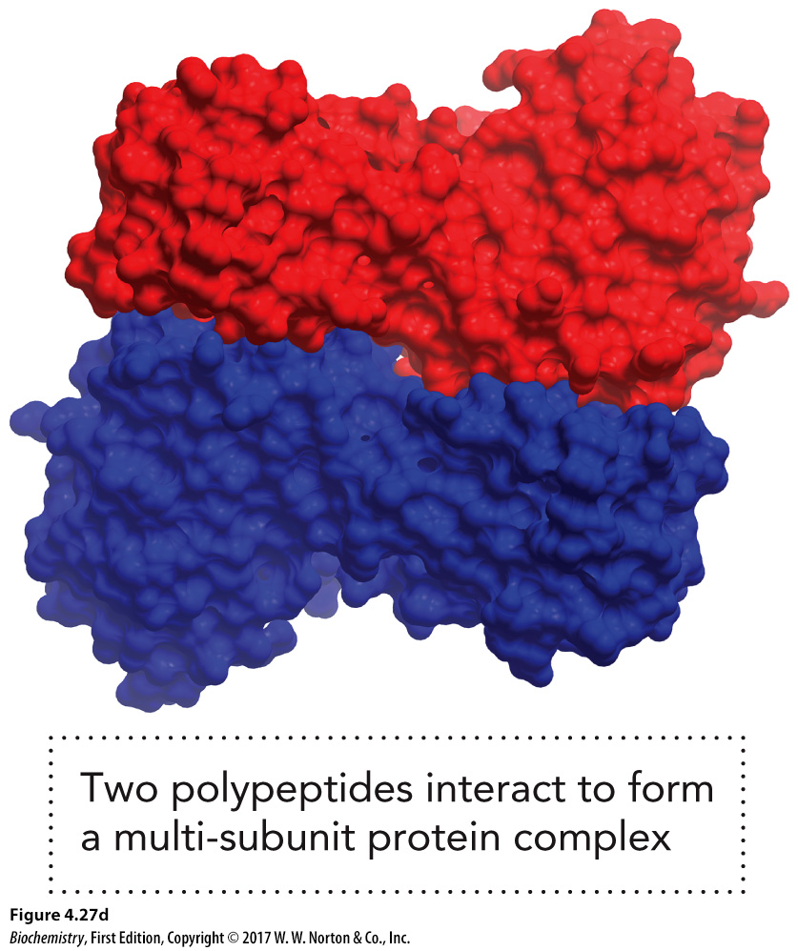
Quaternary Structures, Part 1

Slide 48
Quaternary Structures, Part 2

Slide 49
Quaternary Structures Increase Functionality

Slide 50
Fibrous Proteins

Slide 51
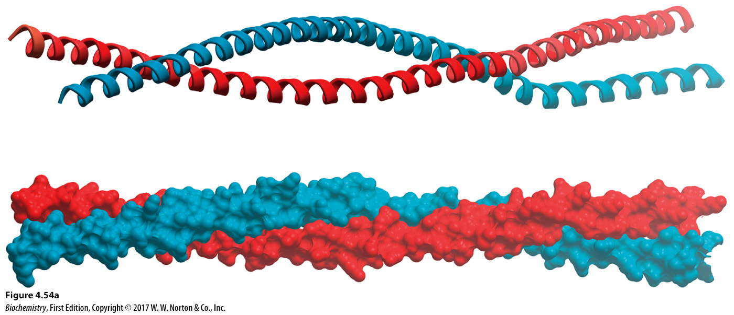
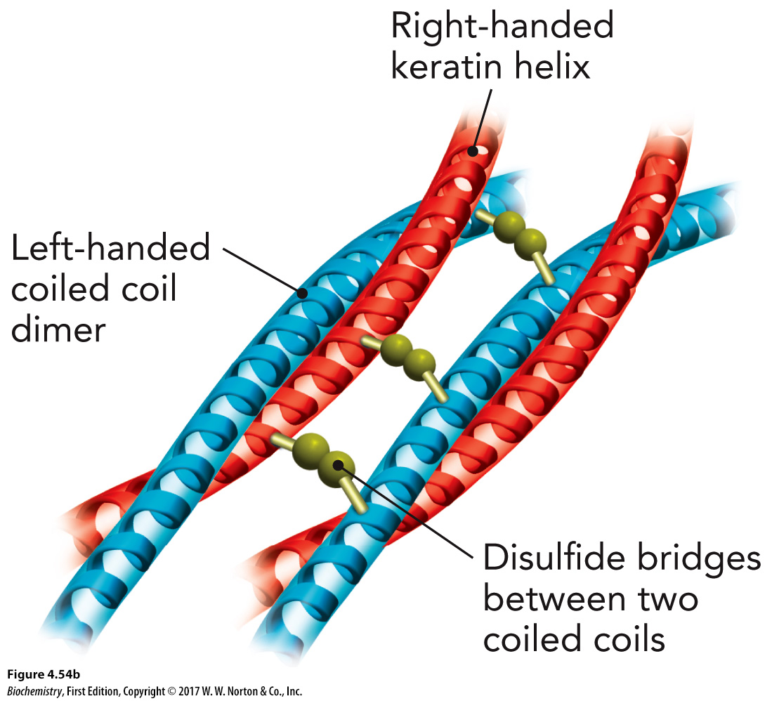
Keratin: A Fibrous Protein

Slide 52
Silk Protein: A Fibrous Protein

Slide 53
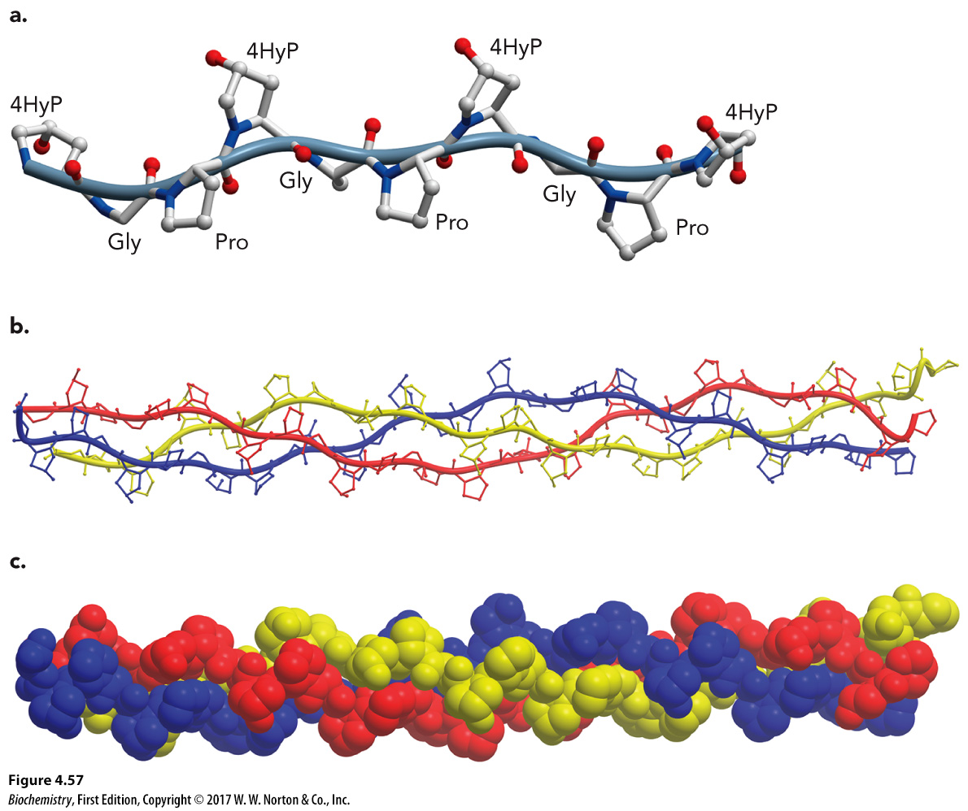
Collagen: A Fibrous Protein

Slide 54
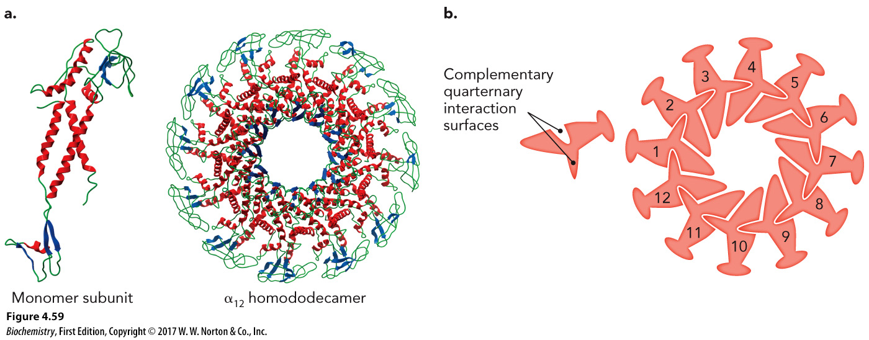
Globular Proteins
Spherical proteins that consist of multi-subunit protein complexes

Slide 55
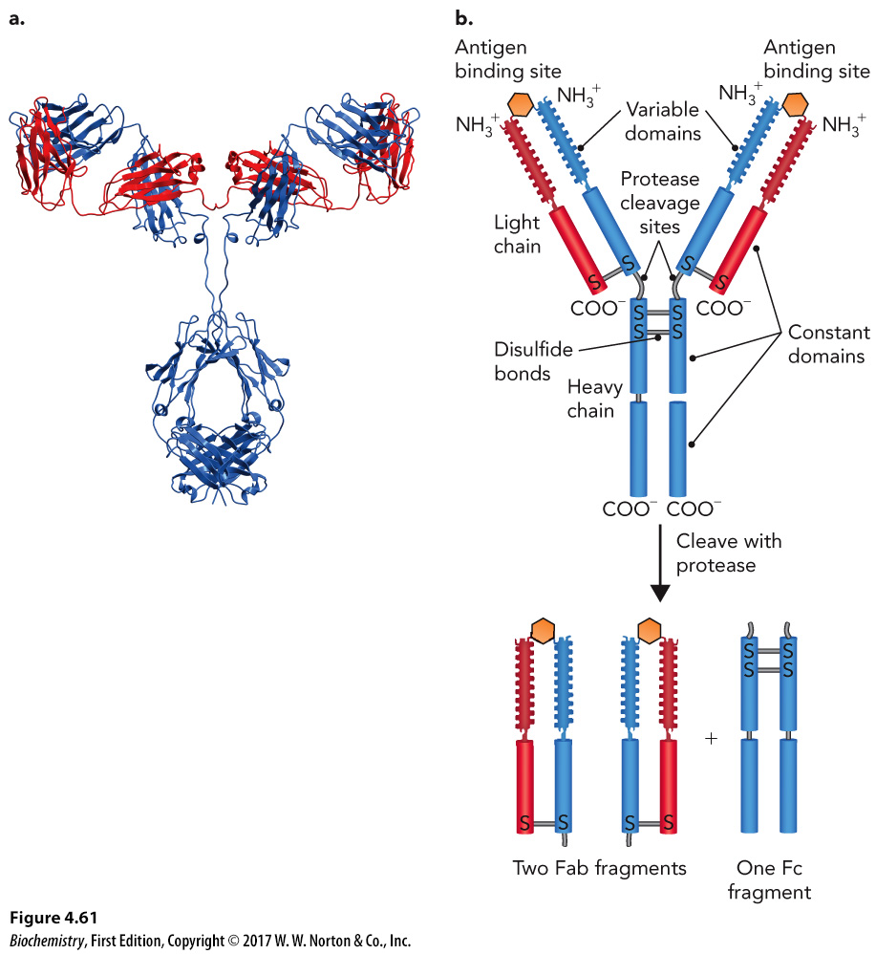
Immunoglobulins: An Example of Globular Proteins

Slide 56
4.3 Protein Folding, Part 1
Primary sequence leads to a limited number of possible folding pathways.

Slide 57
4.3 Protein Folding, Part 2

Slide 58
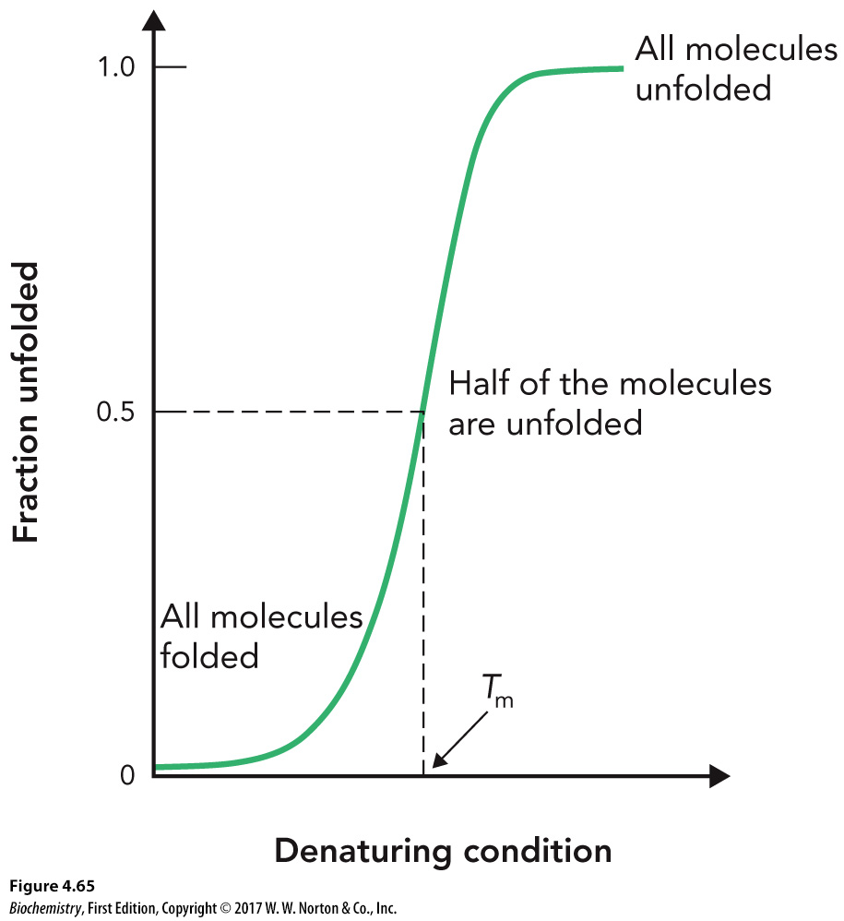
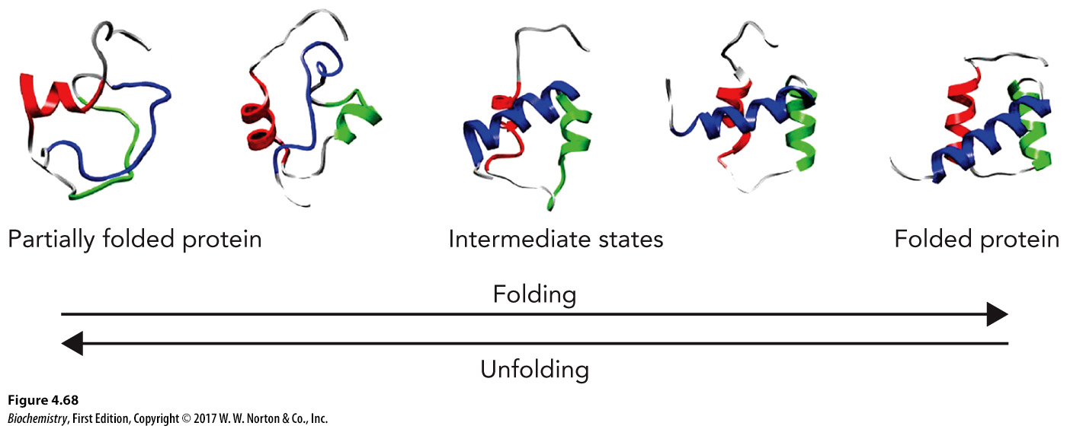
Cooperativity in Protein Folding

Slide 59
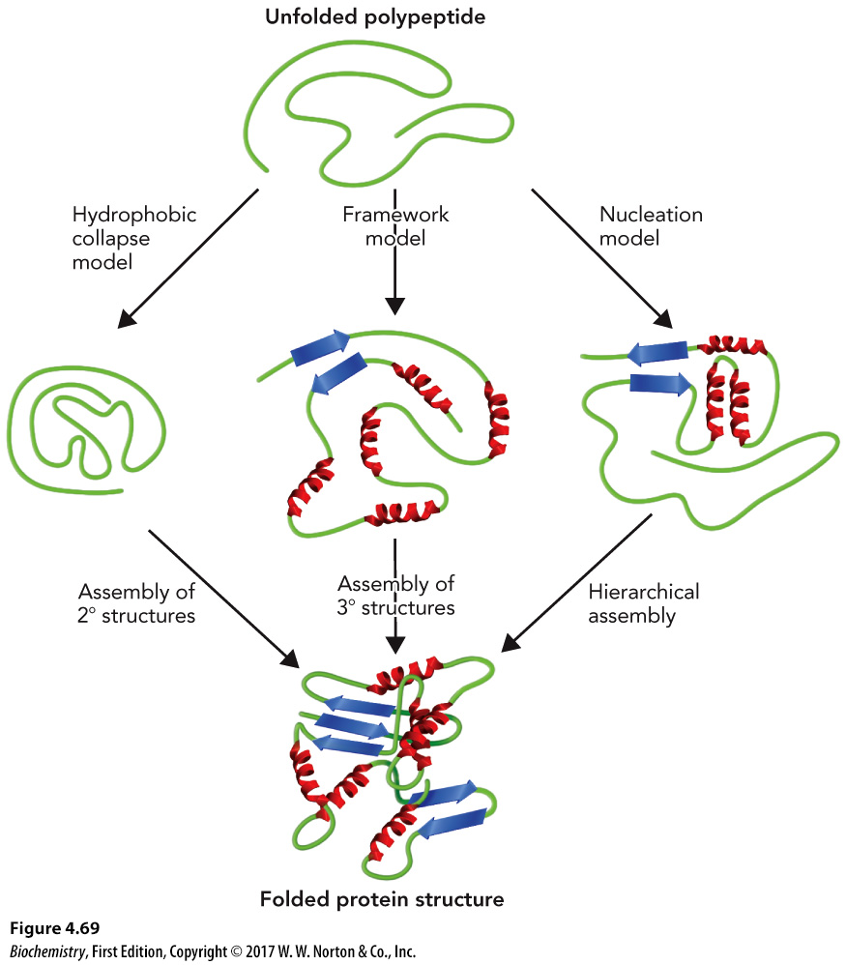
Proposed Models of Protein Folding

Slide 60
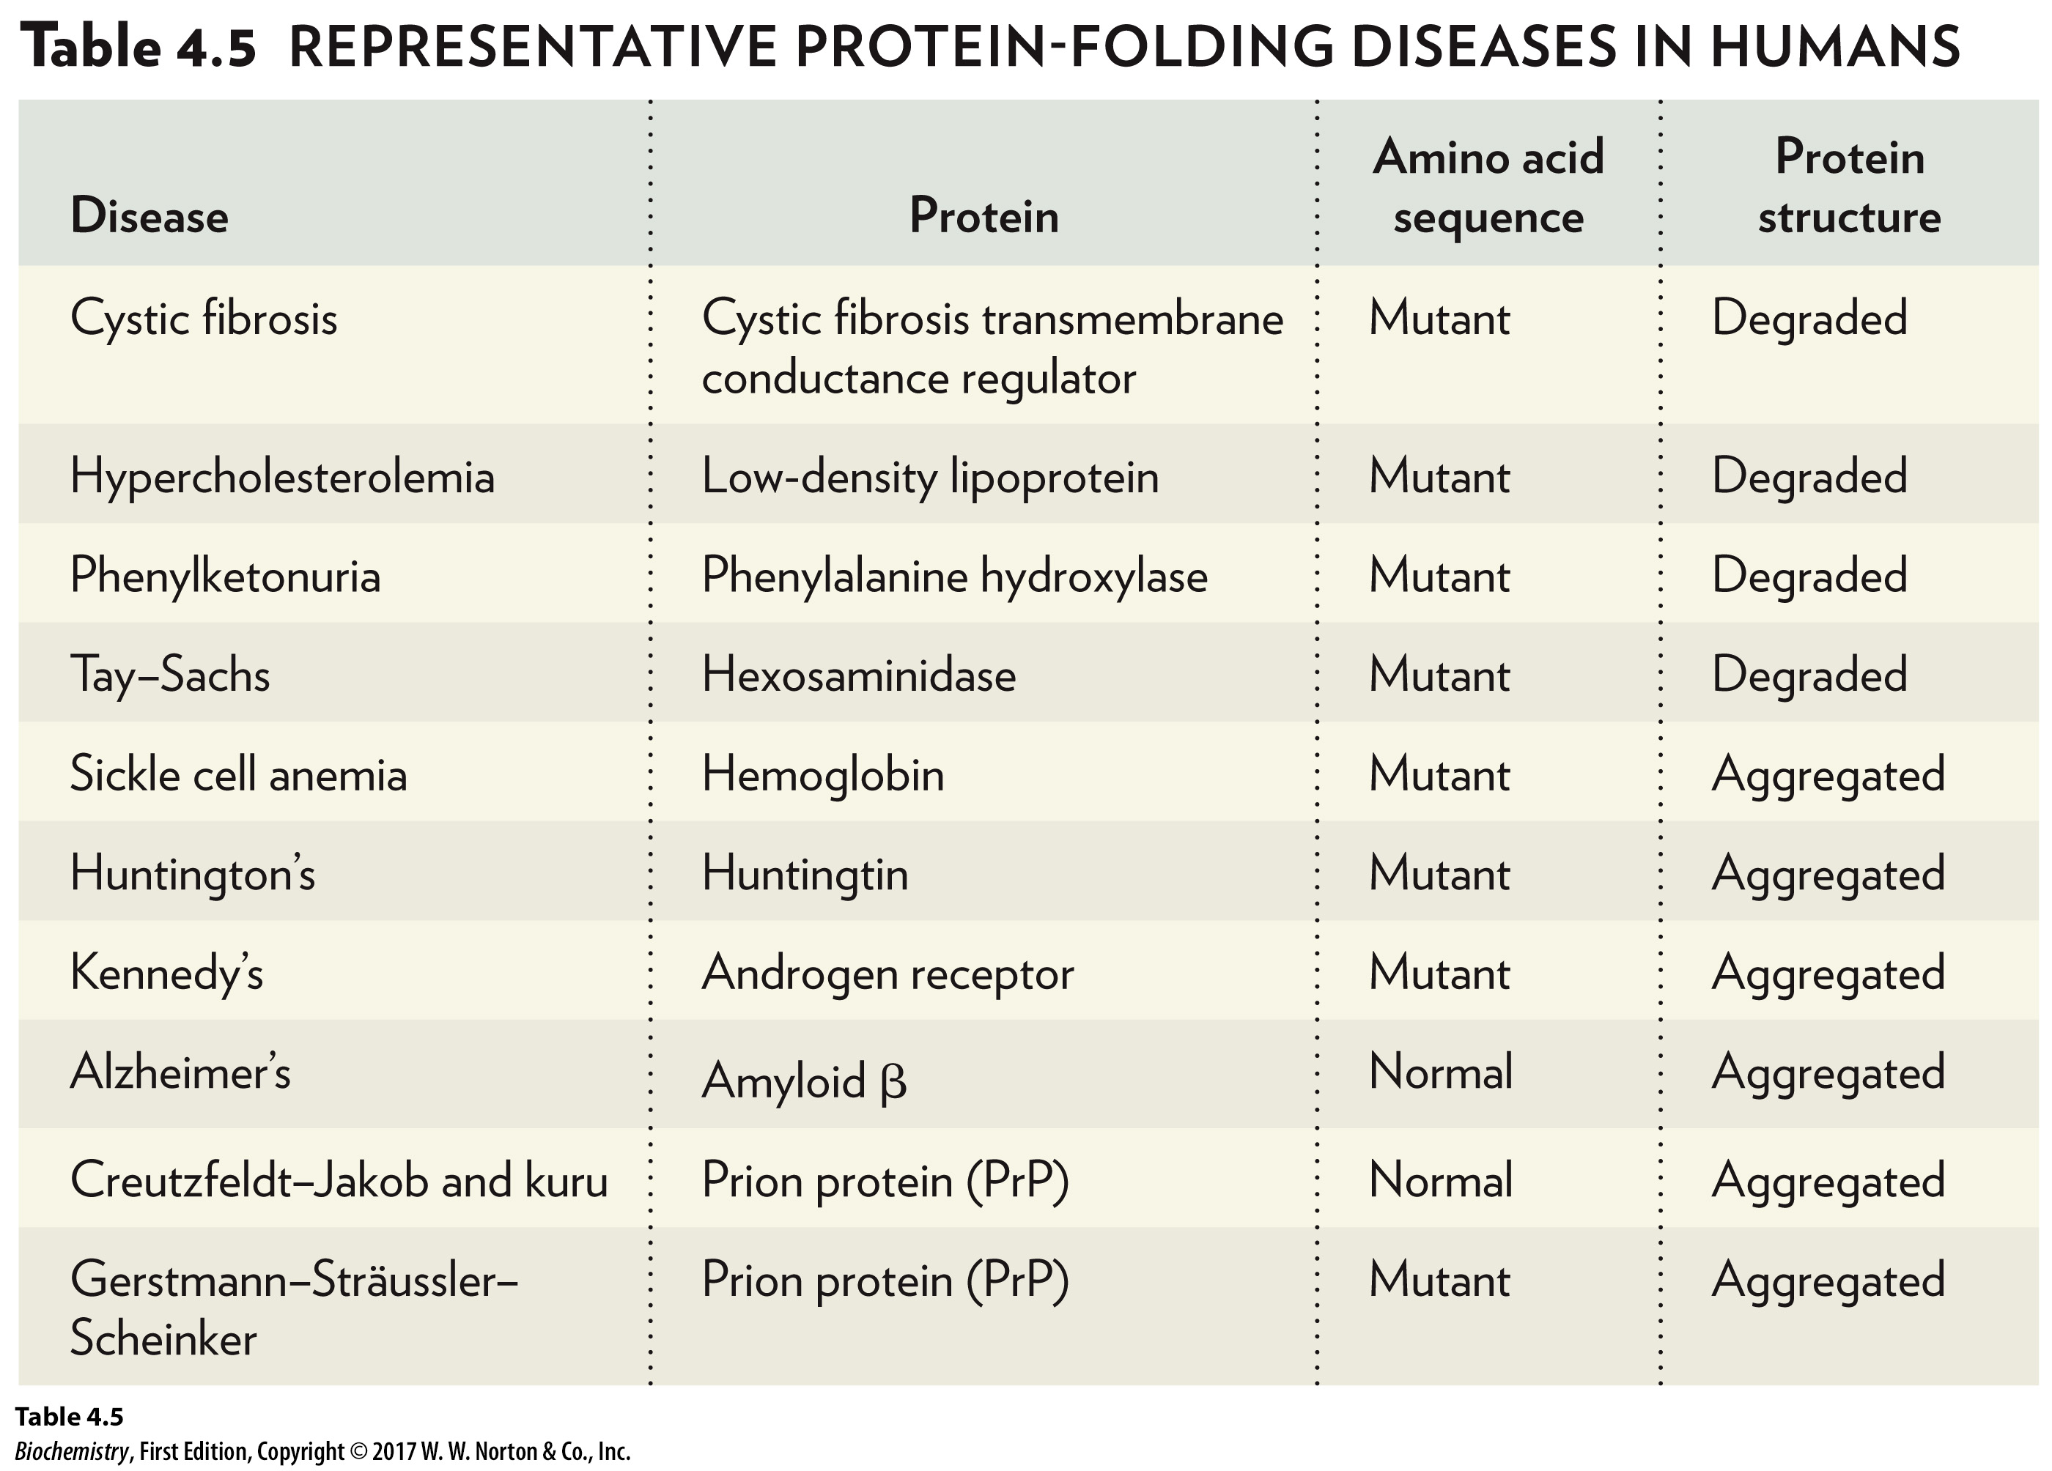
Protein Misfolding Can Lead to Disease
Disease | Protein | Amino acid sequence | Protein structure
Cystic fibrosis | Cystic fibrosis transmembrane conductance regulator | Mutant | Degraded
Hypercholesterolemia | Low-density lipoprotein | Mutant | Degraded
Phenylketonuria | Phenylalanine hydroxylase | Mutant | Degraded
Tay-Sachs | Hexosaminidase | Mutant | Degraded
Sickle cell anemia | Hemoglobin | Mutant | Aggregated
Huntington's | Huntingtin | Mutant | Aggregated
Kennedy's | Androgen receptor | Mutant | Aggregated
Alzheimer's | Amyloid beta | Normal | Aggregated
Creutzfeldt-Jakob and kuru | Prion protein (Upper P r Upper P) | Normal | Aggregated
Gerstmann-Sträussler-Scheinker | Prion protein (Upper P r Upper P) | Mutant | Aggregated

Slide 61
Genetic Mutations Due to Protein Misfolding
Aspect | Cystic Fibrosis | Huntington's Disease | Creutzfeldt-Jakob Disease
Gene variation | Gene contains mutation or deletion | Gene contains polyglutamine track expansion | Gene encodes wild-type protein sequence
This variation produces: | Misfolded protein | Misfolded protein | Protein conformation 1 is at equilibrium with protein conformation 2
Type of protein | Degraded | Aggregated | Aggregated
Result | Loss of function | Gain of function | Gain of function

