Slide 1
Chapter 7
Enzyme Mechanisms

Slide 2
7.1 Overview of Enzymes
1926 – James Sumner discovered that enzymes are proteins.
Urease was the first enzyme to be crystallized and purified.
1929 – John Northrop purified pepsin.

Slide 3
Enzyme Specificity
Lock and key
Induced fit

Slide 4
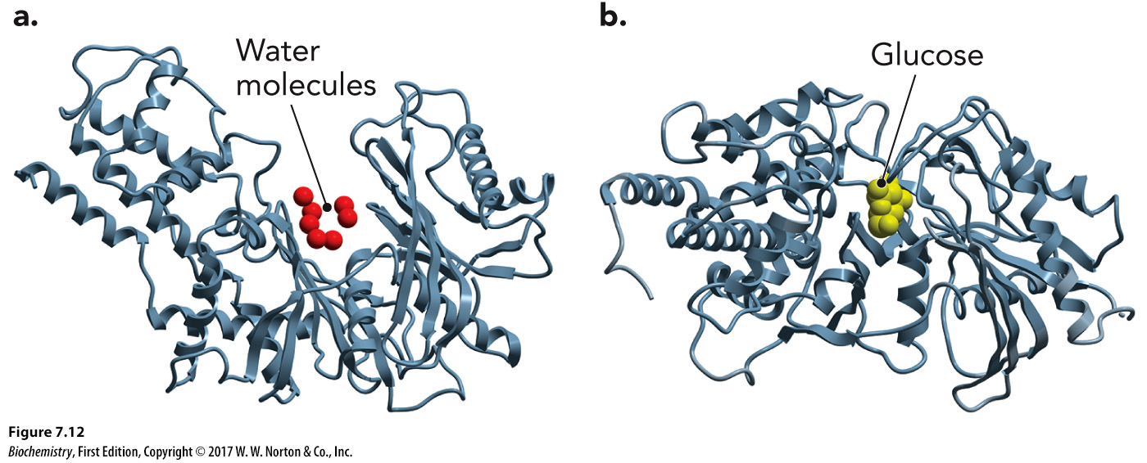
Hexokinase: An Induced Fit Mechanism

Slide 5
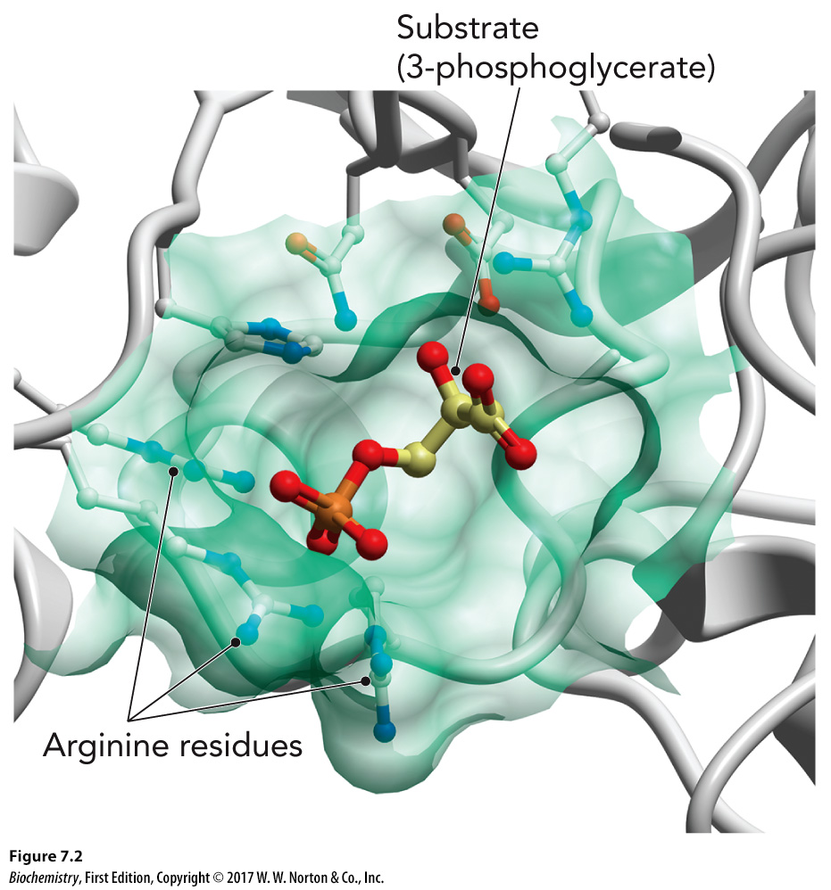
Critical Aspects of Enzyme Structure and Function, Part 1

Slide 6
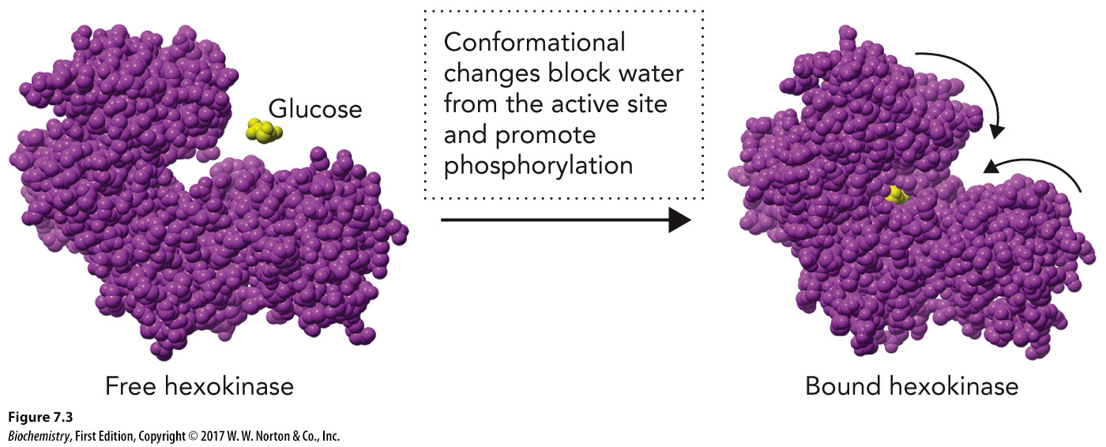
Critical Aspects of Enzyme Structure and Function, Part 2

Slide 7
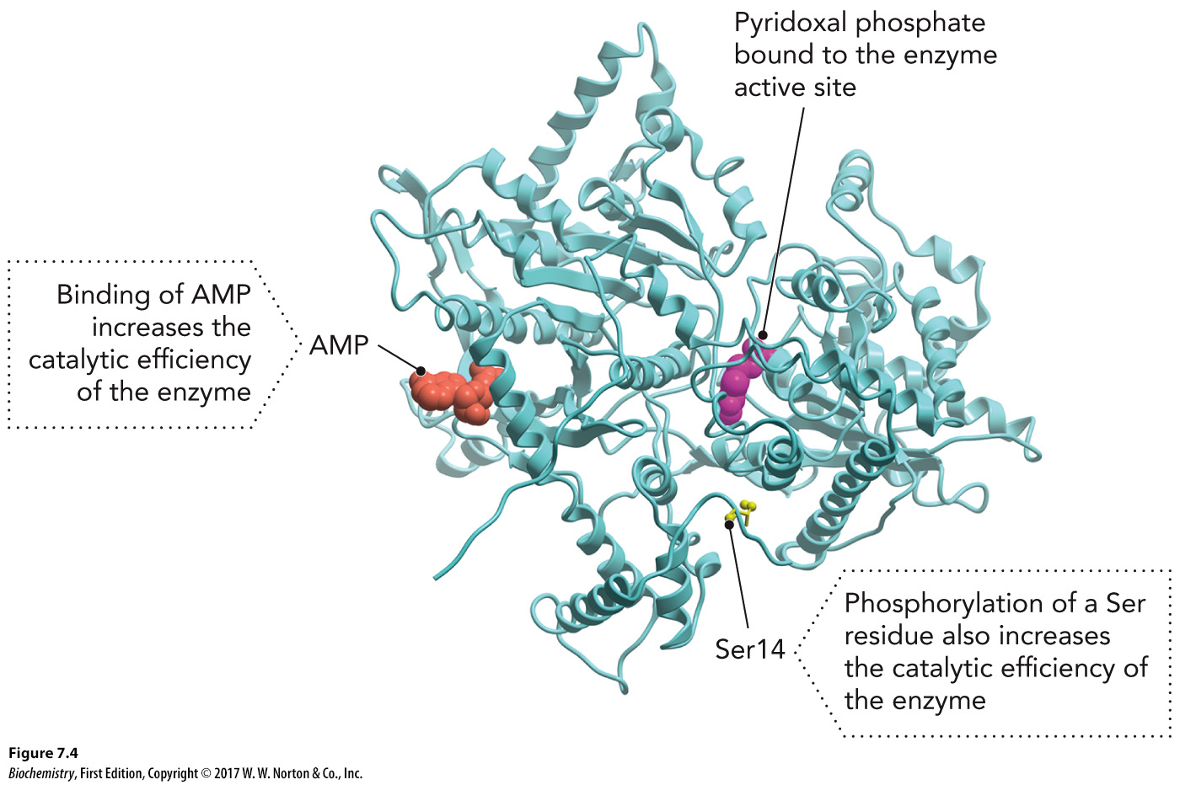
Critical Aspects of Enzyme Structure and Function, Part 3

Slide 8
Enzymes Are Chemical Catalysts

Slide 9
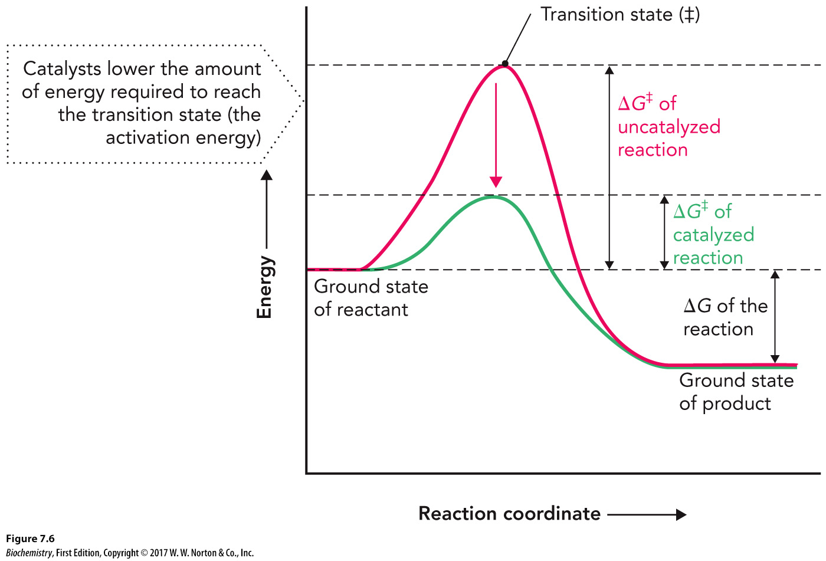
Reaction Coordinate Diagram

Slide 10
Cofactors and Coenzymes
Cofactors
Coenzyme
Prosthetic groups – coenzymes that are permanently associated with enzymes

Slide 11
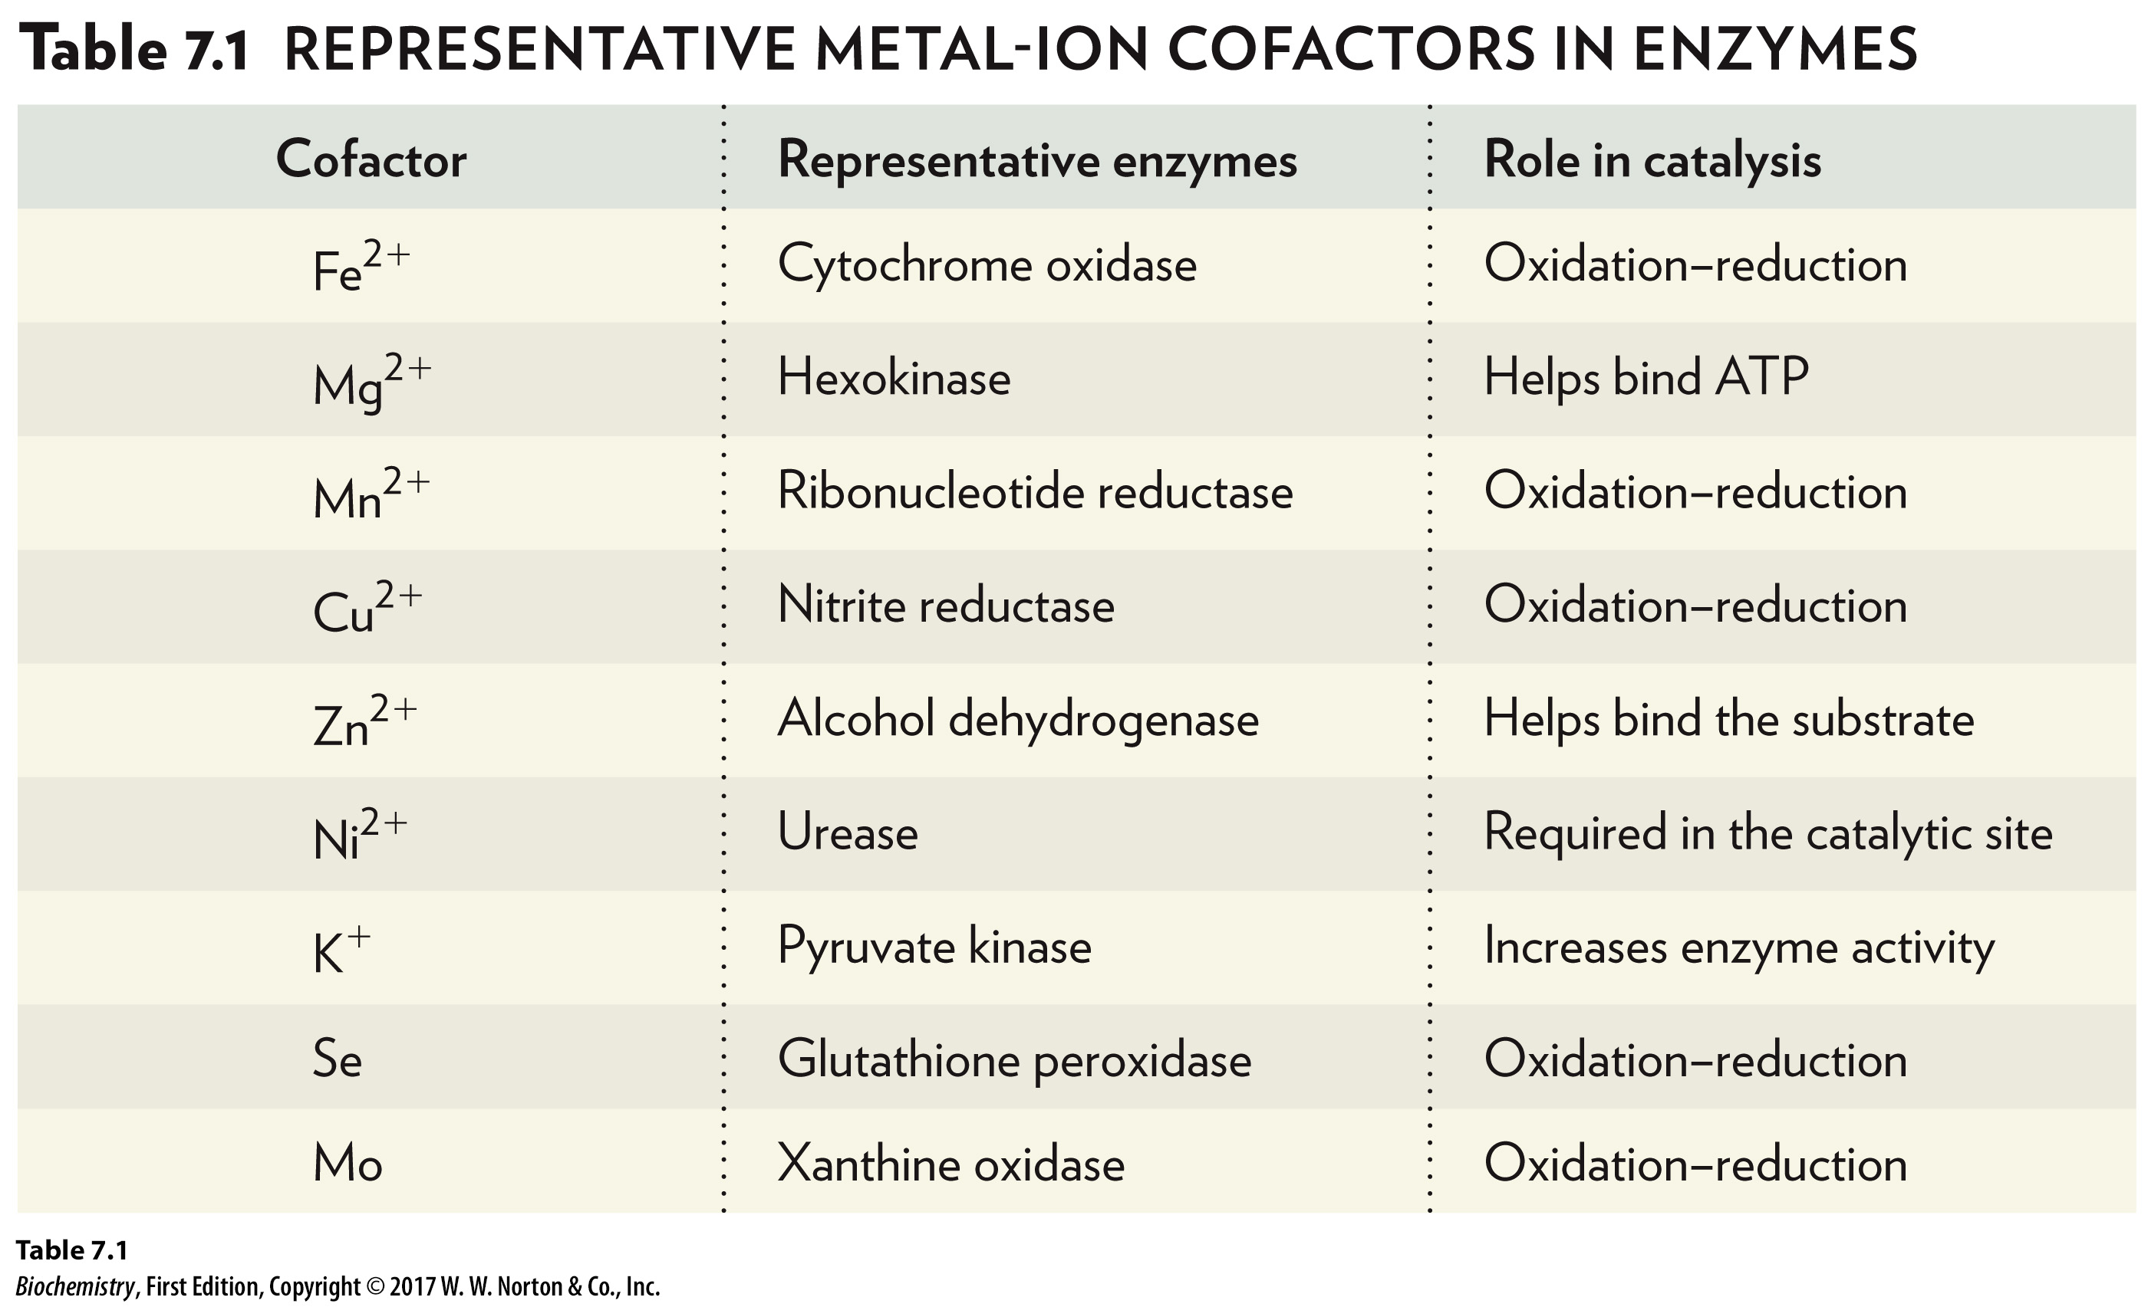
Common Cofactors Used in Catalysis
Cofactor | Representative enzymes | Role in catalysis
Positive 2 iron ion | Cytochrome oxidase | oxidation-reduction
Positive 2 magnesium ion | Hexokinase | Helps bind ATP
Positive 2 Manganese ion | Ribonucleotide reductase | oxidation-reduction
Positive 2 copper ion | Nitrate reductase | oxidation-reduction
Positive 2 zinc ion | Alcohol dehydrogenase | Helps bind the substrate
Positive 2 nickel ion | Urease | Required in the catalytic site
Positive 2 potassium ion | Pyruvate kinase | Increase enzyme activity
Selenium | Glutathione peroxidase | oxidation-reduction
Molybdenum | Xanthine oxidase | oxidation-reduction

Slide 12
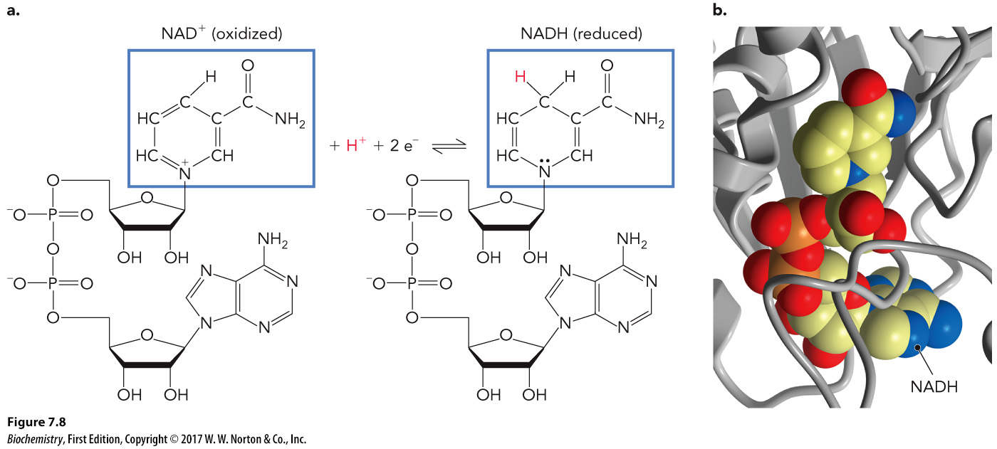
NAD⁺/NADH Redox Reaction

Slide 13
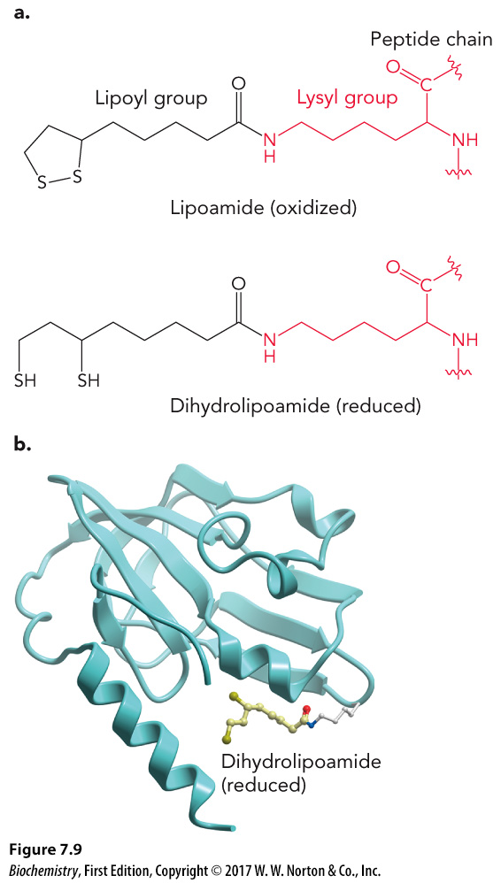
Lipoamide as a Coenzyme

Slide 14
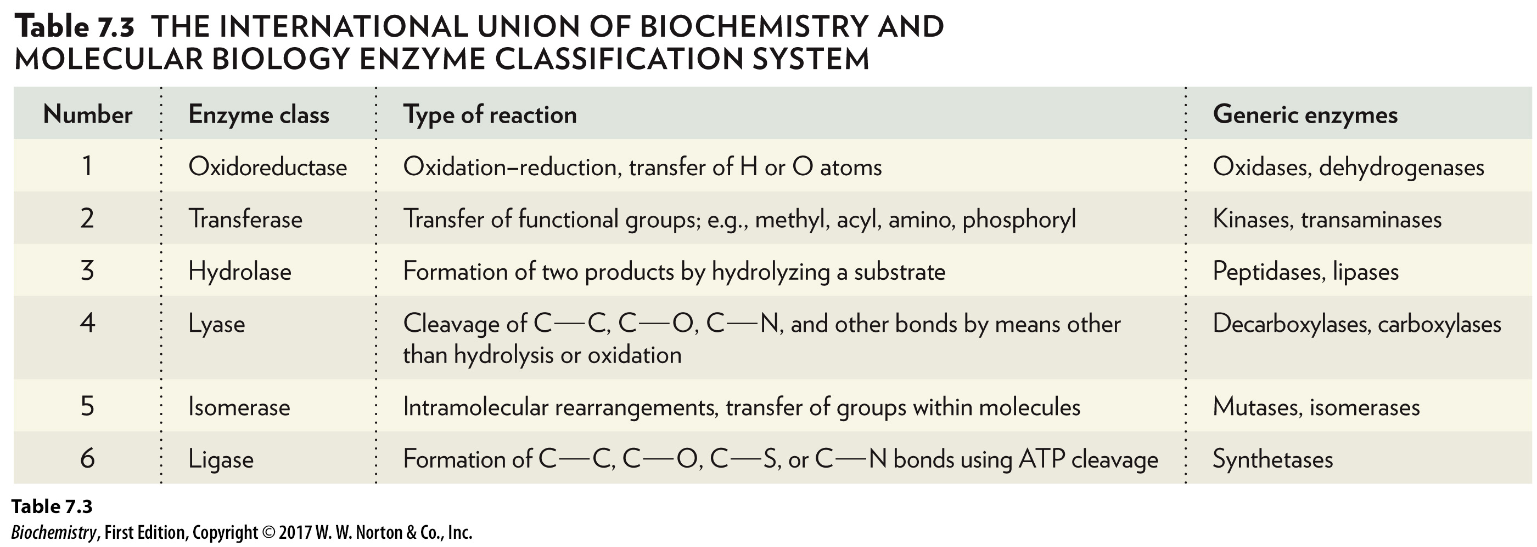
Enzyme Nomenclature
Most enzymes end in “-ase.”
The substrate is usually included in the name.
Number | Enzyme class | Type of reaction | Generic enzymes
1 | Oxidoreductase | Oxidation-reduction, transfer of upper H or upper O atoms | Oxidases, dehydrogenases
2 | Transferase | Transfer of functional groups; e.g., methyl, acyl, amino, phosphoryl | Kinase, transaminases
3 | Hydrolase | Formation of two products by hydrolyzing a substrate | Peptidases, lipases
4 | Lyase | Cleavage of Carbon carbon single bond, carbon oxygen single bond, carbon nitrogen single bond and other bonds by means other than hydrolysis or oxidation | Decarboxylases, carboxylases
5 | Isomeracse | Intramolecular rearrangements, transfer of groups within molecules | Mutases, isomerases
6 | Ligase | Formation of carbon carbon single bond, carbon oxygen single bond, carbon sulfur single bond or carbon nitrogen single bond using ATP cleavage | Synthetases

Slide 15
7.2 Enzyme Structure and Function
Enzymes increase the rate of reaction in three major ways:

Slide 16
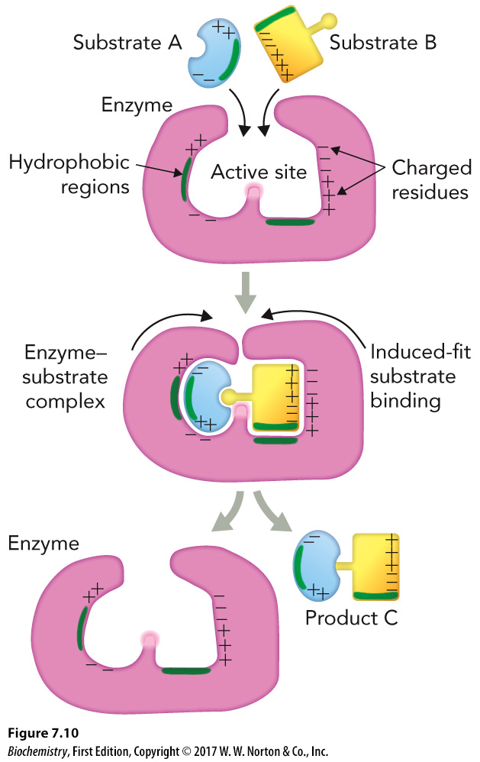
Physical and Chemical Properties of Active Sites

Slide 17
Active Sites Contribute to Catalytic Properties
Sequestered microenvironment of the active site
Binding interactions between the substrate and the enzyme to create a transition state
Presence of catalytic functional groups

Slide 18
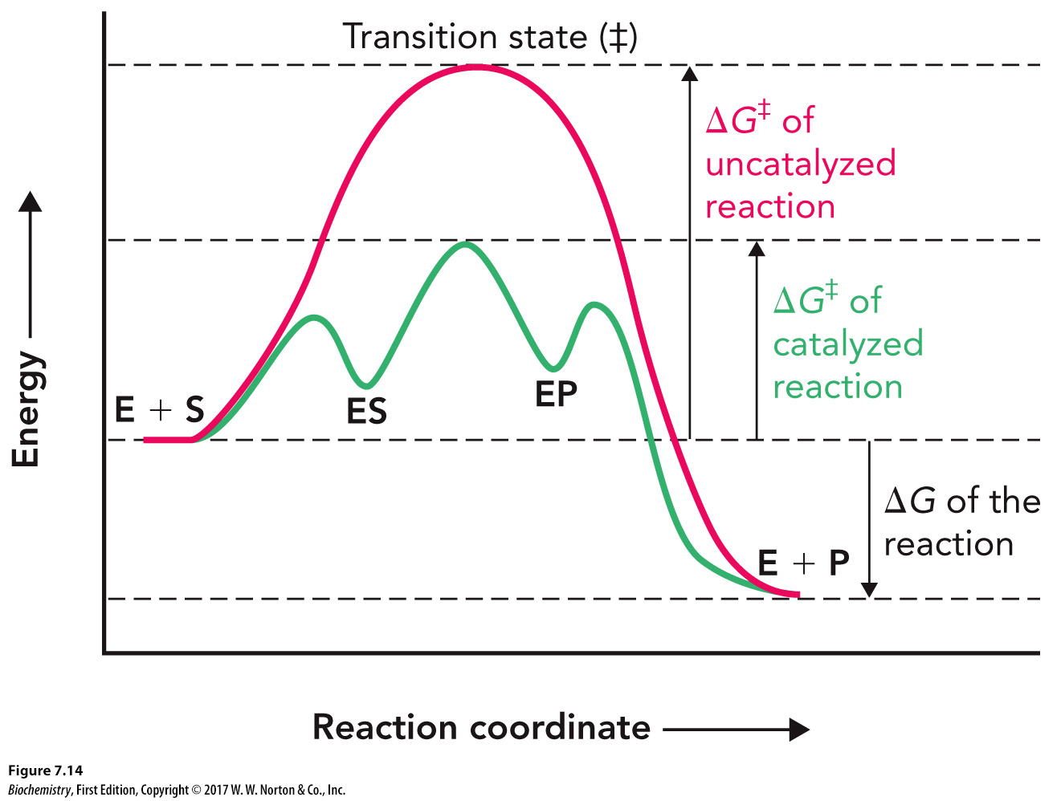
Stabilization of the Transition State

Slide 19
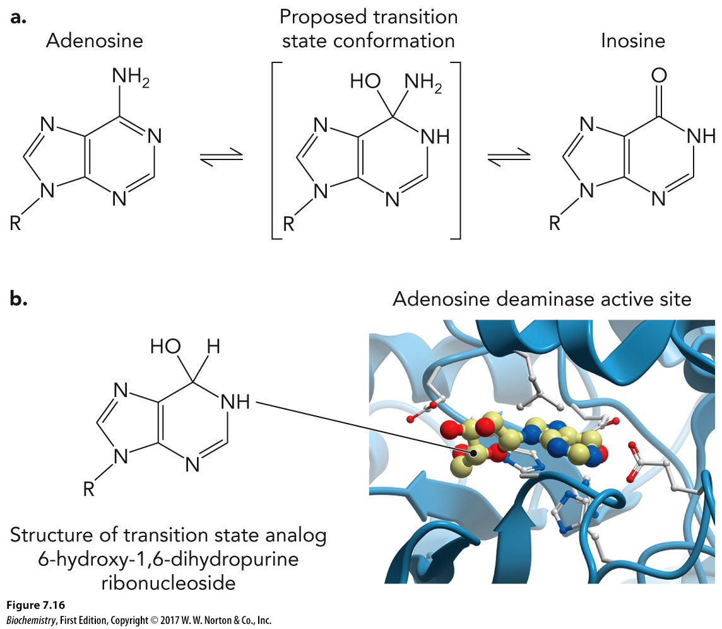
Transition State Analogs

Slide 20
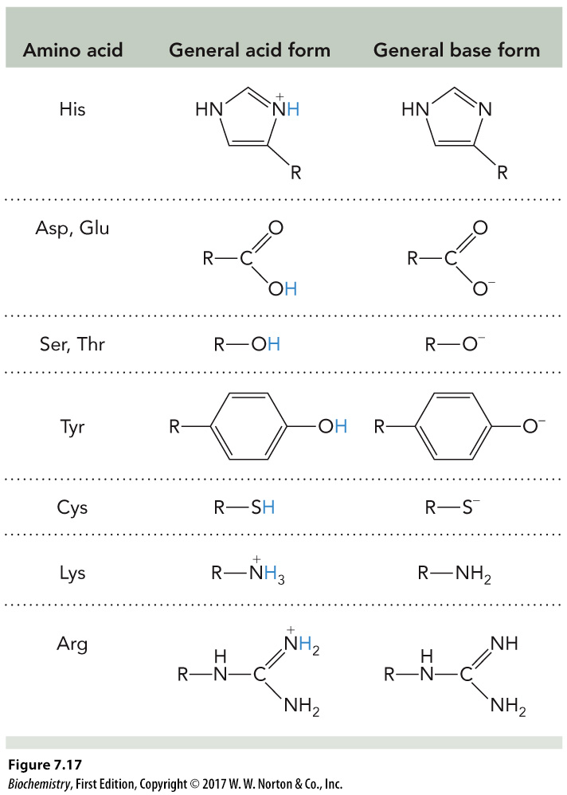
Catalytic Functional Groups
Amino acid | General acid form | General base form
His | (The imidazole part of the side chain. One of the nitrogen in the five-membered ring is positive and has an extra hydrogen) | (The imidazole part of the side chain. One of the nitrogen in the five-membered ring is neutral and has no hydrogen)
Asp, Glu | (The carboxylic acid group of the side chain for asp and glu) | (The deprotonated carboxylic acid group of the side chain with a negative charge on one of the oxygen)
Ser, Thr | (The hydroxyl group from the side chain for Ser and Thr) | (the deprotonated hydroxyl group from the side chain with a negative charge on the oxygen)
Tyr | (The side chain of Tyr with the hydroxyl group on the ring is neutral) | (The side chain of Tyr with a deprotenated hydroxyl group so that the oxygen has a negative charge)
Cys | (The thiol side chain on the Cyc ) | (The deprotonated thiol side chain on Cyc so that there is a negative charge on the sulfur)
Lys | (The protonated amino group of the side chain with three hydrogens and a positive charge on the nitrogen) | (The amino group part of the side chain from lys)
Arg | (The side chain of Arg with two hydrogens on the nitrogen double bonded to the carbon so that the nitrogen has a positive charge) | (the side chain of Arg which has an overall neutral charge)

Slide 21
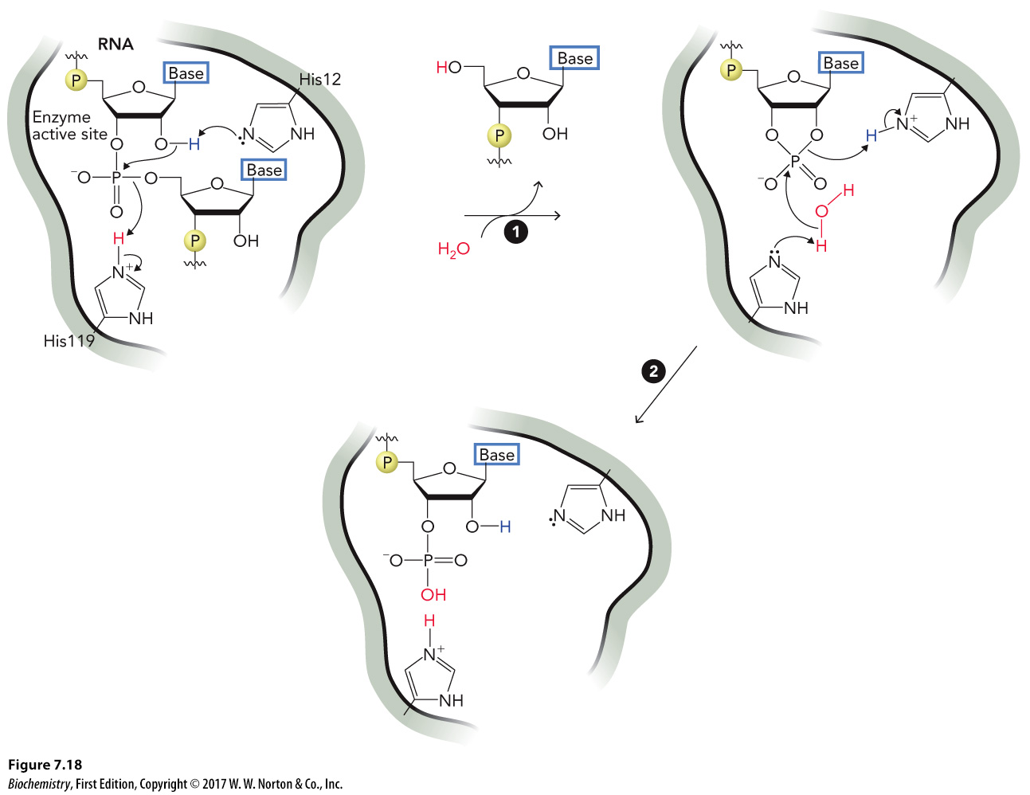
Common Catalytic Mechanisms, Part 1

Slide 22
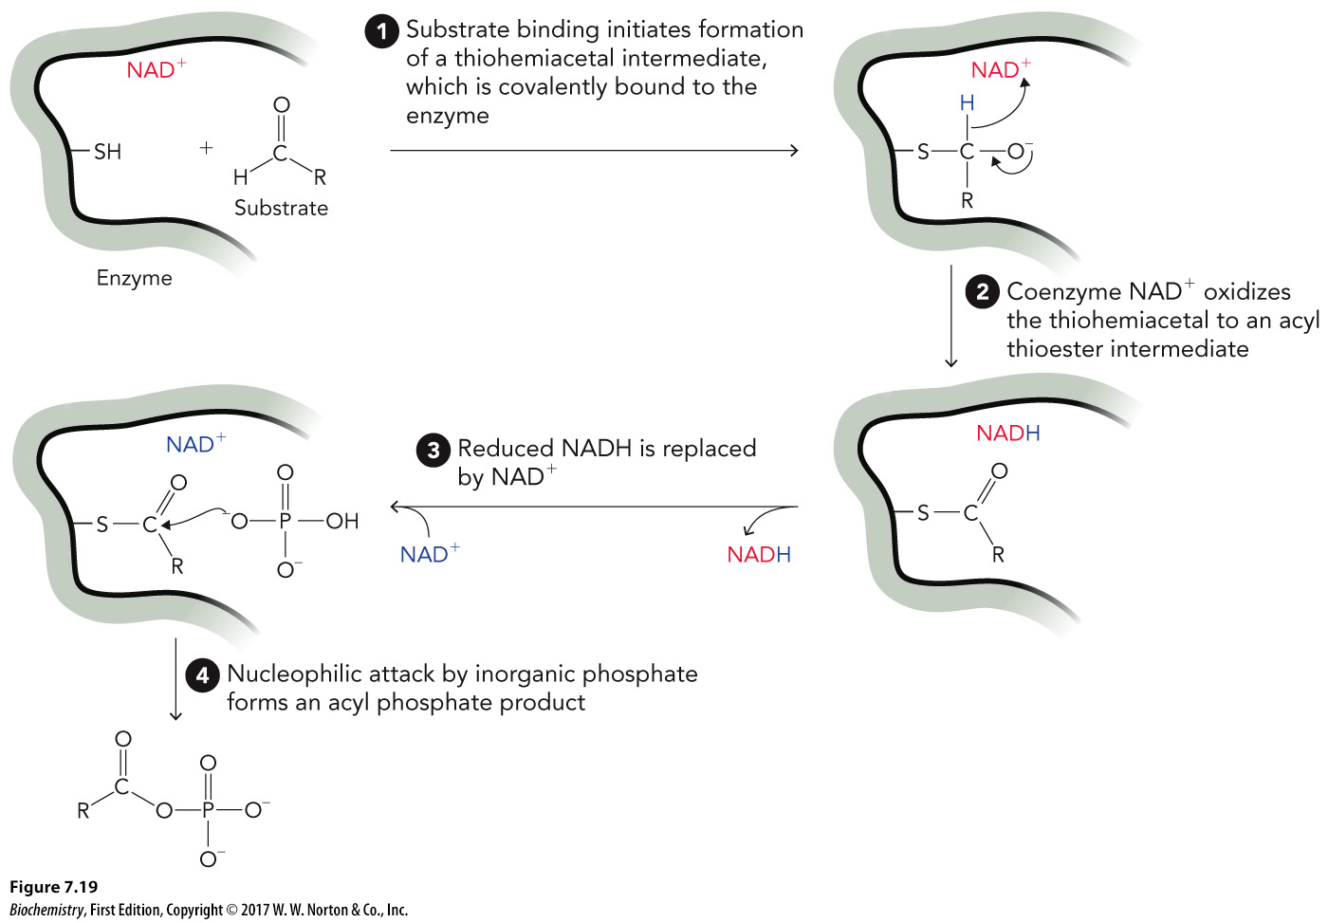
Common Catalytic Mechanisms, Part 2

Slide 23
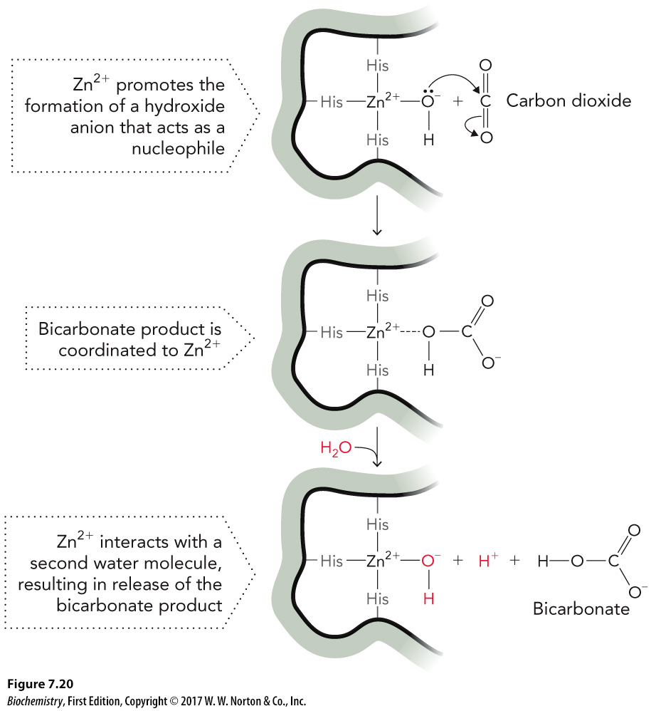
Common Catalytic Mechanisms, Part 3

Slide 24
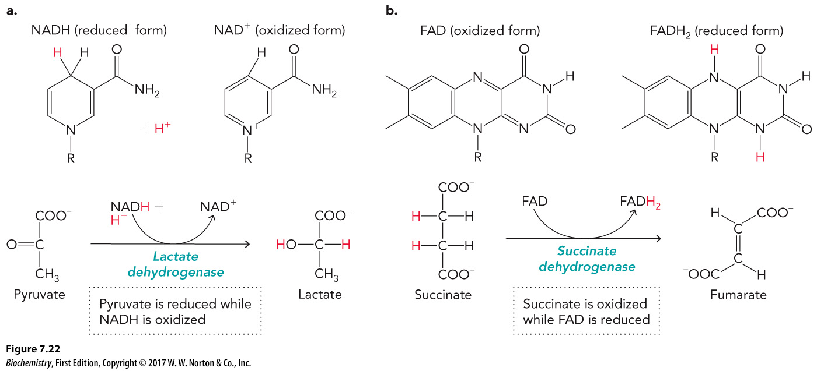
Enzyme-Mediated Reactions, Part 1

Slide 25
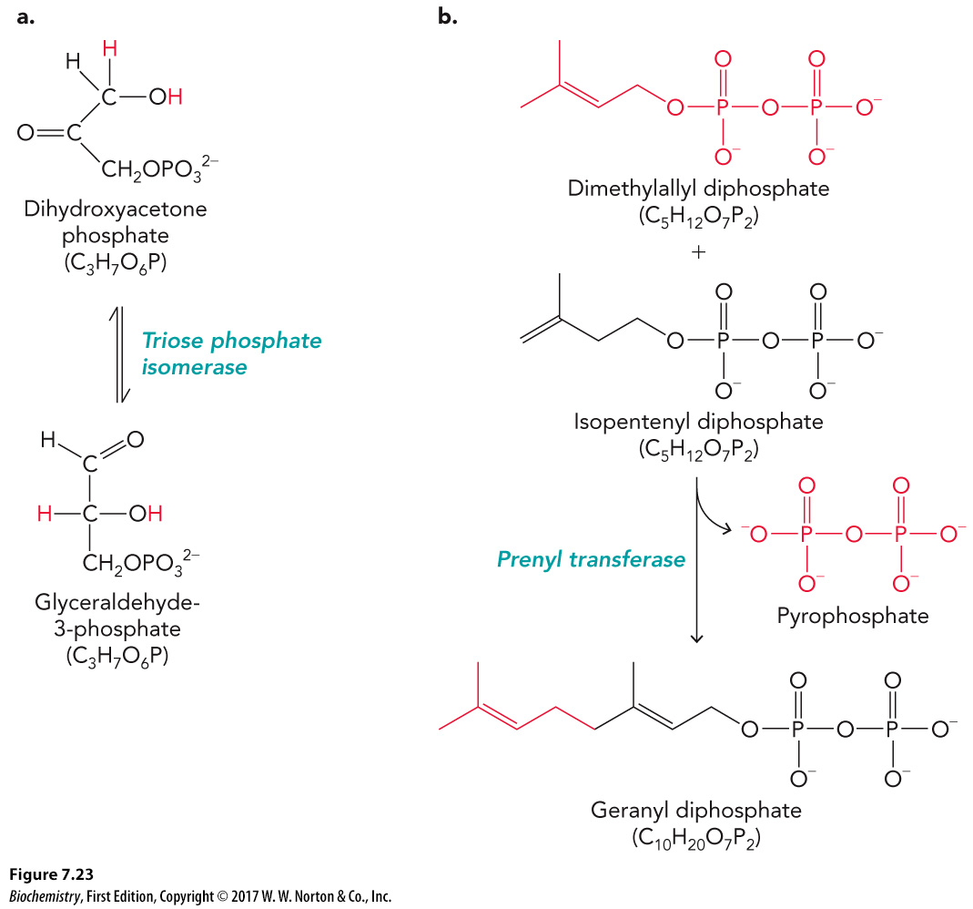
Enzyme-Mediated Reactions, Part 2

Slide 26
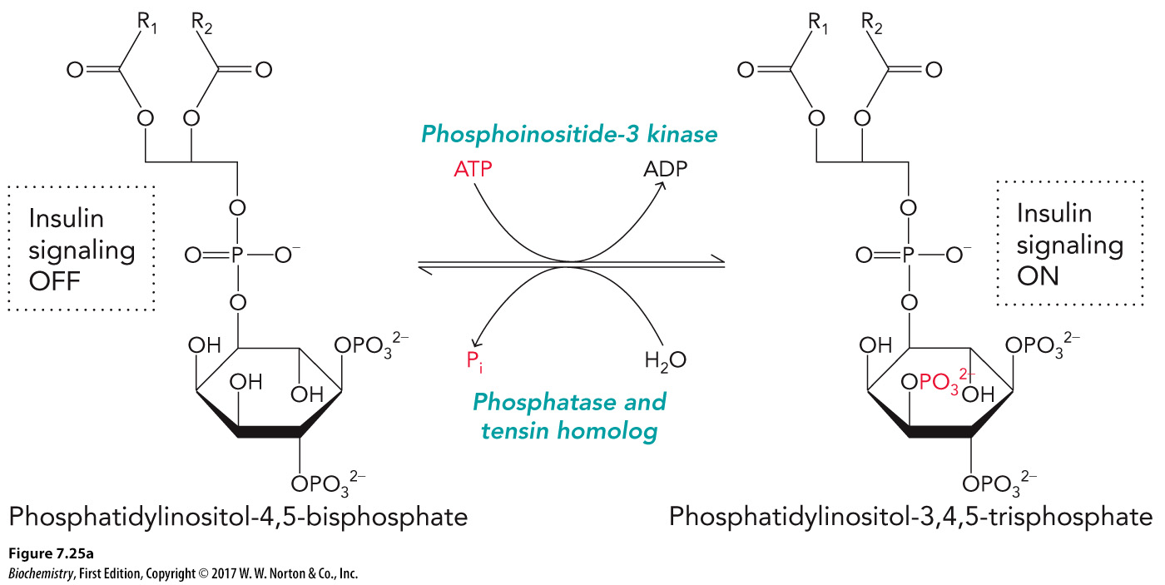
Enzyme-Mediated Reactions, Part 3

Slide 27
7.3 Enzyme Reaction Mechanism

Slide 28
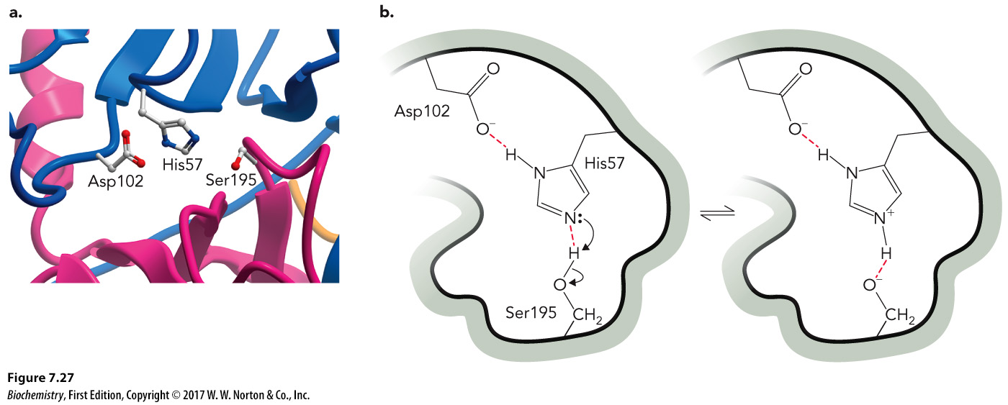
Chymotrypsin: A Serine Protease

Slide 29
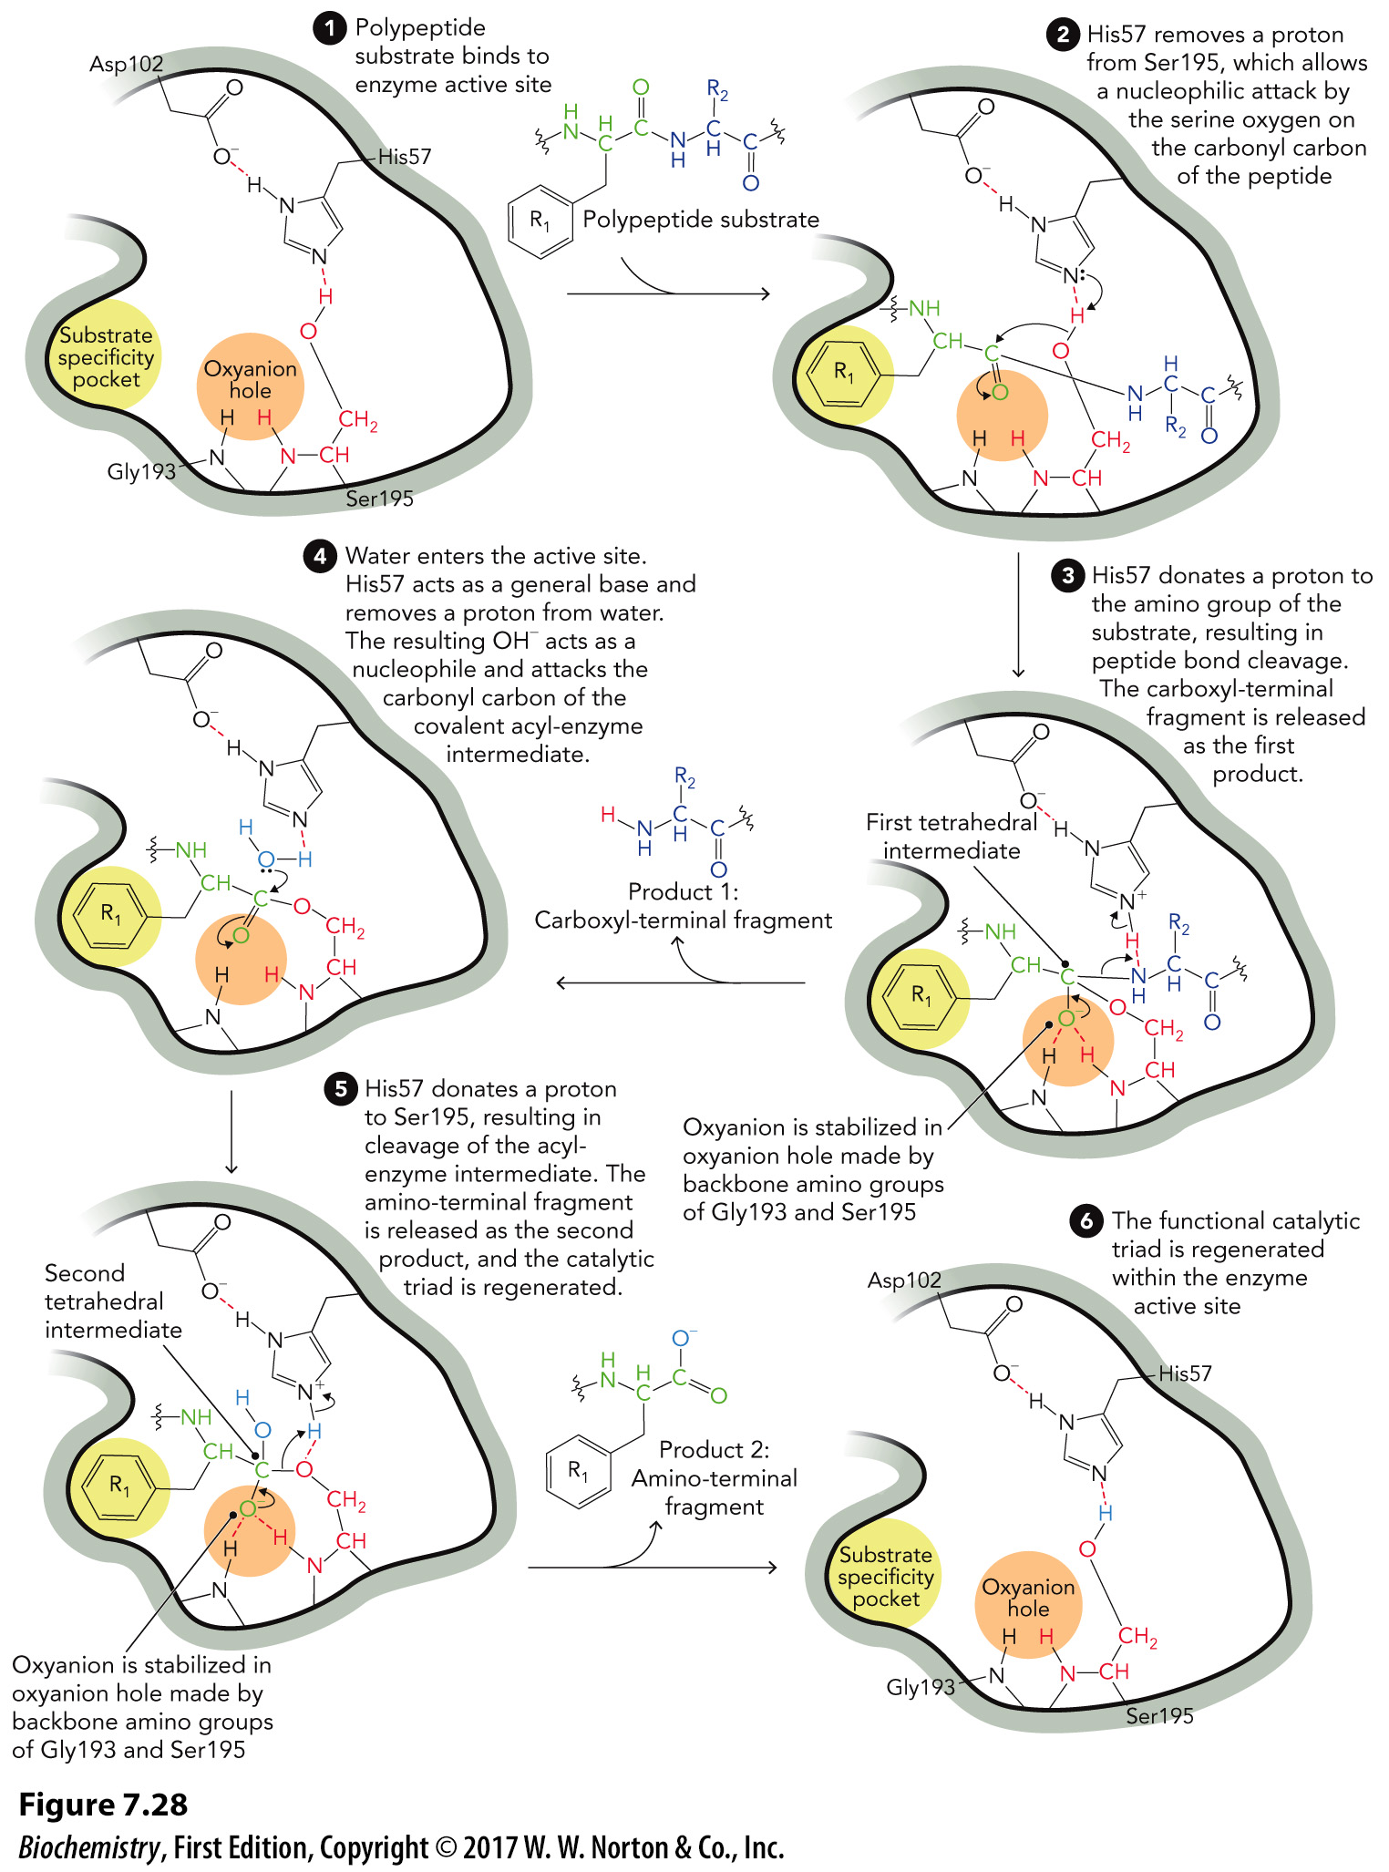
Catalytic Mechanism for Chymotrypsin

Slide 30
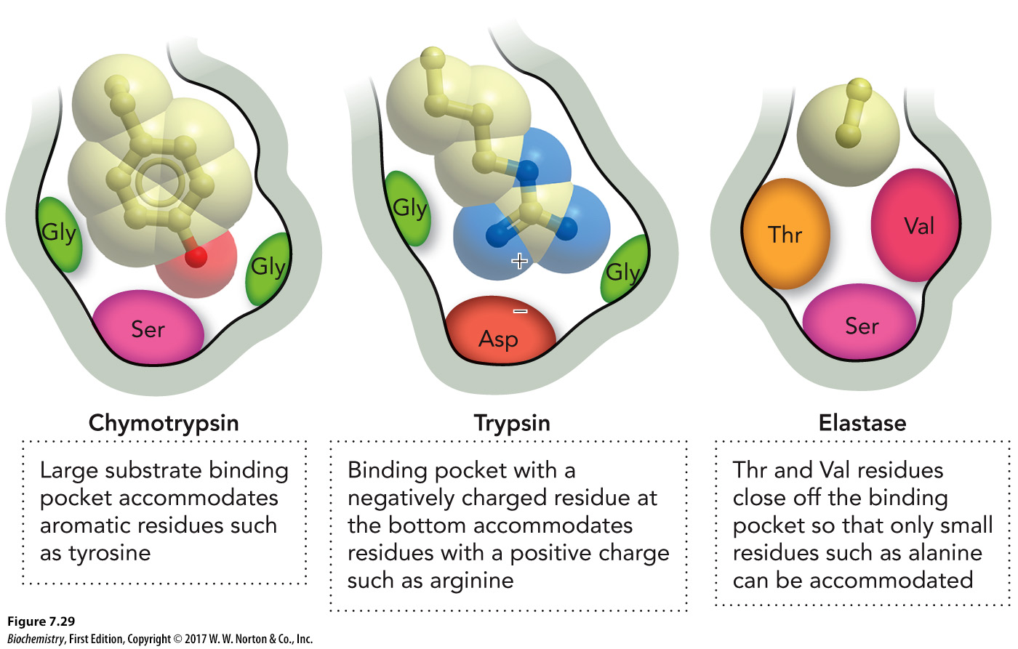
Enzyme Specificity for Binding Pockets

Slide 31
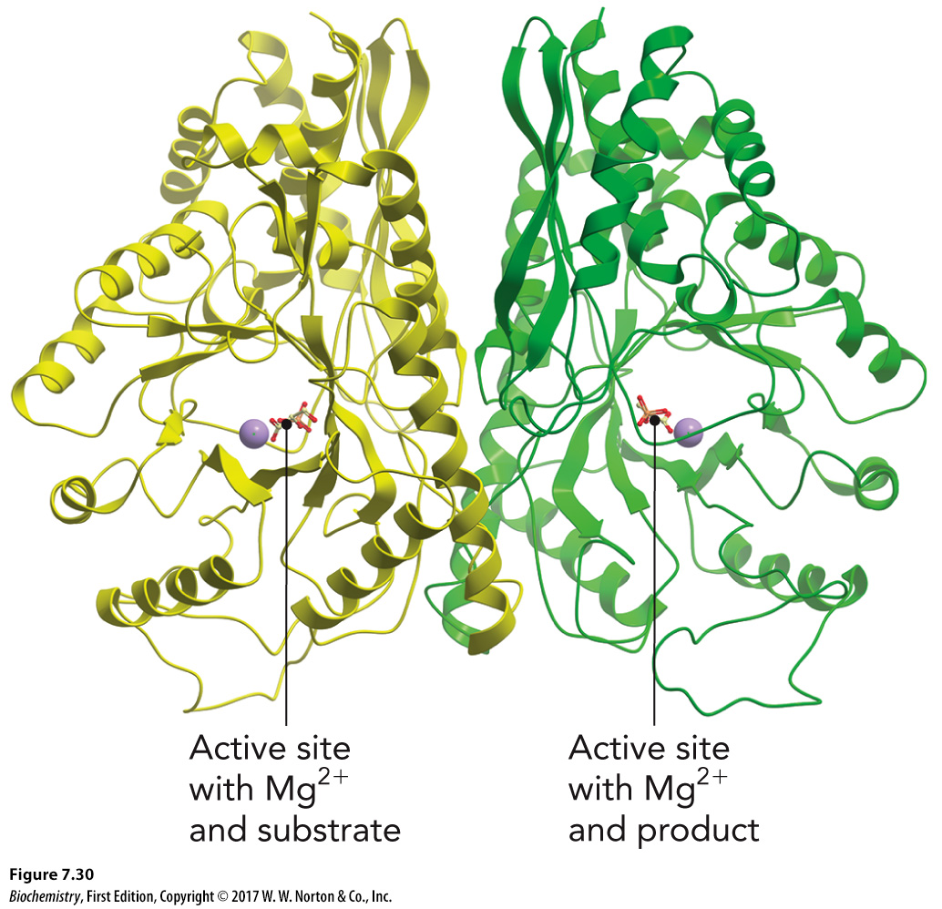
Enolase: A Metalloenzyme

Slide 32
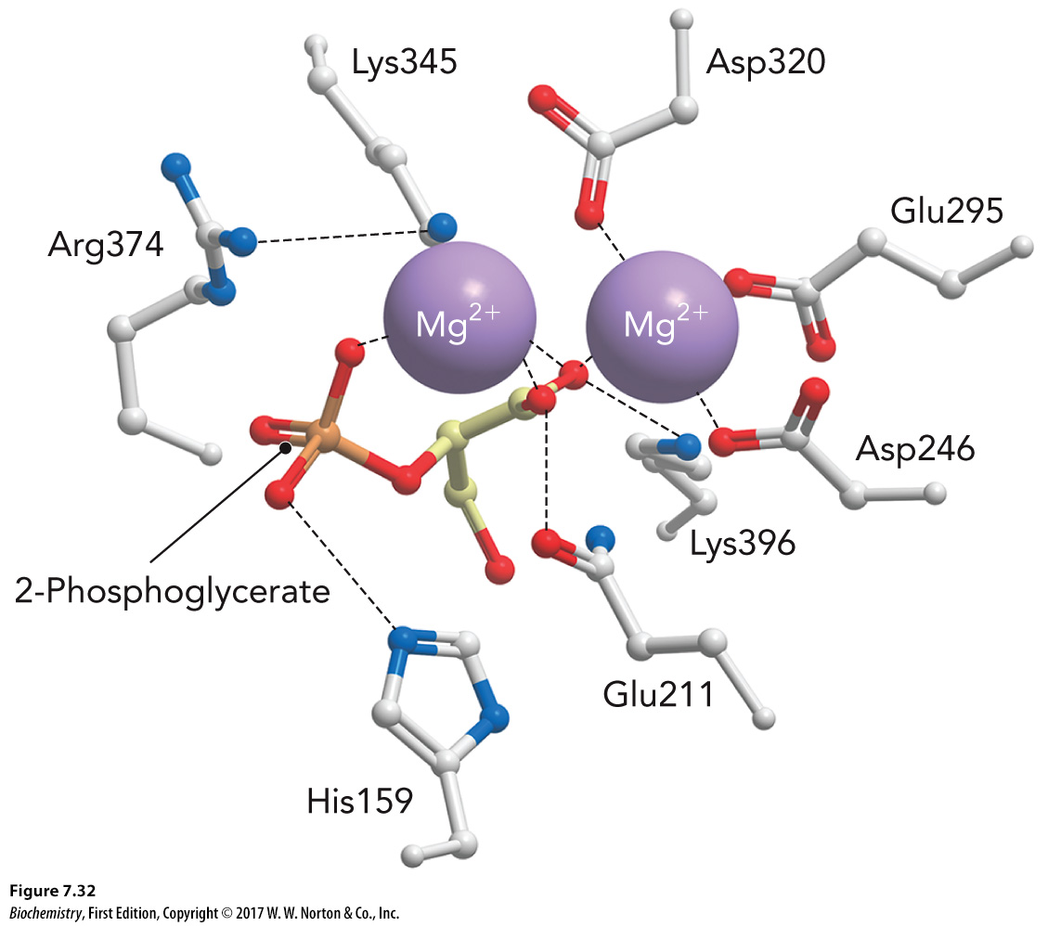
Enolase’s Active Site

Slide 33
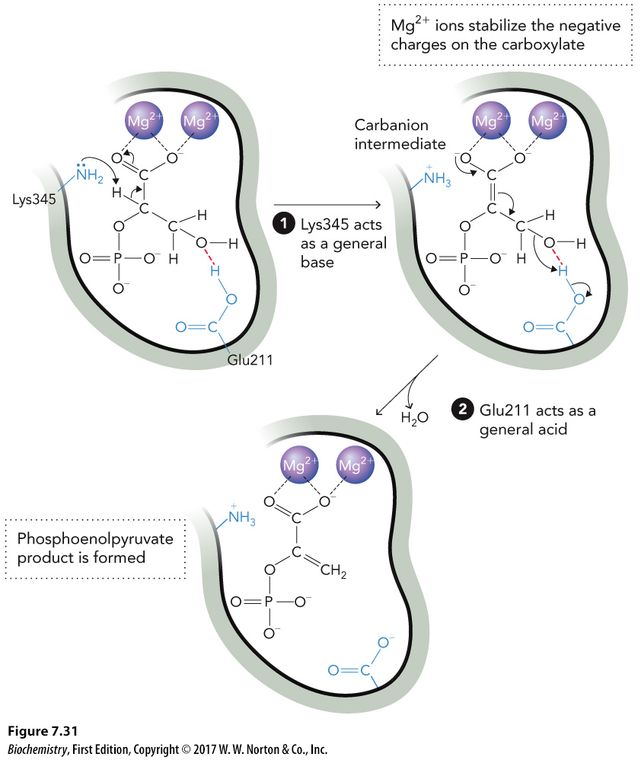
Catalytic Mechanism for Enolase

Slide 34
HMG-CoA Reductase

Slide 35
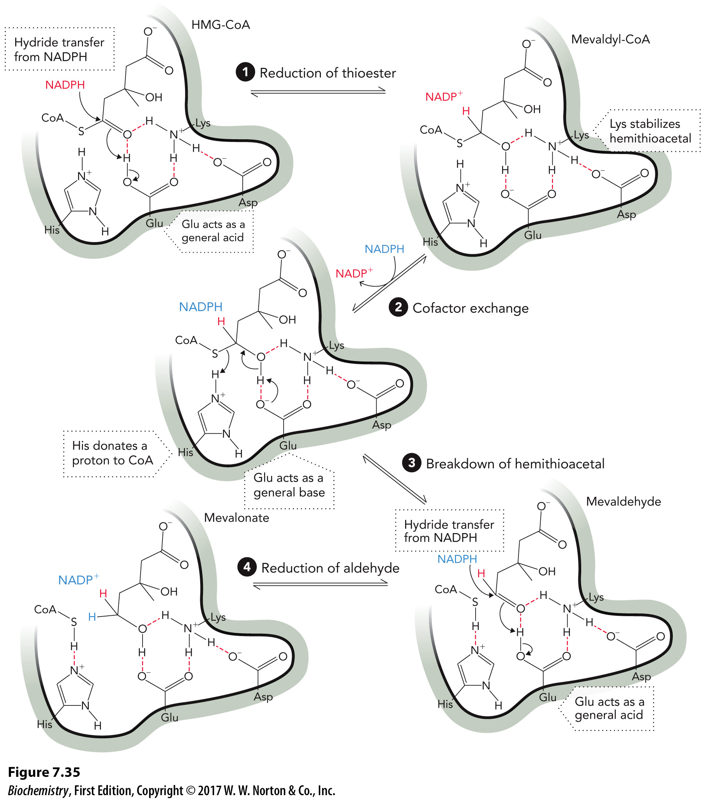
HMG-CoA Reductase Mechanism

Slide 36
7.4 Enzyme Kinetics

Slide 37
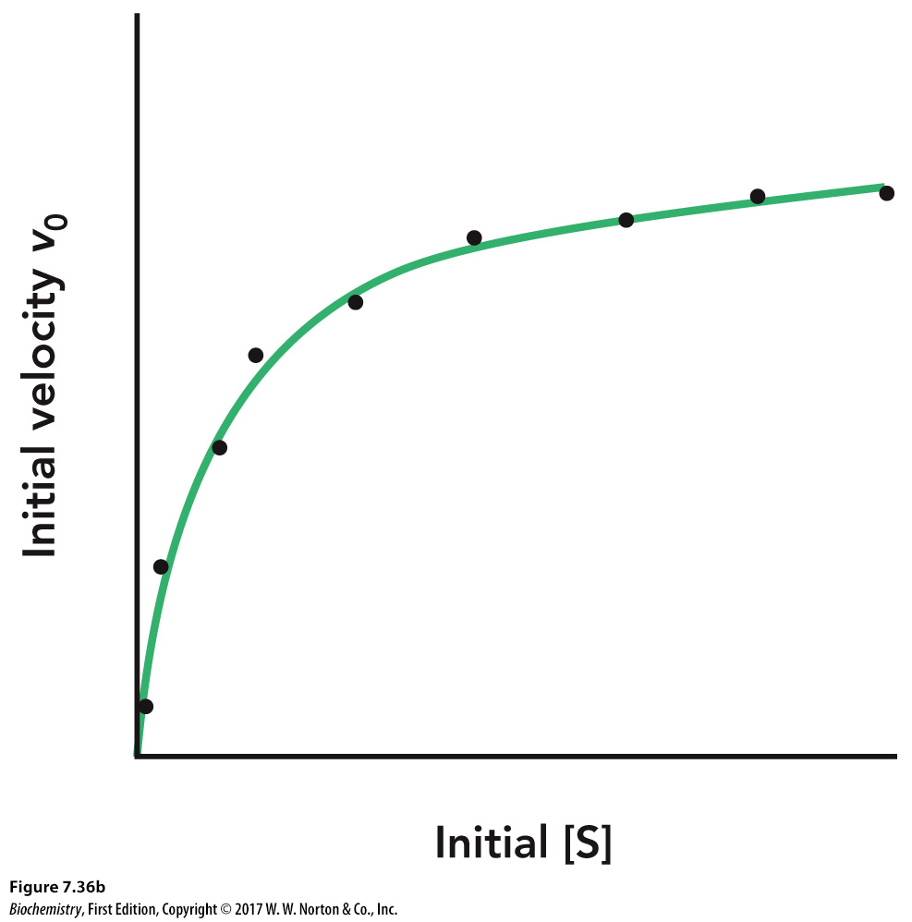
Michaelis-Menten Kinetics, Part 1

Slide 38
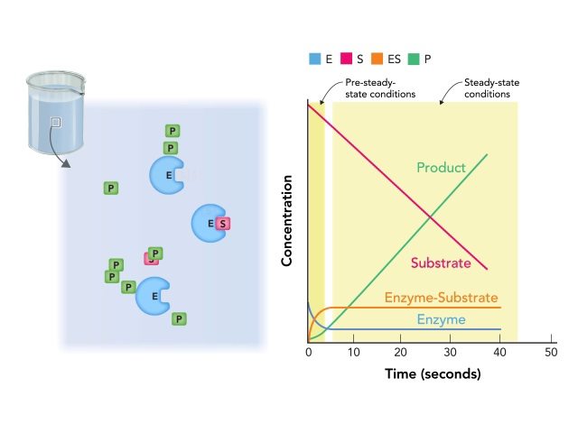
Enzyme Kinetics Animation
Click to view the Enzyme Kinetics Animation

Slide 39
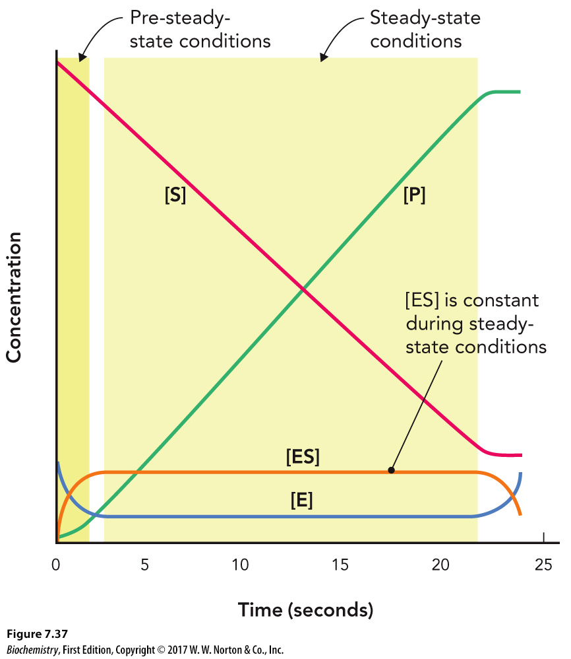
Steady-State Conditions
[ES] is constant after the initial reaction time.

Slide 40
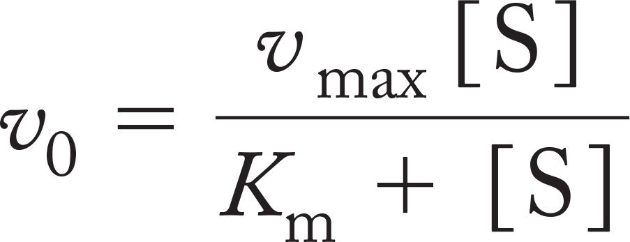
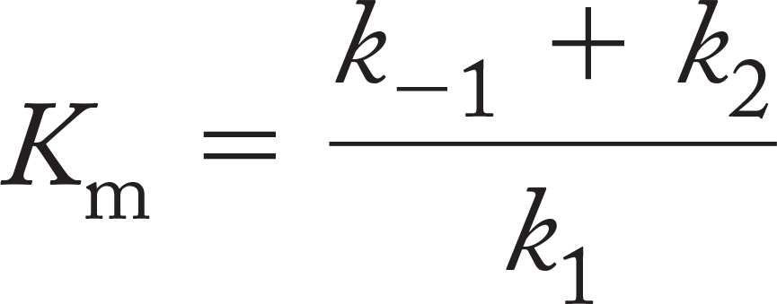
Michaelis-Menten Kinetics, Part 2
Michaelis-Menten equation

Slide 41
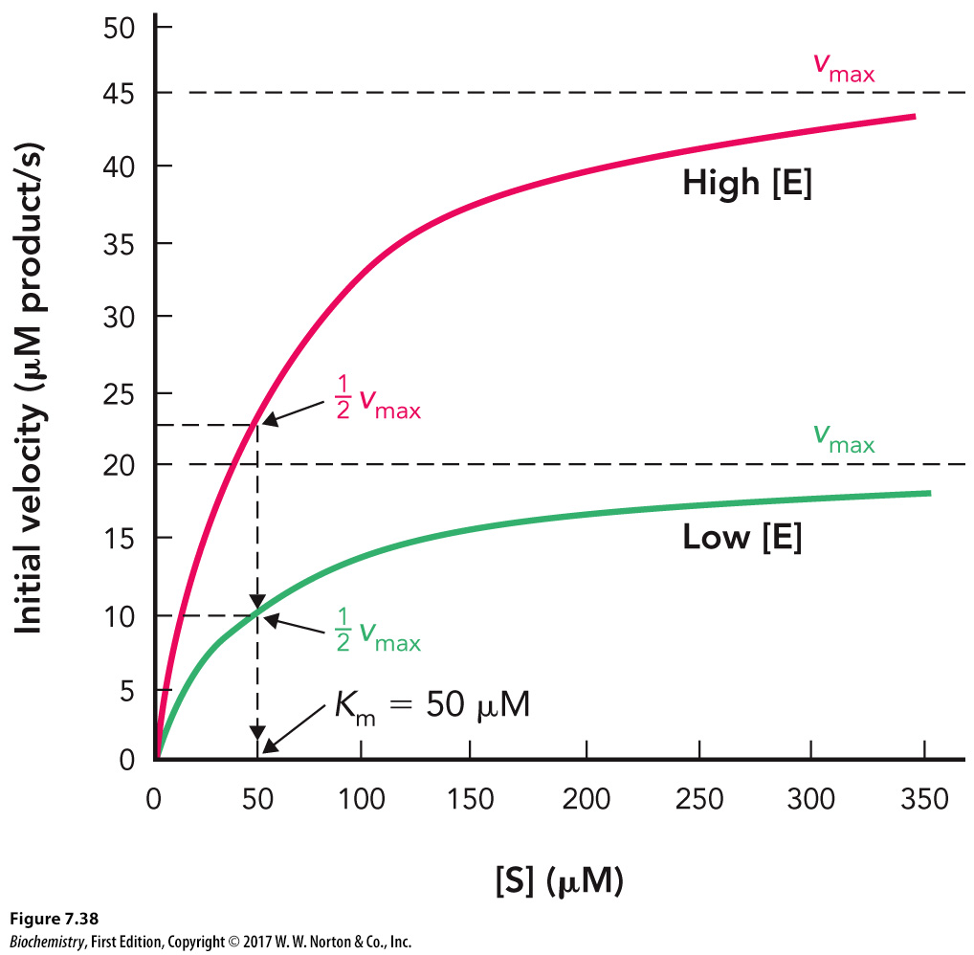
Typical Michaelis–Menten Enzyme

Slide 42
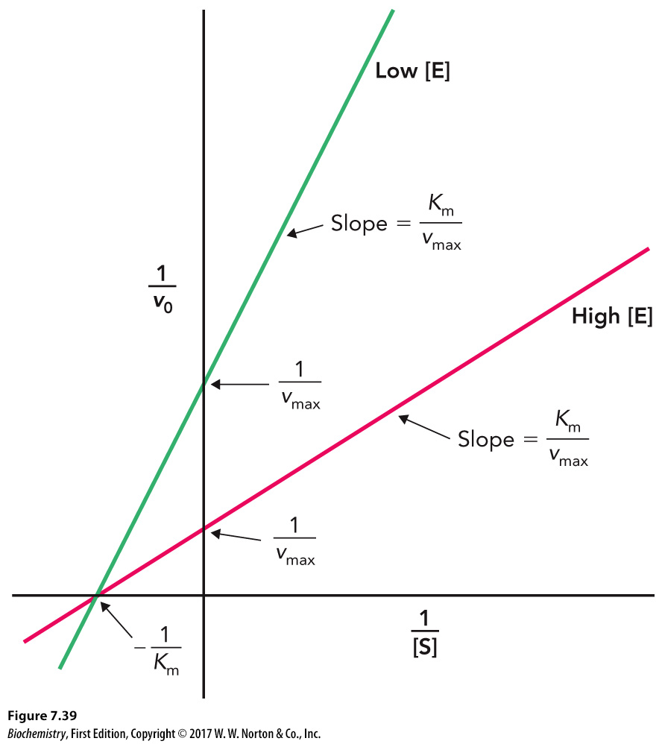
Lineweaver-Burk Equation

Slide 43
Catalytic Efficiency
Turnover number (k_{cat})

Slide 44
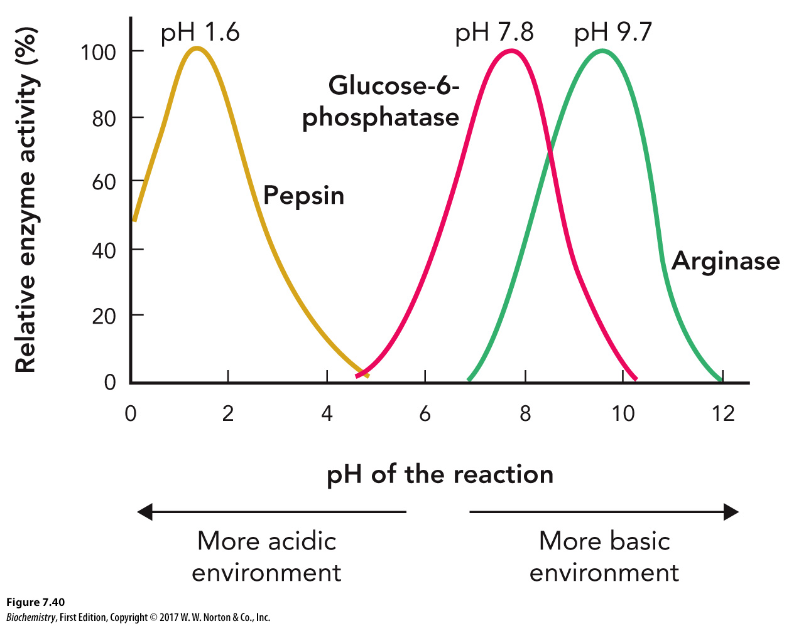
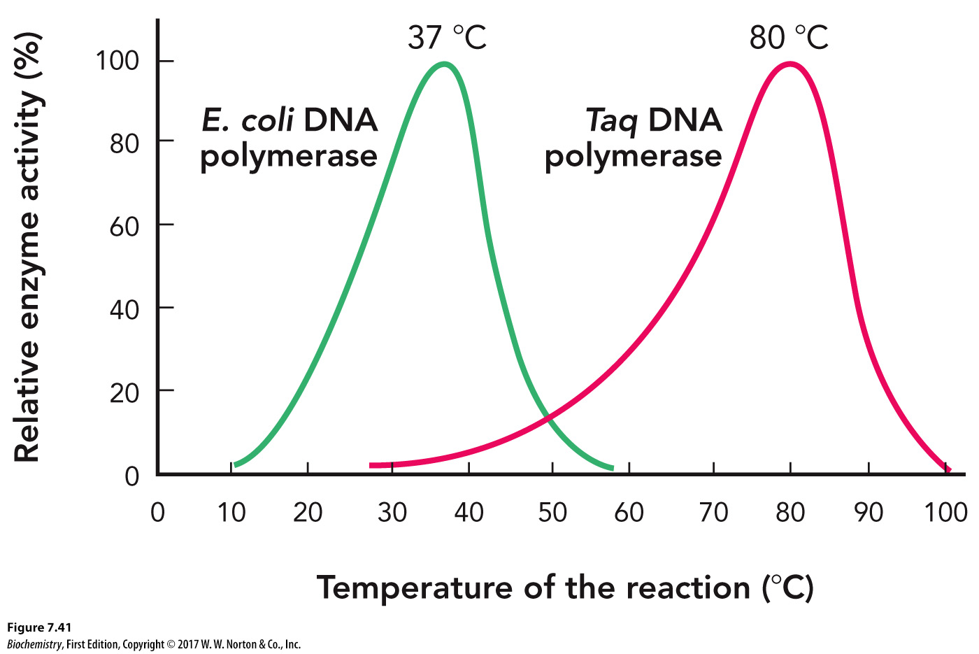
pH and Temperature Effects on Enzyme Activity

Slide 45
7.5 Regulation of Enzyme Activity

Slide 46
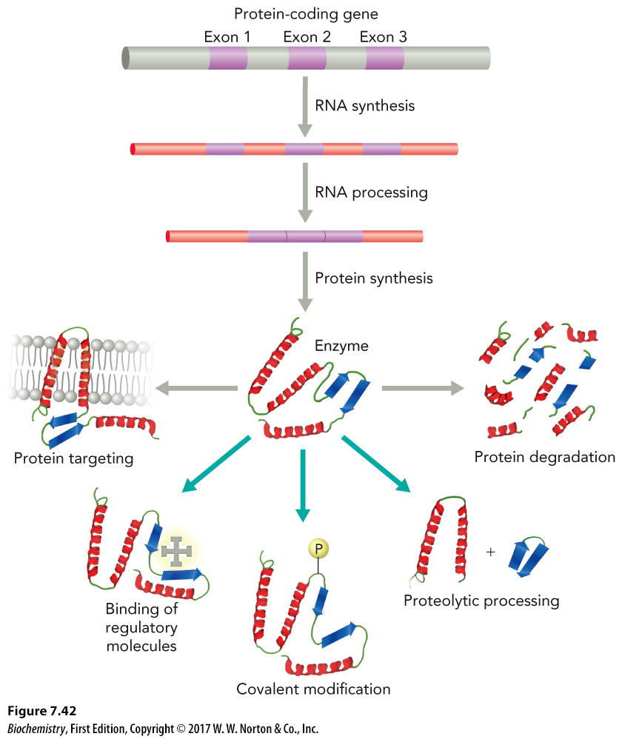
Bioavailability and Catalytic Efficiency

Slide 47
Enzyme Inhibition
Reversible
Irreversible

Slide 48
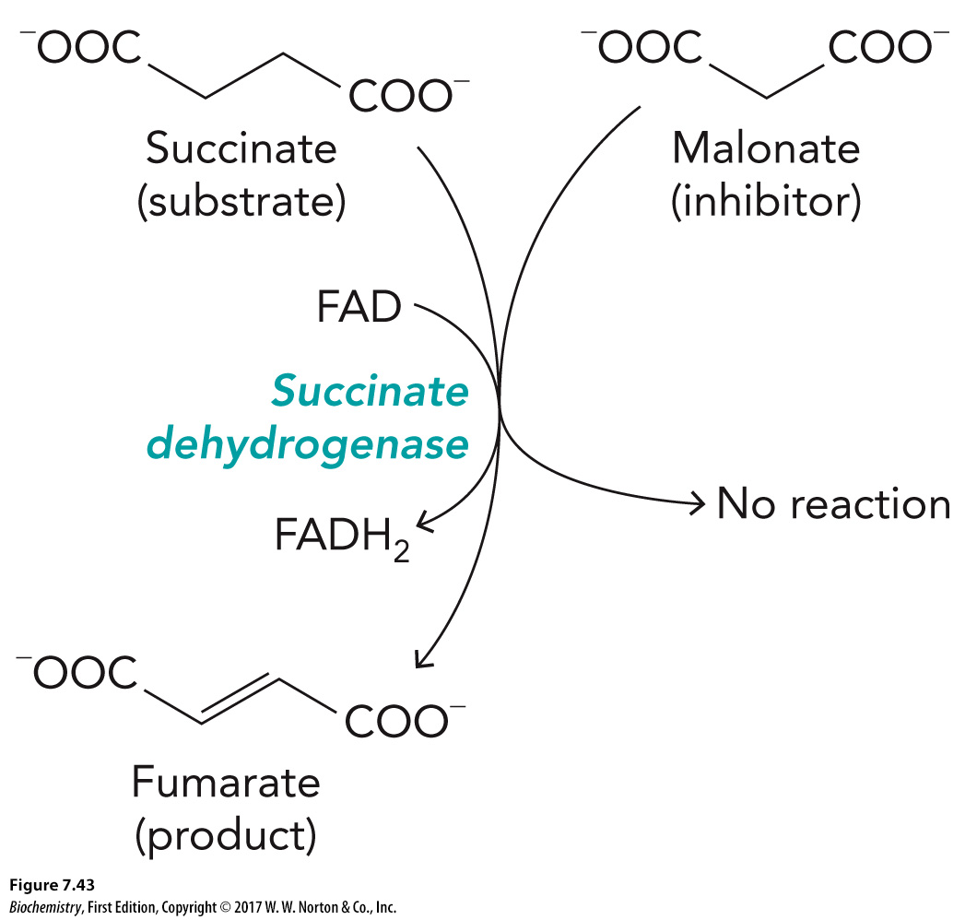
Malonate: A Reversible Inhibitor of Succinate Dehydrogenase
Competes with succinate to bind to the active site

Slide 49
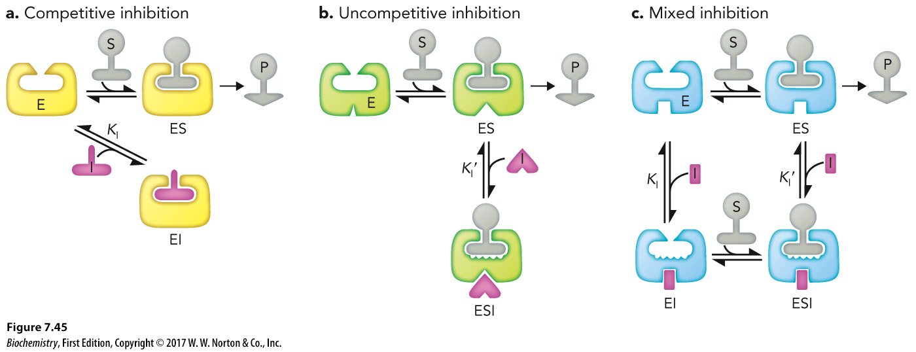
Reversible Inhibitor Summary

Slide 50
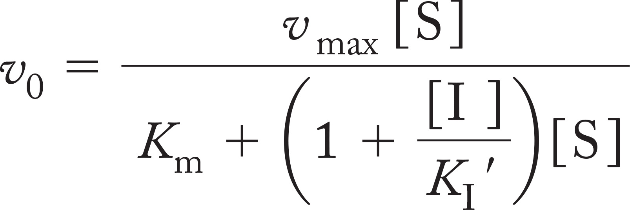
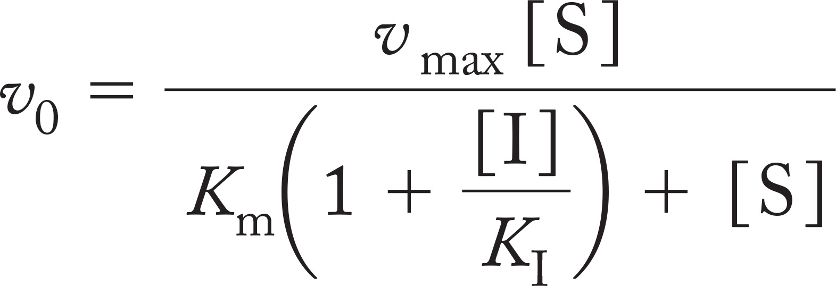
Competitive Inhibition, Part 1

Slide 51
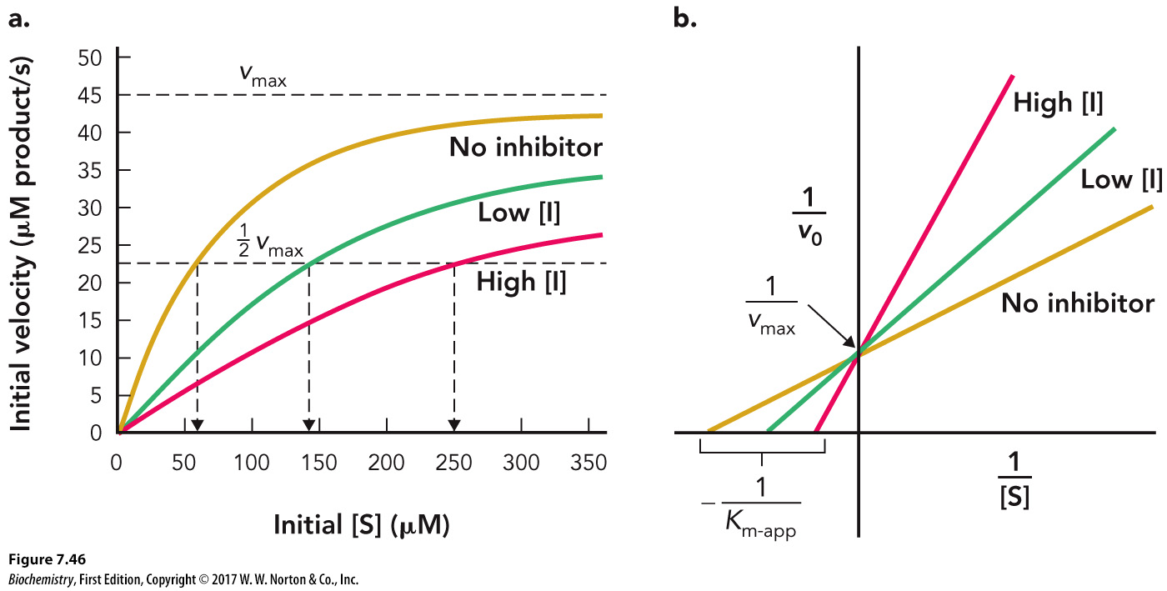
Competitive Inhibition, Part 2

Slide 52
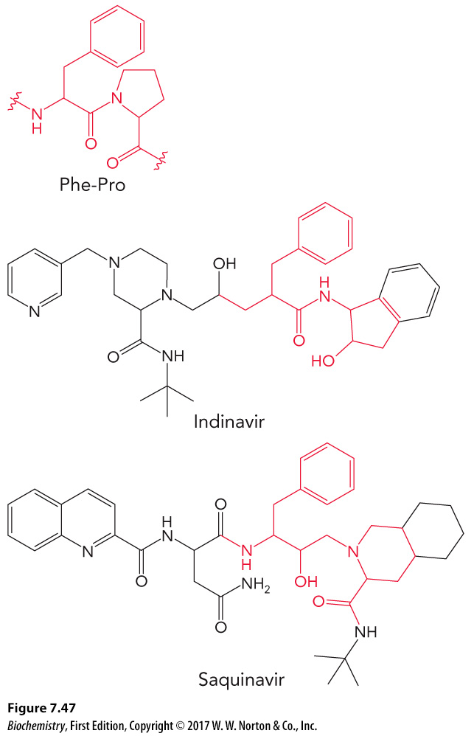
Saquinavir: A Competitive Inhibitor

Slide 53
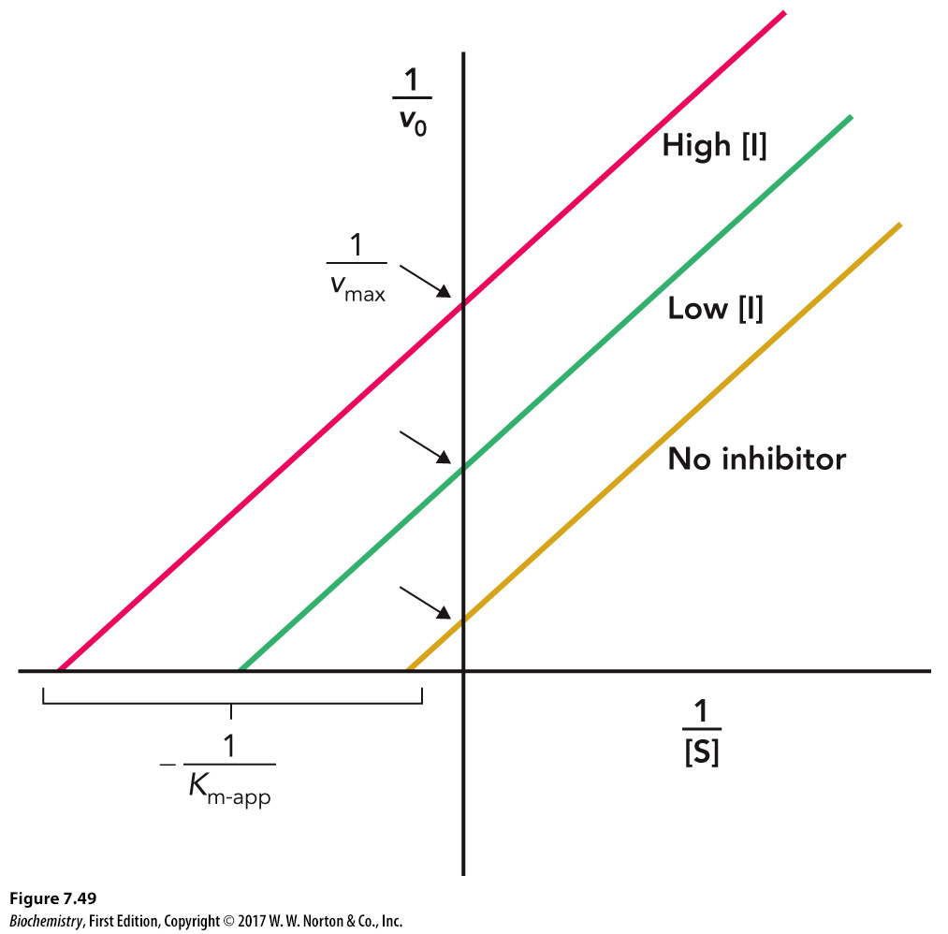
Uncompetitive Inhibition

Slide 54
Mixed Inhibition, Part 1

Slide 55
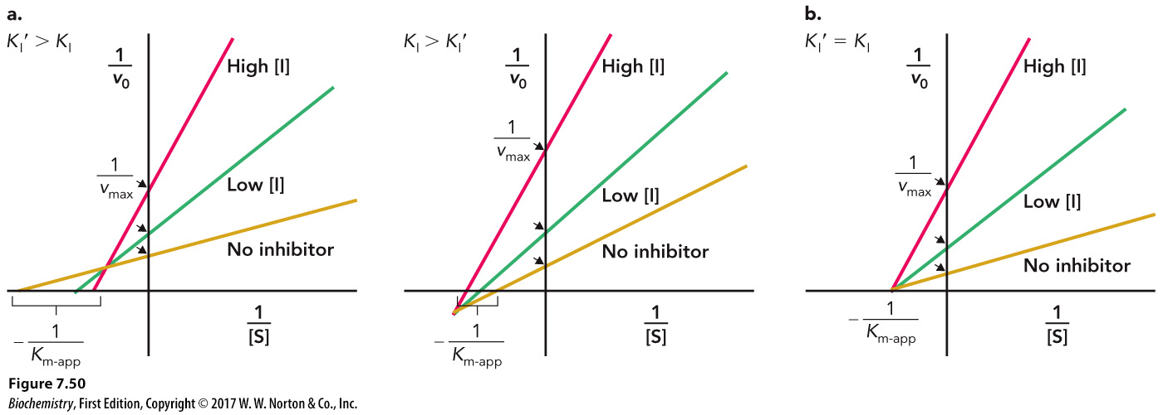
Mixed Inhibition, Part 2

Slide 56
Diisopropylfluorophosphate: An Irreversible Enzyme Inhibitor

Slide 57
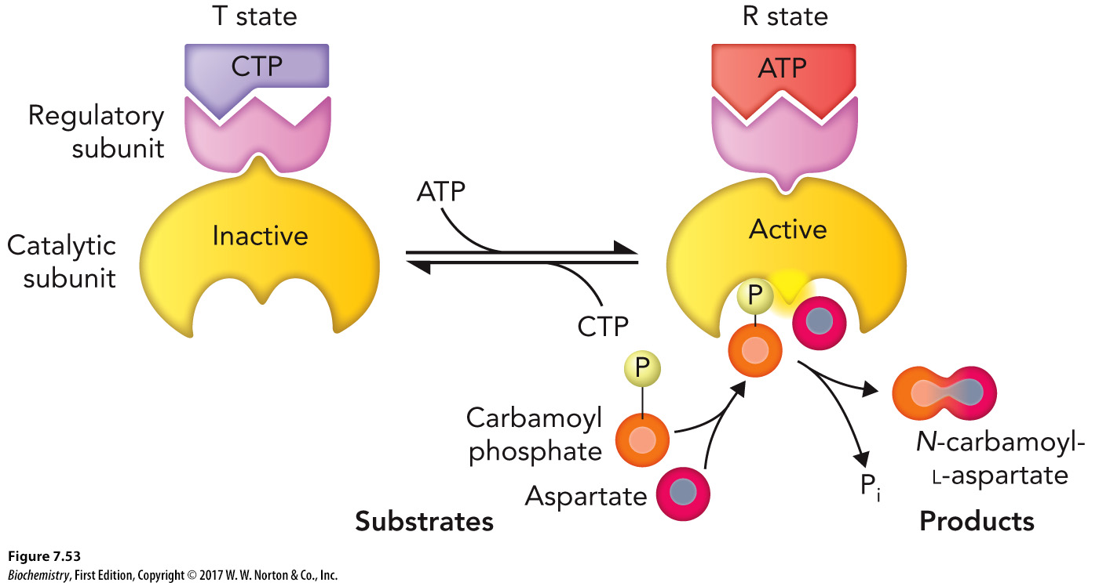
Allosteric Regulation

Slide 58
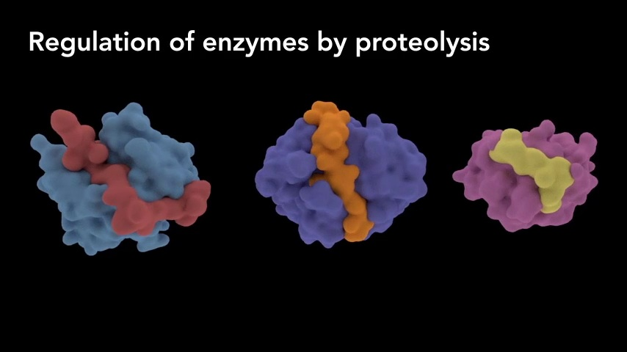
Modes of Enzyme Regulation
Click to view the Modes of Enzyme Regulation animation

Slide 59
Allosteric Regulation of Catalytic Activity

Slide 60
ATCase

Slide 61
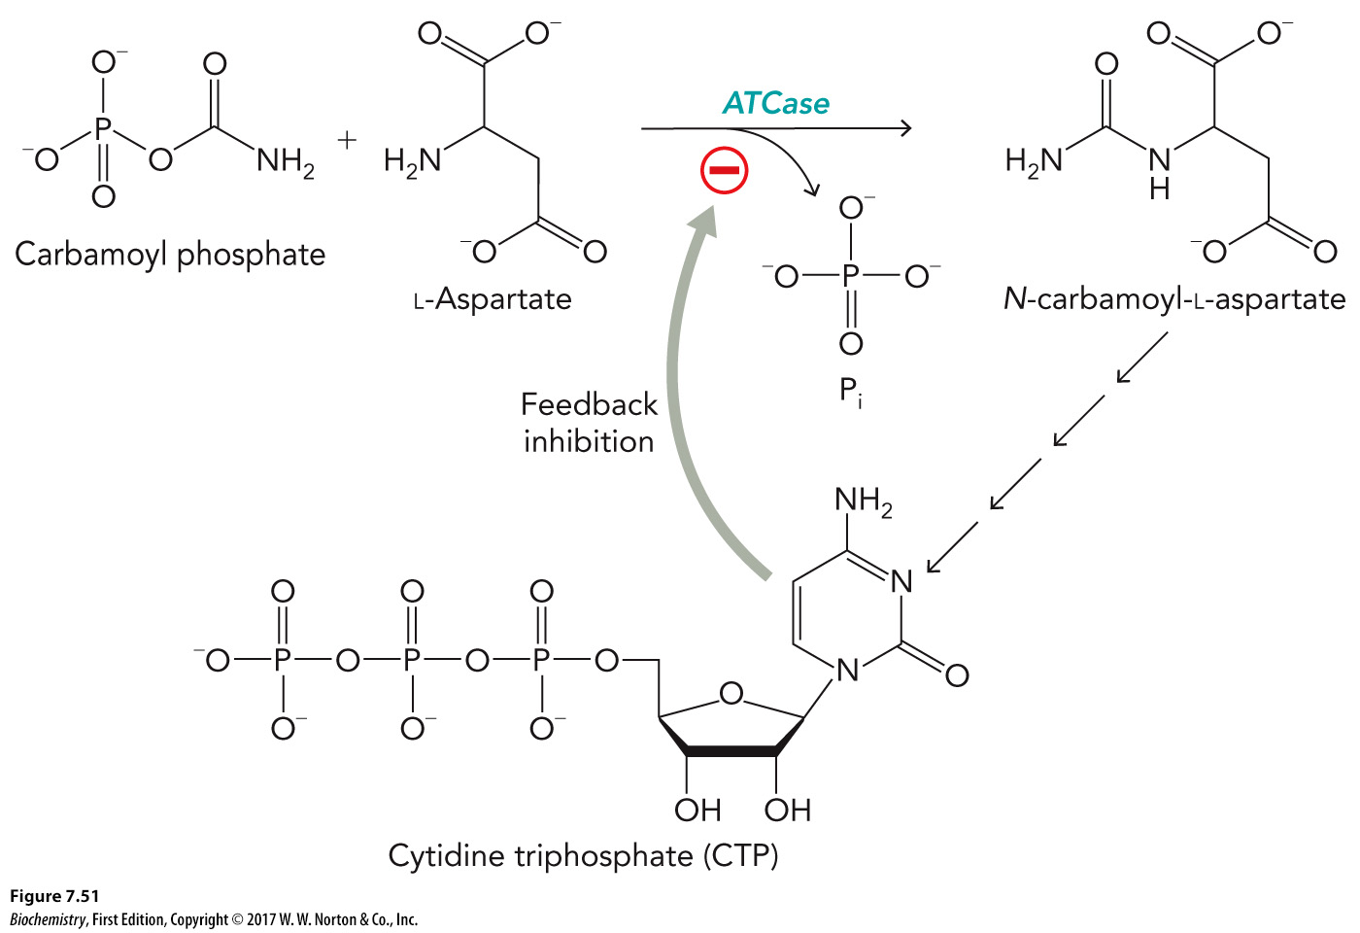
ATCase Activity

Slide 62
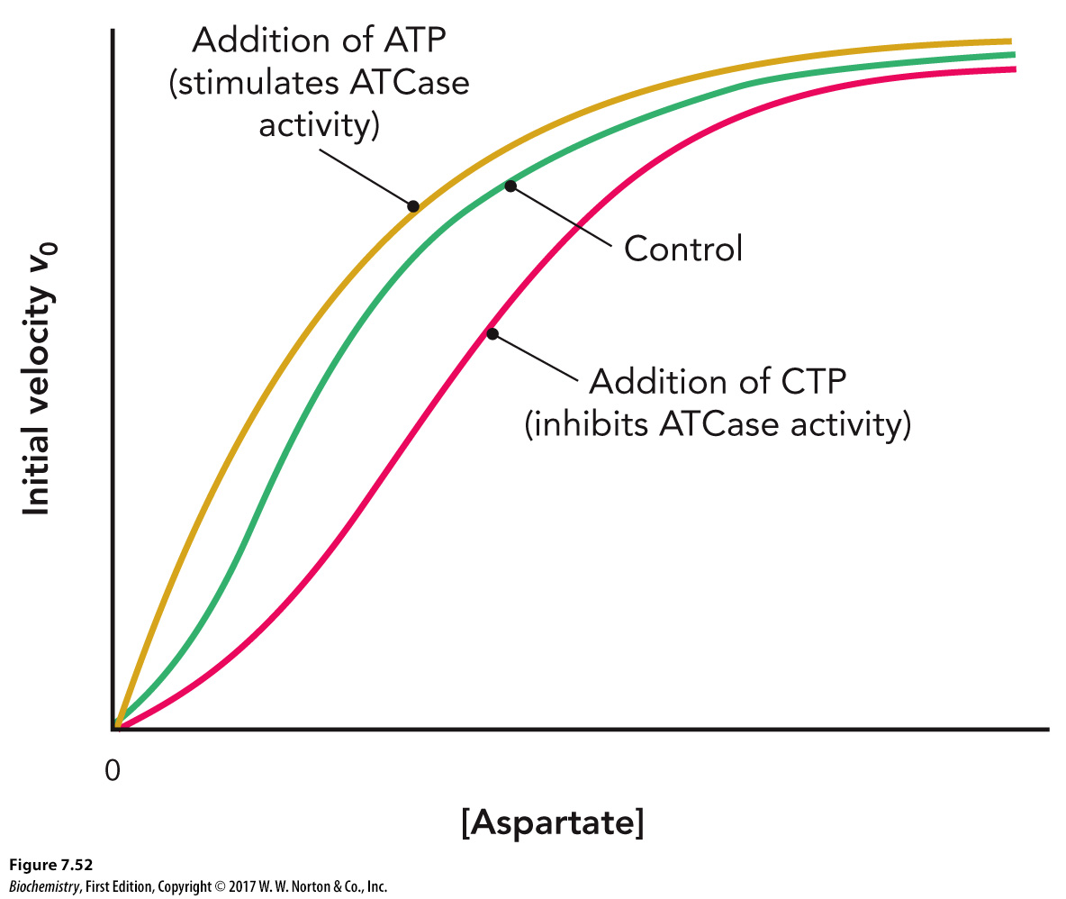
ATCase: A Cooperative Enzyme

Slide 63
Covalent Modification

Slide 64
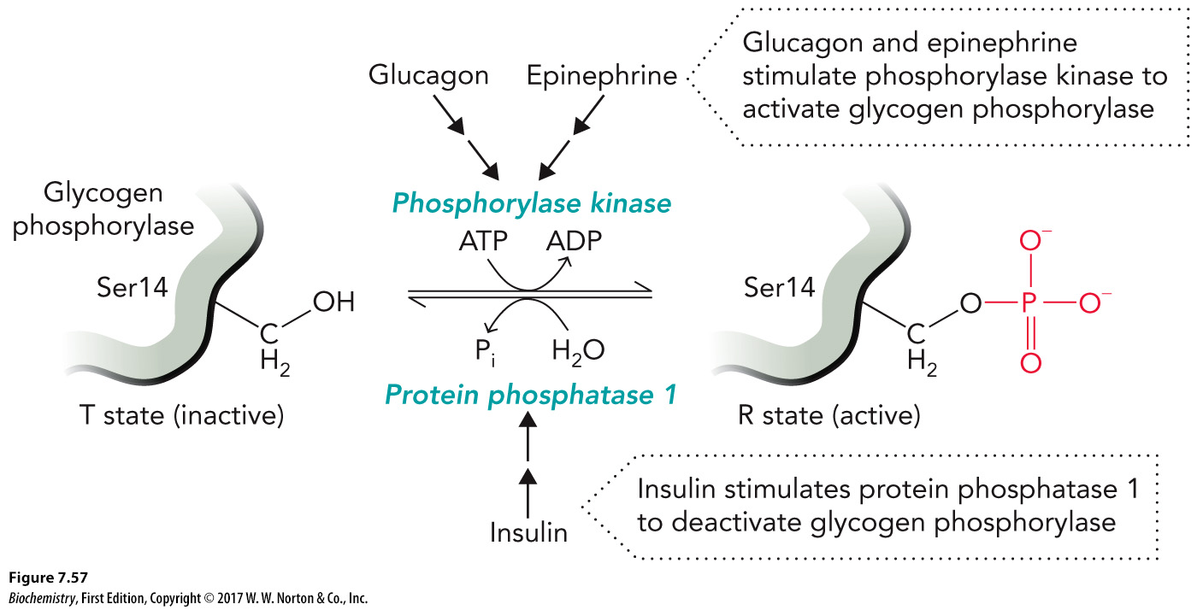
Glycogen Phosphorylase: An Example of Regulation by Phosphorylation

Slide 65
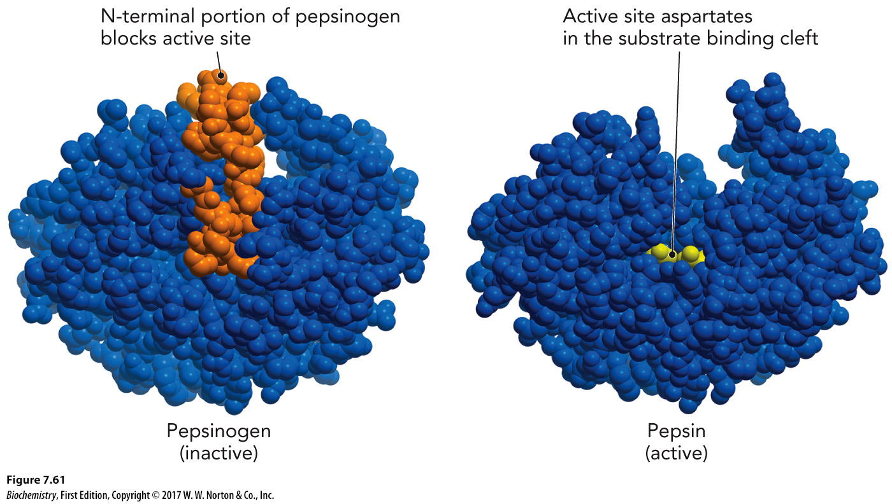
Enzyme Activation via Proteolysis
Zymogens – inactive precursor proteins
Become active upon cleavage

